Slide 1
Philmont Scout Ranch
One Philmont -
Many Opportunities
Tom Baltutis
tfbaltutis@gmail.com
Philmont Ambassador
Communications Coordinator
August 2021

Slide 2
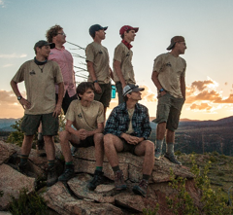
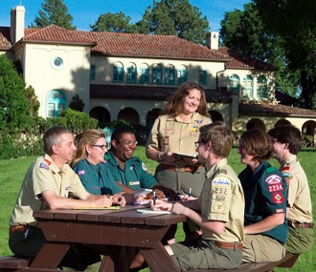
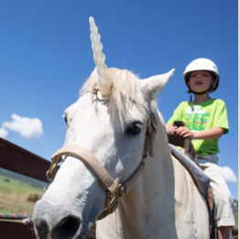
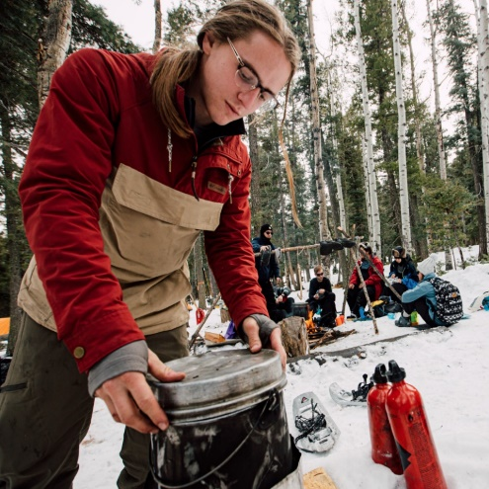
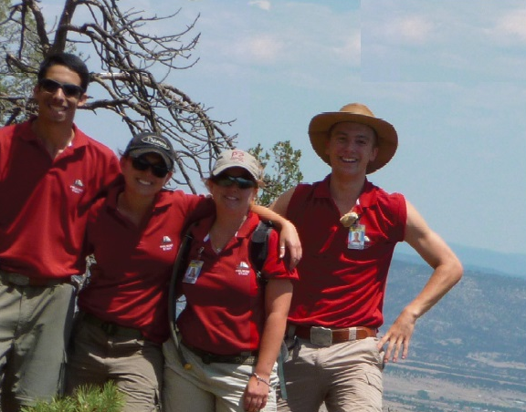
One Philmont – Many Opportunities
Crew Treks
Individuals
Training Center
Family Adventure
Off-Season Adventures
Jobs
Notes:
I’ll be covering a number of topics about Philmont. Philmont is famous for Treks, but there are also Individual Opportunities that let you experience the backcountry especially if you don’t have a Troop or Crew to go with. The Philmont Training Center provides Scout Leaders an opportunity to learn more about the Scouting program so they can better serve youth in their area. A newer program called Family Adventure Camp gives families an opportunity to vacation at Philmont. Philmont is also open year-round for off-season adventures. All these programs require the help of a lot of staff, and Philmont is always looking for good people to provide program to visitors, so I’ll touch on that as well.

Slide 3
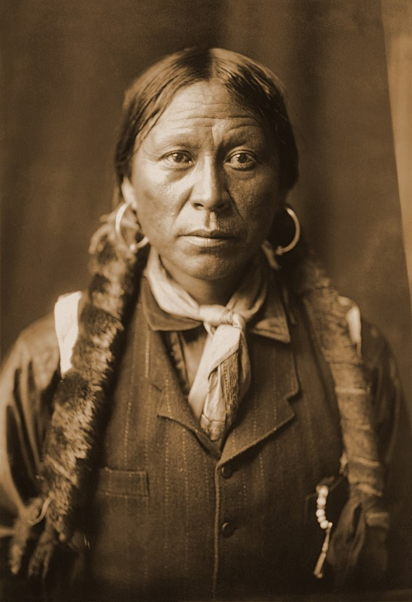
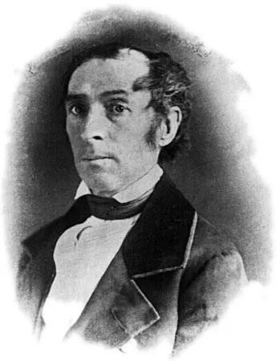
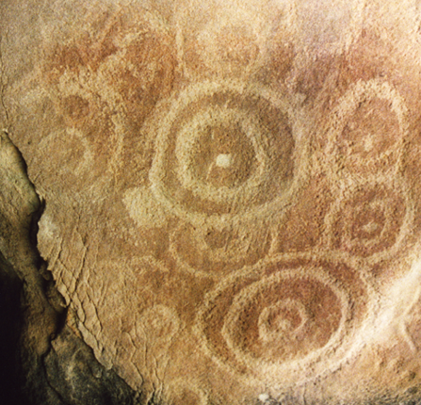
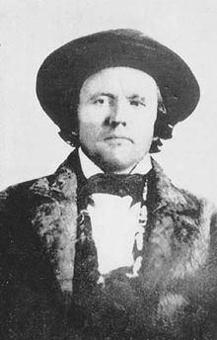
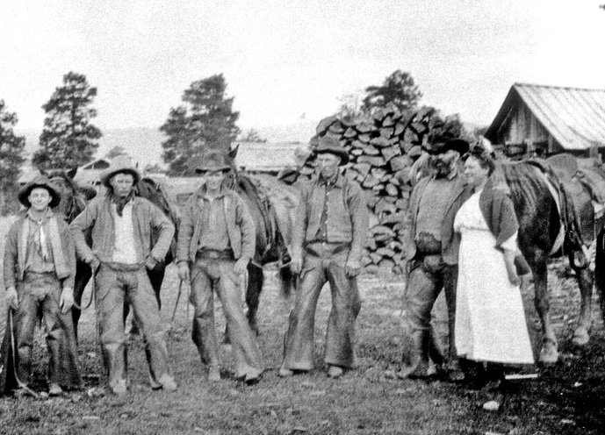
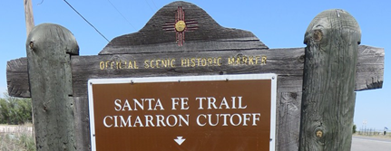
But First, Some History
Notes:
The Philmont area abounds with history, from ancient peoples who left their mark on the rocks, to native Jicarilla (Hee-kah-ree-yah) Apache and early Mexican settlers. Carlos Beaubien, originally a fur trader from Quebec, obtained a very large land grand from the Mexican Government in 1841 that included the site of Philmont. The Santa Fe trail passed right through Philmont, and wagon ruts are still etched into the landscape. The famous frontiersman Kit Carson once made his home here. Later, gold miners, loggers, ranchers and homesteaders came this area of New Mexico.
The nearby town of Cimarron was a real part of the Wild West. The St. James Hotel (formally Lambert’s Inn), was host to such notables as Wyatt Earp, Bat Masterson, Jesse James, Black Jack Tom Ketchum, Annie Oakley, Buffalo Bill, Fredrick Remington, Governor Lew Wallace, and Zane Grey. Bullet holes from gunfights can still be seen in its walls.

Slide 4
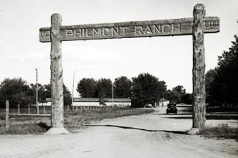
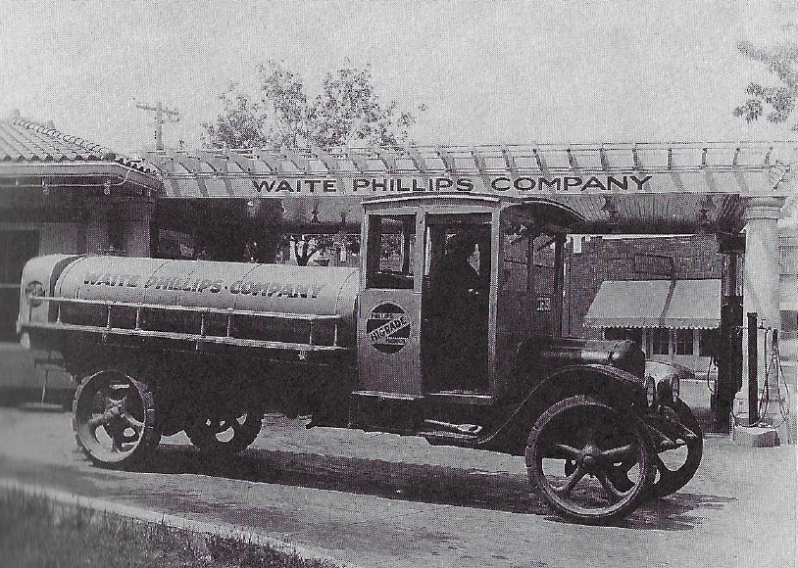
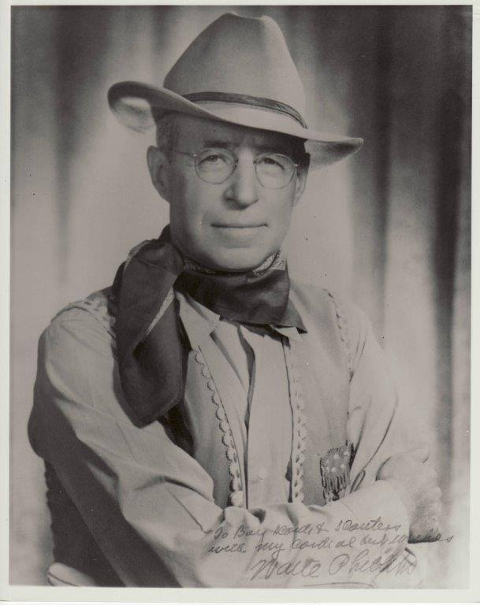
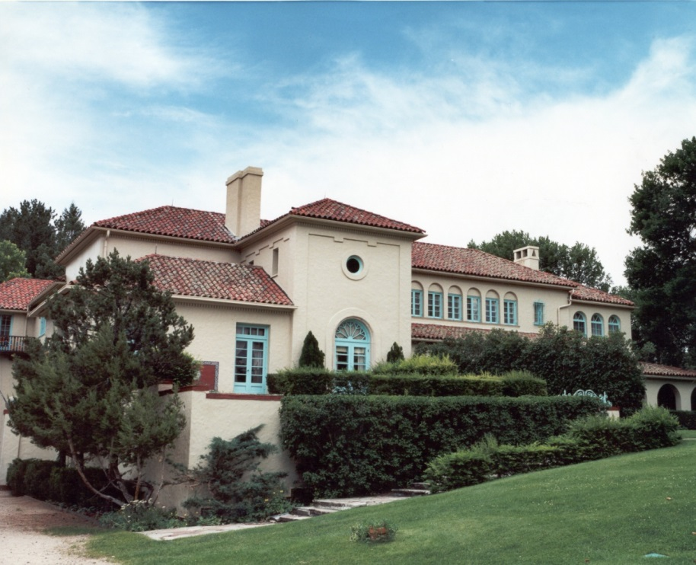
Waite Phillips
Notes:
Waite Phillips was an Iowa farm boy who roved the West with his twin brother Wiatt. After Wiatt’s death from appendicitis in 1902, Waite moved back to Iowa and later to Oklahoma to join his other brothers in business. They became successful oil men, and his elder brother Frank founded the Phillips Petroleum Company with its trademark Phillips 66 gasoline.
Waite founded his own successful oil company which he eventually sold 1925 for $25 million. He built a mansion in Tulsa and acquired a 300,000 acre ranch in New Mexico where he had his summer home. There, he could enjoy riding the range, hunting and fishing in the mountains, and entertain his friends.

Slide 5
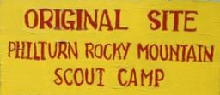
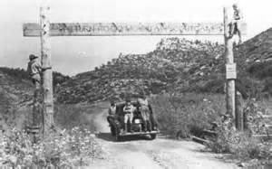
A Generous Donation
“These properties are donated and dedicated to the Boy Scouts of America for the purpose of perpetuating faith, self-reliance, integrity and freedom….
Waite Phillips, December 31,1941
Notes:
Troops from the newly formed Boy Scouts of America approached Mr. Phillips asking to camp on his land. Waite learned more about Scouting and admired its principals embodied in the Scout Oath and Law. His first donation of nearly 36,000 acres in 1938 was put to such good use that he donated an additional 91,000 acres in 1941. The first camp was named Philturn for Phillips and the Scouts’ “Good Turn”. Over his lifetime, Waite Phillips gave half his fortune to charity.
Today, Philmont Scout Ranch is now one of the four national high adventure bases of the BSA. It is famous for backpacking trips in the Sangre de Cristo (Blood of Christ) Mountains for scout crews. However, Philmont offers many more Scouting opportunities than Treks which I’ll be talking about later in this presentation.

Slide 6
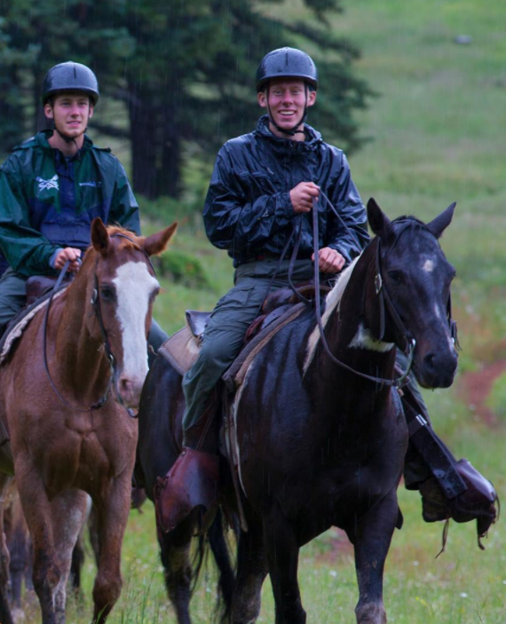
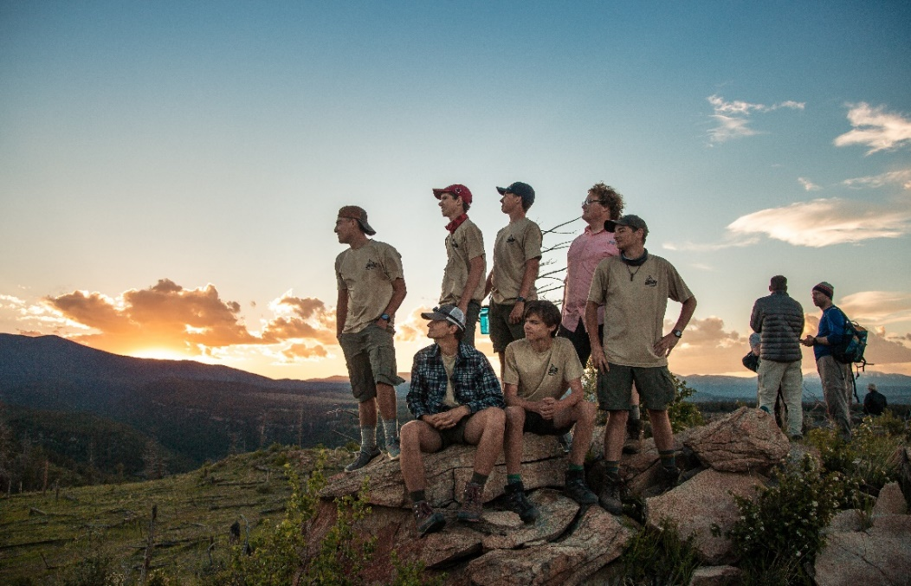
Philmont Unit Programs
Notes:
Philmont has developed several programs for Scout groups. Principal among them are high adventure expeditions, commonly known as Treks, and Cavalcades which are essentially treks on horseback. Scout Councils can put together contingent crews made up of scouts from several units, or individual Units can form their own crews.

Slide 7
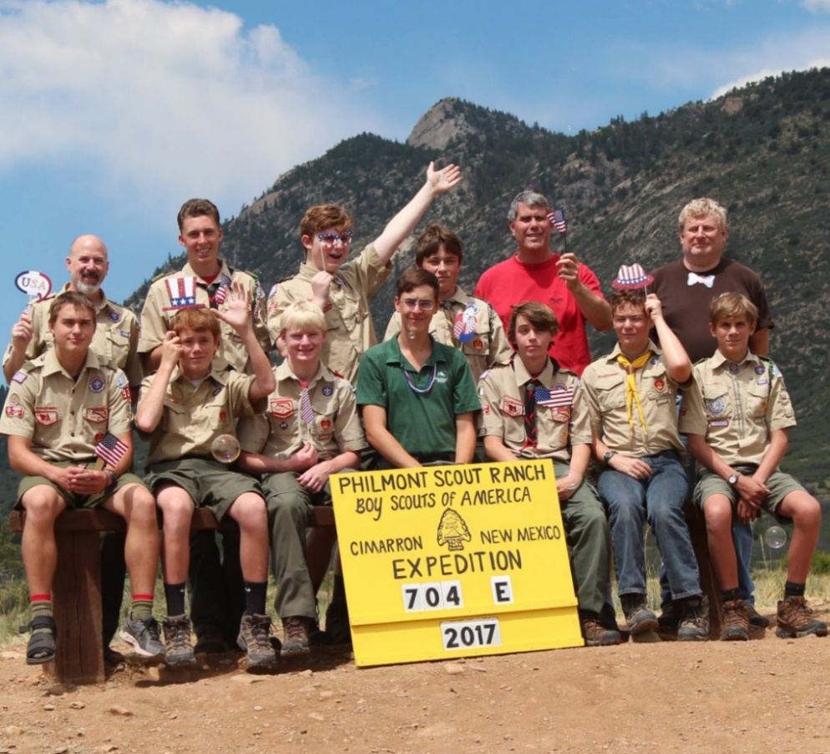
Crews
8 to 12 members
Youth led
Majority under 21
Two adult advisors over 21
Co-ed advisors if necessary
Notes:
Trek crews are made up of 8 to 12 people, a majority of which must be youth. The minimum age to go on a Trek is 14 (or 13 and having completed 8th grade). The maximum age for Scouts BSA Troops is 18. The age limit for youth in Venturing, Exploring and Sea Scouts is 21.
A youth Crew Leader is selected by participants, and he or she will be responsible for organizing the crew, assigning duties, making decisions, and recognizing the capabilities of each crew member.
A minimum of two adult advisors over 21 are on each crew. Co-ed crews need both male and female adult advisors over 21. The main responsibility of the adult advisors is crew safety. They positively support the Crew Leader and let them manage the crew.

Slide 8
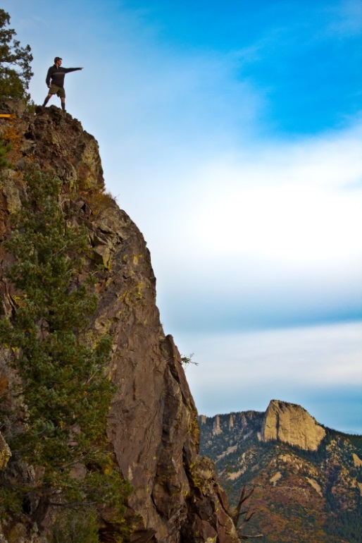
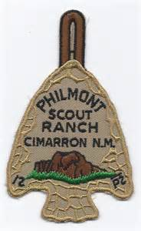
Philmont Treks
Mountain backpacking
50 to over 85 miles
Variety of camping
Fantastic scenery
Many activities available
Notes:
A Philmont Expedition, commonly called a Trek, is often the highlight of a Scout’s experiences. Scouts backpack with their crew through mountainous terrain on itineraries rated challenging, rugged, strenuous and super strenuous from 50 to 85 plus miles over 12 days. Backcountry camps range from wilderness areas with no water available, so scouts learn conservation principals to staffed camps with potable water and even showers.
Along the way, trekkers will have great scenery and be able to participate in many activities.

Slide 9
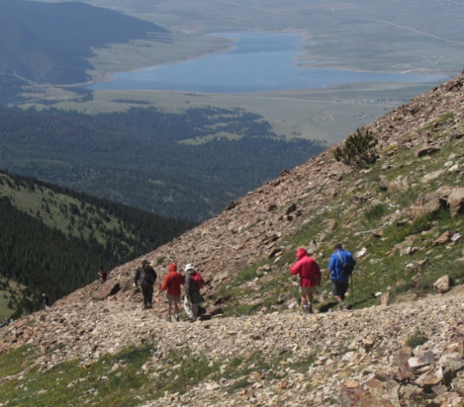
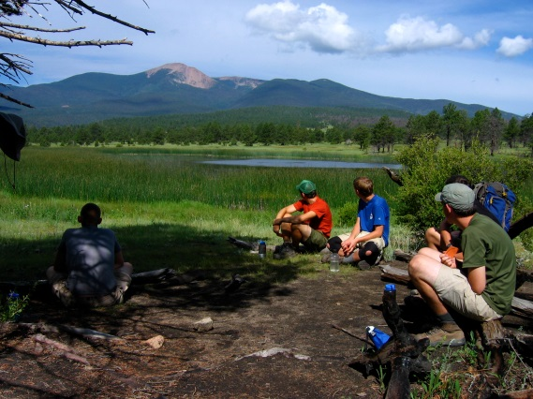
Short Treks – 7 or 9 Day
Fits one-week vacation schedule
Just as adventurous
Notes:
Many Scouters may not have two weeks vacation for a Trek. Short Treks provide them with an alternative. Seven-day treks begin and end on a weekend, so they fit in with vacation schedules.
As with all Treks, the difficulty rating and activities are your choice, but match your route to your Unit’s capabilities and interests.

Slide 10
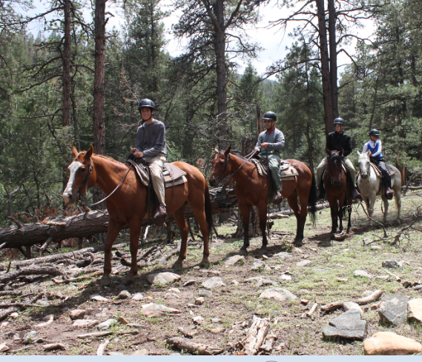
Cavalcades
8 days
10 to 15 people
200-pound weight limit
Drawing held in January for following summer
Notes:
Cavalcades are treks on horseback. There is a minimum of 10 per cavalcade, so if you don’t fill the Cavalcade, you will be charged for the other slots. It’s good to reach out to other units to fill any Trek to the max.
There is a 200-pound limit for the safety of the horses that also applies to everyone on the trek, including adults.
Cavalcades visit the same camps and have activities along the trail much like Treks. At the end of their trip, riders participate in a Gymkhana which is a friendly horse-riding skills competition.

Slide 11
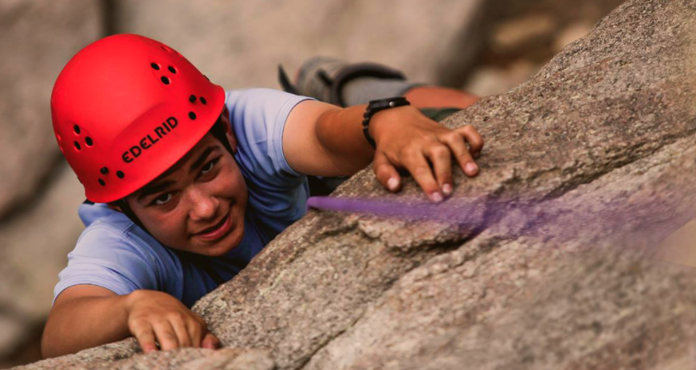
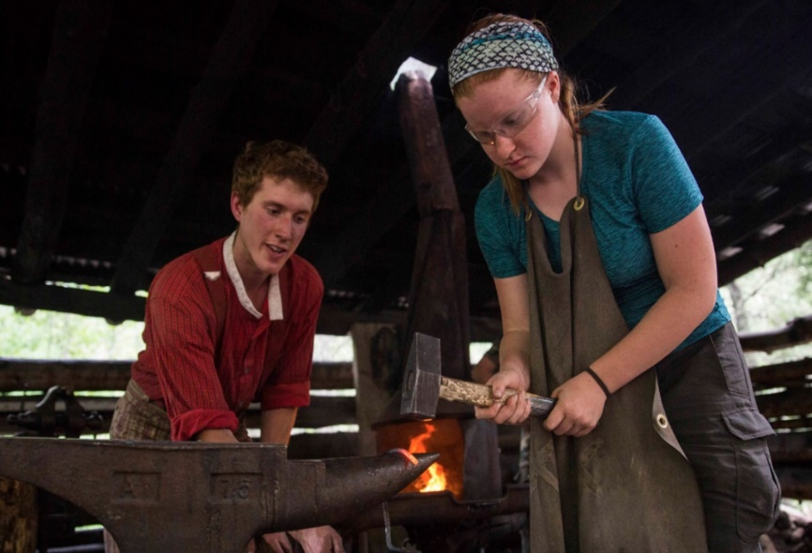
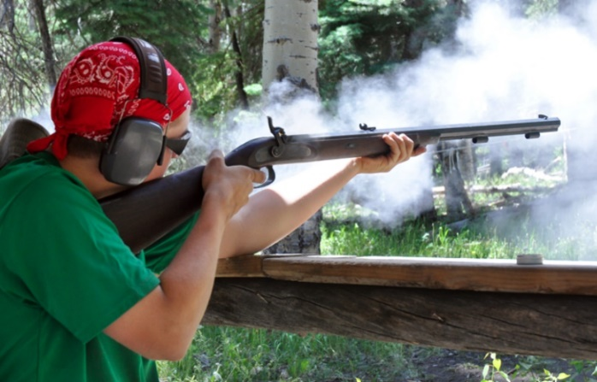
Program Camps
Notes:
What makes Philmont unique is the number of program camps that crews visit along their route. Scouts get to have fun rock climbing, rifle shooting, blacksmithing, spar pole climbing, horse riding, gold mining, and many more such activities in the backcountry. Philmont camps teach the history of the American West through a wide variety of interactive programs. More modern activities include mountain biking and ATV riding.
Philmont has numerous itineraries to choose from so your scouts get to select the combination of trail length, activities and sights that interest them the most.

Slide 12
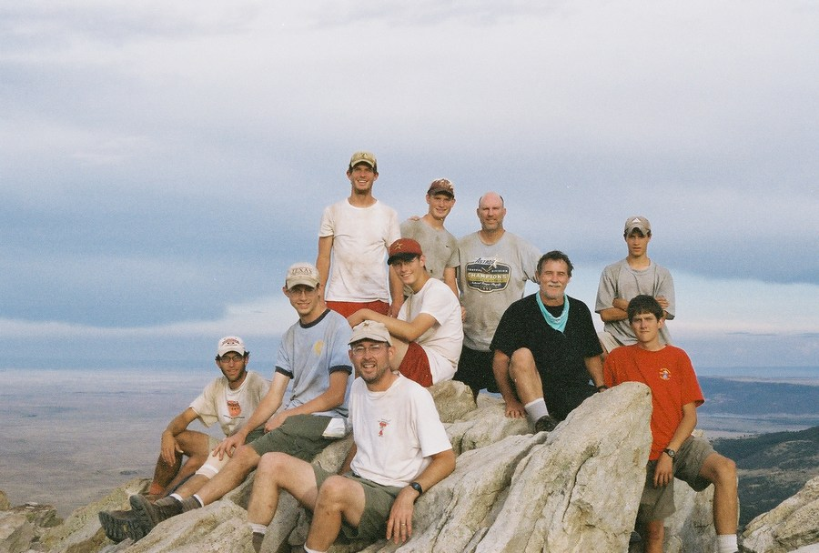
Council Contingents
45% of Treks
Crews:
Single unit
Individuals
Combinations
Notes:
Council contingents make up 45% of Philmont Trek crews. Some councils assign their Trek slots to a unit through an application process. Others make up contingents of scouts from several units. Check with your local council to see how they fill their allotment.

Slide 13
Unit Registration Process
Lottery October to November
Gives you time for training and fundraising
or
Watch Philmont site for open Trek slots
Notes:
Individual units can get a slot for a Trek through a lottery held by Philmont each fall. Registration for the lottery begins in October 18 months prior to the Trek. It costs nothing to enter the lottery, but only one bid per unit is accepted.
It’s important to include younger scouts in your long-range planning process because they may be the ones leading their Trek in a few years.
The long lead time before you trek helps you get ready through team-building, practice backpacking trips and fundraising.
If you are unsuccessful getting a lottery slot, don’t give up. Check the Philmont web site for openings that occur if a crew has to drop out for whatever reason. These slots are available on a first-come, first served basis.

Slide 14
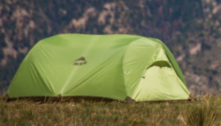
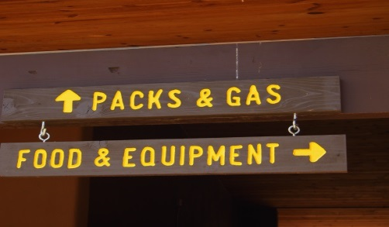
Backpacking Equipment
Free from Philmont (except packs)
Can bring you own
Any combination OK
Notes:
Many troops may not have backpacking equipment, because it is a big investment for a scout. Philmont can provide you with all the crew essentials. Philmont gear is durable, so it can be a bit heavier, but it has been proven to stand up to the rigors of the backcountry. You can bring all your own gear or mix what you have with Philmont gear. Philmont also can provide MSR stoves, so you do not have to cope with shipping fuel.
If you choose to use Philmont tents, be sure to bring your own stakes!
The one piece of Philmont-provided equipment that you must carry is their bear bag and rope. Your Philmont Ranger, who accompanies you for your first days on the trail, will teach you backcountry essentials along with bear safety procedures.

Slide 15
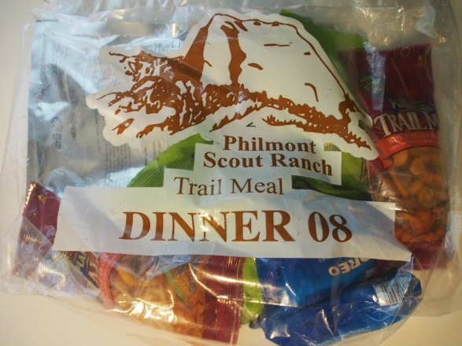
Trail Food
Provide all the calories you need
Pick-ups/2 – 3 days
Swap boxes at staffed camps
Notes:
Philmont provides meals that give you all the calories you’ll need each day of your Trek. Each food packet feeds two people.
Cooked one-pot dinners are designed to be eaten with a bowl and spoon, so you don’t need to haul lots of eating utensils. Commissaries along your route re-supply you with provisions. Some commissaries have trading posts where you can purchase supplies like extra fuel or batteries.
Be sure to have packs large enough to accommodate all the food you’ll be carrying. For a crew of 12, a three-day supply of food will be 54 packages. Each package is about the size of a liter water bottle.
Staffed camps have food drops where you can swap out meal components or pick up extras.
If you have special needs, Philmont will work with you to accommodate your diet.

Slide 16
Expect Weather
Days
75 – 95 F
Cool AMs
PM Showers possible
Nights
40 - 55 F
Temperature drops fast at night
Occasional night showers
Notes:
You will be in the high country where the weather can change frequently. Be Prepared. Don’t bring just a poncho! Summer weight sleeping bags may not keep you warm at night because the temperature drops fast in the mountains once the sun goes down.

Slide 17
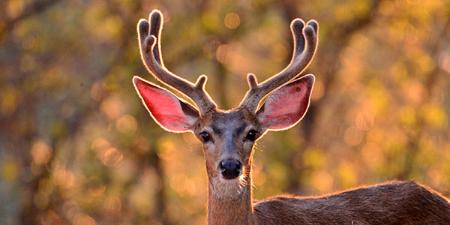
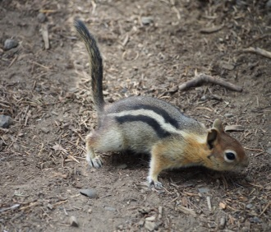
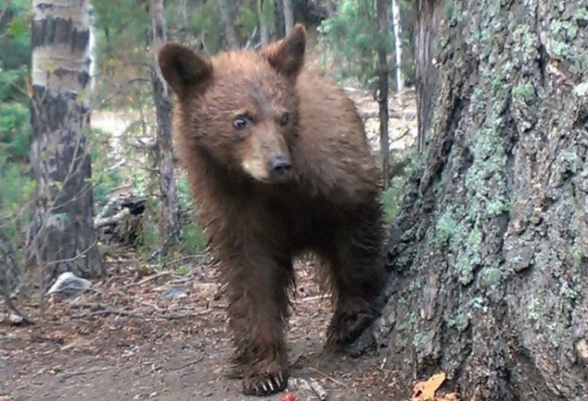
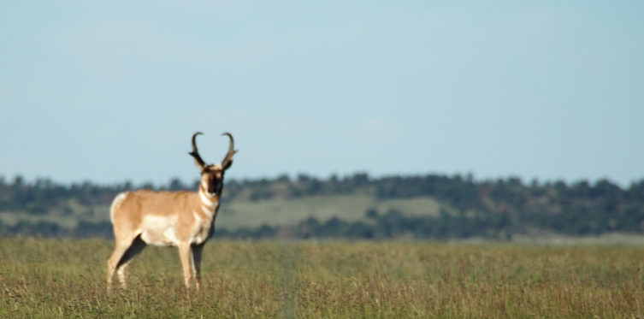
Encounter Wildlife
Notes:
Wildlife is abundant on the ranch. Mule deer are plentiful, and so are mini-bears (chipmunks) which can be as destructive to packs and food as real bears. Philmont has pronghorn, elk, black bears, bison, and mountain lions along with smaller animals like racoons, beaver and jackrabbits. Golden eagles, red-tail hawks, magpies, jays, and hummingbirds can be seen on the fly. Be aware that you also share the backcountry with snakes and spiders.

Slide 18
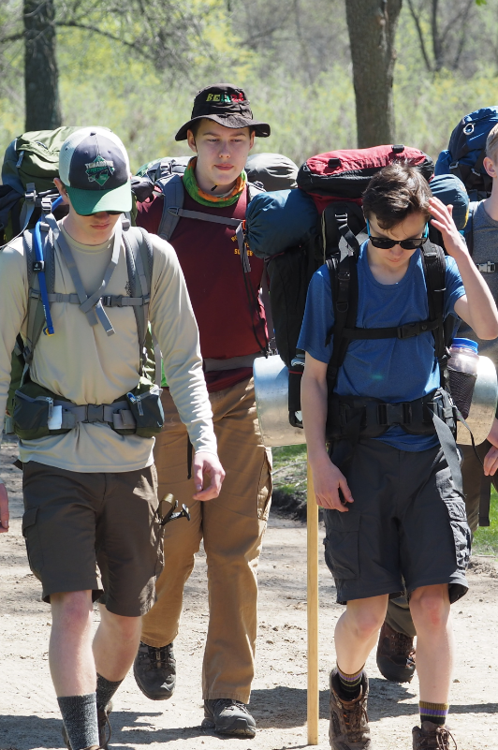
Words of Wisdom
Get in shape!
Read everything Philmont sends you
Have extra adult on-deck
Make it affordable
Notes:
There is no substitute for getting in shape by doing backpacking trips or long hikes with your full pack on. You don’t need mountains - just hike! Be creative in your local area. You can do multi-day backpacking trips at a state park and make multiple loops.
Have an extra adult willing to go so that if one drops out, you still have two-deep leadership. You might also plan on three adults or two female and two male for a co-ed crew.
“A Scout is Thrifty” Driving may be the least expensive way to travel if you have time. Economize by camping along the way, staying at churches or military bases. Most bases are happy to accommodate scout crews.
Philmont will pick up crews at the Amtrak station in Raton, NM. The train makes long-distance travel easy and saves overnight accommodation costs along the way. Amtrak loves Scouts!

Slide 19
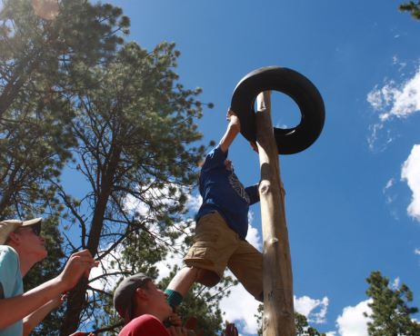
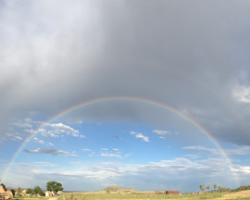
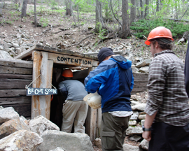
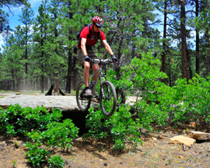
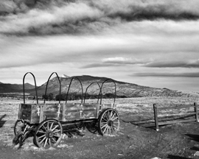
Why Philmont?
Places
People
Program
Notes:
You might say that you could go on a long backpacking trip to lots of area. What you’ll miss out on is the camaraderie of fellow Scouts on the trail, the carefully planned routes and beautiful scenery Philmont provides and the activities that you will get to do on your Trek
People, places and program make Philmont a ‘once in a lifetime’ experience for scouts and adults. Combined, they provide an experience like no other on earth.

Slide 20
Financial Assistance
Ask your council
Find local donors
Check with Philmont
Notes:
There are costs associated with a Philmont trek, but don’t let lack of funds stand in the way of a youth attending Philmont. You’ll have over a year to do fundraising to support your trip. Backpacking gear makes great birthday and holiday presents.
Scholarships may be available through your council, Philmont, or by appealing to local donors.
Scholarships are also available if you need help in going to Philmont Training Center.

Slide 21
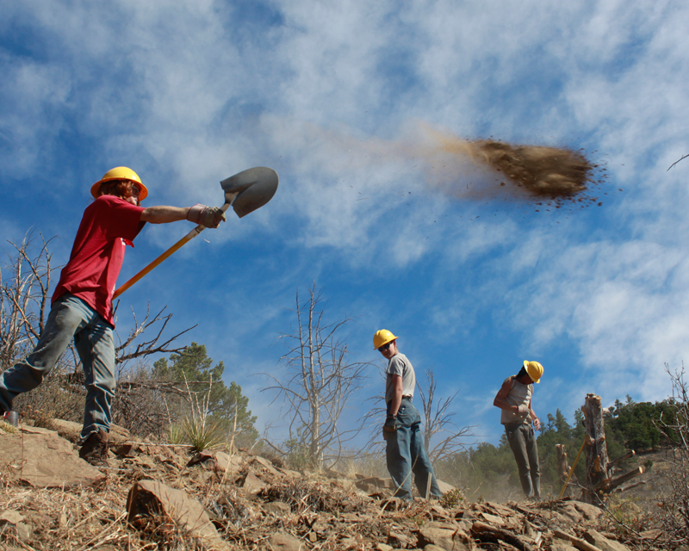
Individual Opportunities
Notes:
Philmont offers great programs called Individual Opportunities for scouts to experience Philmont if they do not have a chance to go on a Trek with a unit. Several Individual Opportunities combine a week of work with a week of trekking. This results in a substantially reduced cost. Although you have to arrange transportation for a scout to and from Philmont, the ranch can assist with travel from airports in Denver, Colorado Springs, and Albuquerque or the Raton, NM Amtrak Station.
NEW – Parents or guardians may stay at Family Adventure Camp while their scout is on an Individual Trek. You might even be able to volunteer to help out at Philmont during your stay.

Slide 22
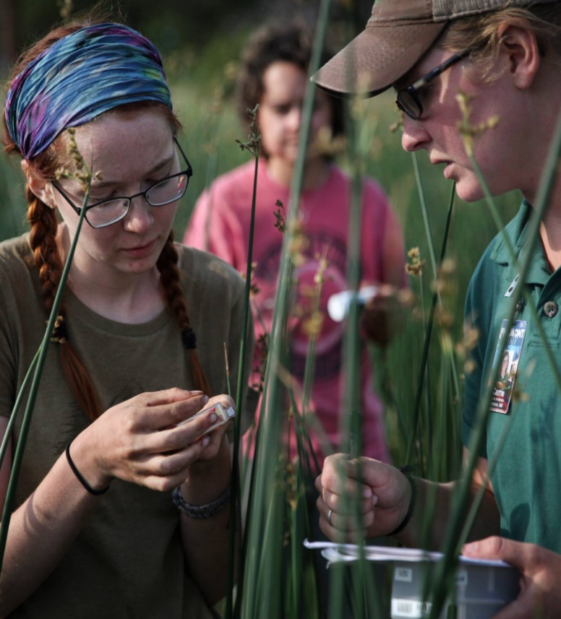
STEM Treks
Applied science in the backcountry
Ages 14-18
Co-Ed
Notes:
STEM is an important Scouting program for Scouts. At Philmont, they learn applied science and math on the trail. Besides the obvious biology and forestry, STEM treks cover mathematics, chemistry, physics, engineering, astronomy, geology and other sciences.

Slide 23
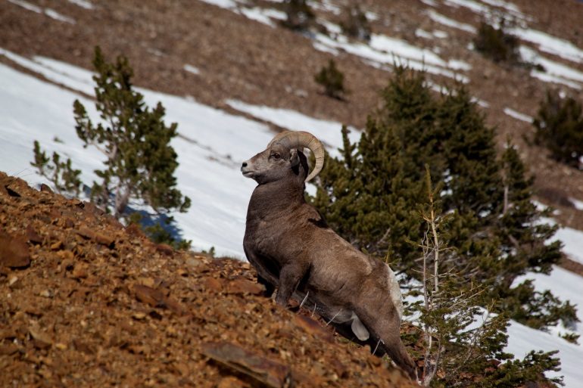
Rayado
Ages 15 to 21
Ultimate 21-day backcountry Trek
Areas not available to ‘trekkers’
Notes:
Rayado crews roam the entire backcountry and visit places that normal treks do no get to visit. A Rayado Trek really builds self-sufficiency and teaches skills so that attendees can lead other high adventure outings.

Slide 24
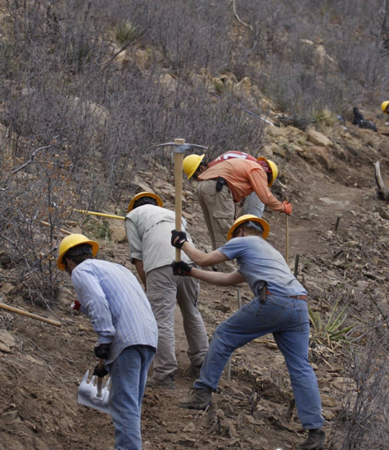
Trail Crew
Ages 16 – 21
7 days trail work/ 7-day trek
Learn and apply conservation skills
Reduced cost
Notes:
Trail Crews help maintain the Philmont Backcountry. After your work week is done, you get to plan your own 7-day trek. Because you work for part of your experience, the cost is reduced compared to an equivalent trek.

Slide 25
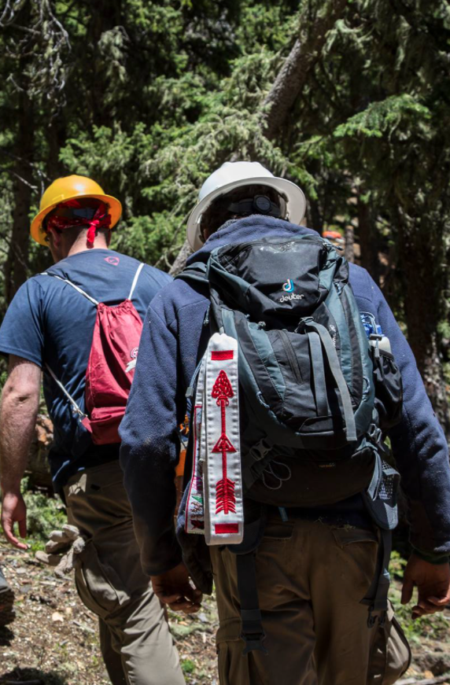
Order of the Arrow Trail Crew
Ages 16 - 21
7 days trail work/ 7 days of DIY Trek
Embody “Cheerful Service”
Reduced cost
Notes:
Like Trail Crew, the OA Trail Crews maintain backcountry paths. They also incorporate OA leadership and service principles into the program. Cost is reduced because of the work you do for Philmont in building and maintaining trails.
Later in your scouting career, you may get the satisfaction of hiking a trail that you built.

Slide 26
Roving Outdoor Conservation School
16 to 21 years
21 Day Trek
In depth resource management
Reduced cost
Notes:
Anyone interested in natural resource management should take advantage of the Roving Outdoor Conservation School, or ROCS, to learn vital skills in the backcountry. Philmont teaches forestry, geology, fish and wildlife management, watershed management, and many more disciplines while on this extended trek. Participants will work on conservation projects in the backcountry and so the cost of the experience is less than an equivalent trek.

Slide 27
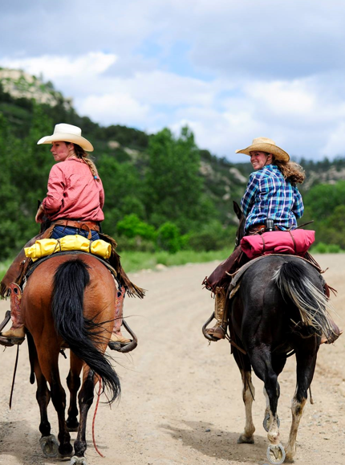
Ranch Hands
Ages 16 to 21
Know horse care
Work 8 days
Enjoy an 8-day cavalcade
Reduced cost
Notes:
Those with equestrian care experience can put it to good use as a ranch hand. Ranch Hands help with Philmont horses, cattle and livestock for a week. Afterwards, they go off on their own cavalcade which is a trek on horseback. The cost is reduced because of your work on the ranch.

Slide 28
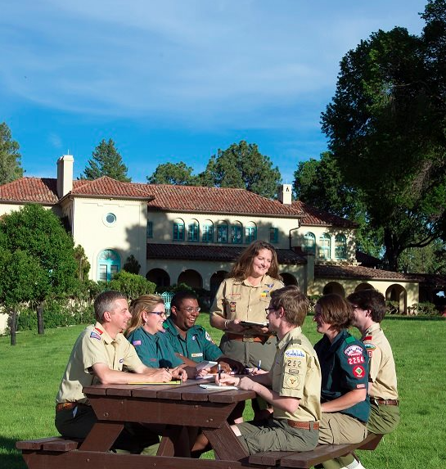
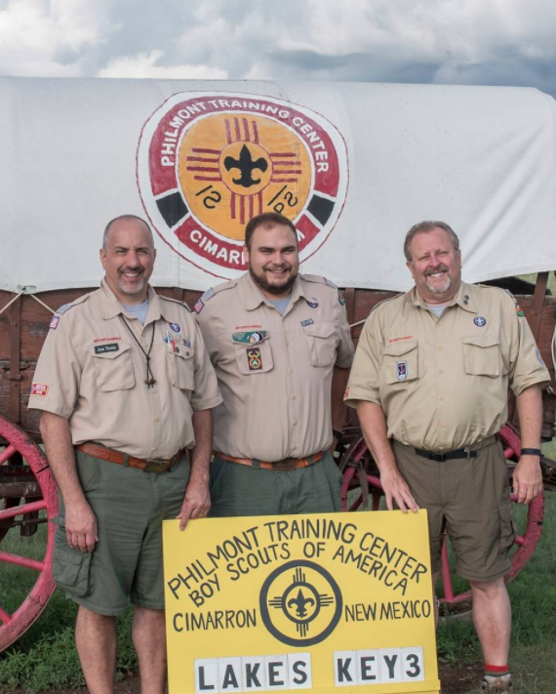
Philmont Training Center
Notes:
Philmont Training Center is open to all Scouters in all Programs. Conferences are held on the grounds of the beautiful Villa Philmonte, which Waite Phillips donated to be a center of Scouter training programs.

Slide 29
Philmont Training Center
Enroll on-line
Have fun!
Gain program insights
Learn new skills
Meet Scouters from across the country
Bring your family
Notes:
PTC makes learning fun from national subject matter experts.
You can reroll on-line at the Philmont Web site. No special invitation is required.
You’ll gain a lot of information that you can take back home and use. One of the best things about PTC is that you interact with Scouters from all over the country to learn best practices that you can take home to help your unit, district, council and greater scouting.
You can bring your family so they can enjoy Adventure Camp activities while you are in class. You’ll have scheduled free time to join with them for activities.

Slide 30
PTC Attendees
Unit leaders
District personnel
Commissioners
Council leaders
Key 3
Chartered Org Reps
Religious leaders
Any Scouter!
Notes:
PTC attendees come from all over Scouting. Adults from Packs, Troops, Crews, Ships and Posts can find a conference that will interest them. Commissioners and Committee members wanting to improve their local programs have a variety of opportunities. Religious leaders can learn ways that Scouting supports their youth in their faith journey.
You don’t need a special invitation to attend a conference. Just go to the Philmont Training Center website, find something that interests you, and enroll on-line. Bring your entire family so they can enjoy Philmont’s amenities as well.

Slide 31
Example Conferences
Sustaining and Growing Units
Recruiting Commissioners
Shooting Sports
Wilderness First Aid
Leveraging Roundtable
Notes:
There are dozens of conference offered each summer. Some focus on programs like Cubs, Scouts BSA and Venturing. Others concentrate on making Scouting better through training commissioners, district personnel and council leaders. Still others help you improve scouting skills so that you can teach and improve programs back home.

Slide 32
Bring Your Whole Family
Kids and Kin Program
Small Fry – Infants to 5
Trappers – 6 to 10
Loggers – 11 to 13
Miners – 14 to 17
Silverados – Non-conference spouses
Notes:
PTC has revived its Family Program, now called “Kids and Kin” for the spouses and children (even grandchildren) of conference attendees. Philmont’s awesome consolers will keep them engaged through the day with age-appropriate activities such as games and crafts for youngsters, hikes and pony rides for older kids, and shooting, climbing and high ropes courses for teens. While the kids are being looked after, spouses can enjoy museum tours, learning to paint or craft, or just relax on the Villa Philmonte grounds. You’ll all have time together at meals and in the evening for loads of fun at campfires, open shooting ranges, crafts and other Philmont activities.
Loggers and Miners get to spend a night camping out with a parent to get a feel for Philmont’s beautiful backcountry.
Other family programs like Philmont’s “Duty to God” and Junior Ranger and Wrangler activities provide opportunities to earn recognition for completing their associated activities.

Slide 33
PTC Accommodations
Notes:
Philmont’s Terrace Tents are spacious and have real beds and electricity. Deluxe Tents, available for an extra fee, have multiple rooms, and can accommodate a family up to 6. Modern facilities have private rooms with toilets, sinks and showers and are large enough for parents to clean off dusty children after a long day playing outside. Roofed housing may also be available.

Slide 34
Meals
Notes:
All your meals are provided in a cafeteria, so there is no cooking and cleaning involved. A wide variety of food is available for even the pickiest eaters. A vegetarian option is available for all meals, and the salad bar always provides fresh fruits and vegetables.
Many of the seasonal staff preparing your food may be enrolled in food service education programs back home.

Slide 35
Advanced Experiences
National Advanced Youth Leadership Experience (NAYLE)
Philmont Leadership Challenge (PLC)
Notes:
Philmont Training Center also offers advanced leadership experiences for both youth and adults.

Slide 36
National Advanced Youth Leadership Experience
14 to 21 years old
In unit leadership position
Intro to Leadership & NYLT
Candidate for Council NYLT staff
Notes:
NAYLE is leadership experience, not training. Scouts get to put into practice all the skills they learn in National Youth Leadership Training (NYLT). Youth who are unit leaders and have completed their local NYLT are encouraged to attend this week-long program. They can take what they learn and help with youth leadership training programs back home.
NAYLE is held at the Rayado Ridge Camp site which is dedicated for such an experience.

Slide 37
Philmont Leadership Challenge
Great Wood Badge ticket item
Put Wood Badge leadership skills into practice
Notes:
The Philmont Leadership Challenge is also a great Wood Badge Ticket item. Along with fellow Wood Badge Scouters, you put the leadership skills you learned into practical use in an outdoor experiential learning environment. Note that participants will not be with their family during the week as all activities take place away from the PTC at the Rayado Ridge site.

Slide 38
Weekly Schedule
Sun | Mon | Tues | Wed | Thurs | Fri | Sat
 |  |  |  |  |  | Depart
 | Lunch
Arrive |  |  | Free time
 | Dinner
Breakfast
Conferences
Conferences
Conferences
Dinner
Evening Activities
Notes:
At PTC, you have time for meals with your family or you can mingle with other scouters. On Wednesday afternoon you are free to explore the surrounding area or do a family activity together. While you are in conferences, your family will be in Adventure Camp activities. During the evenings, there are special events like Western Night, Cobbler Night, Ice Cream Social, and Movie Night.

Slide 39
Family Adventure Camp
Notes:
Family Adventure Camp lets you and your family enjoy many of the activities at Philmont for a week or half-week. It is an unsurpassed opportunity to share time together. If you bring your family while you attend PTC, they will be participating in Adventure Camp activities. Unaccompanied youth of PTC participants will be guided by Philmont counselors during their stay.

Slide 40
Ultimate family summer vacation
Only one participant needs to be in Scouting
Grandparents/ grandkids too!
Fall, Winter and Spring dates also available
Notes:
There are adventures for everyone in your family and for all age ranges from months-old to young adult. Grandparents can even come out to spend a special week with their grandkids.
One person in each family group must be a registered Scouter. A grandparent still active in Scouting can bring their spouse and grandchildren. Even singles and couples in Scouting without kids can enjoy the program.
Check the schedule for open dates throughout the year including spring, fall and winter.

Slide 41
Choose Your Adventure
Welcome HOmE
Philstorical
Mini Bear
Adventure Seekers
Happy Hiker
Angler Adventure
Notes:
There are many activities that you can do at Adventure camp. The best part is that you get to choose what you want to do.
We call Philmont HOmE – Heaven on Earth- and the Welcome HOmE adventure gives you a taste of all Philmont offers.
You get to know the history of the Southwest and Philmont on the Philstorical Adventure.
Mini-bears – those seemingly ever-present chipmunks – act like kids, and the Mini-bear Adventure is full of great activities for 5- to 10-year-olds.
Parents with older children can climb, shoot, fish and camp with the Adventure Seekers.
Want to explore the beautiful backcountry? Then head off on the Happy Hiker adventures to some of the peaks and passes in the Sangre de Cristo mountains.
Philmont’s streams and lakes have an abundance of wary trout, spend time trying to outsmart them fly fishing on an Angler Adventure. Philmont supplies the guides and equipment, but you have to bring your luck.

Slide 42
Premium Experiences
Tooth of Time Hike
Genevieve’s Villa Tea
Horseback Riding
Notes:
You can enhance your adventures with some fun and exciting extras that do have an additional modest cost. Tooth of Time Hike takes you on an all-day 5-1/4-mile hike to the top of this 9,000-foot rugged landmark. The more genteel can enjoy tea and treats on Villa Philmonte’s front porch at Genevieve’s Tea party. You can also experience the backcountry on horseback with Philmont’s wranglers winding you way through the scenery.

Slide 43
More Opportunities
Notes:
Philmont offers off-season as well as special opportunities to enjoy all the ranch has to offer.

Slide 44
Autumn Adventure
Enjoy fall scenery
Plan your own route
Philmont guide
For Scouters or family groups
All for a per person/day fee
Notes:
Autumn adventure is a great opportunity to get out in the backcountry with fellow Scouters. Your route is tailored by your group. Philmont will provide you with a Ranger guide during your time. It can provide camping equipment and meals just as for a regular trek. All of this is for just $74 per person per day. You can even plan for special backcountry activities like fly fishing and rock climbing.

Slide 45
Winter Adventure
Learn cold-weather camping
Philmont provides gear
Skiing and SAR activities
Notes:
Cold-weather camping is the ultimate test of your ability to camp and travel in the backcountry and learn to live in harmony with the environment. Training in winter camping will prepare you to safely enjoy many winter adventures and to teach others to enjoy these unique experiences.
Participants in Winter Adventure learn to camp comfortably in cold weather, and enjoy Philmont’s beauty in a way few others have. Crews snowshoe to their camp, sleep in tents or snow shelters, and participate in a variety of activities. Offerings include cross country skiing, snow shelter building, and earning either Search and Rescue or Snow Sports merit badge
.
Winter Adventure expeditions take place from late December through March.

Slide 46
Sportsman Adventures
Elk
Mule deer
Pronghorn
Bison
Turkey
Apply through your Council to enter lottery
Notes:
Since the 1940s, Philmont has been offering guided, invitational big game hunts to those actively involved in Scouting. Sportsmen are considered upon recommendation from a local council Scout Executive. If approved, Sportsmen will be able to submit an application for a lottery to hunt.

Slide 47
Fly Fishing Invitational
In September
Invited through your Council Executive
Great incentive for donors
Notes:
Philmont’s benefactor Waite Phillips was an enthusiastic and accomplished fly fisherman. He spent many days beside some of America’s most prominent citizens, fly rod in hand, fishing the small streams and lakes of “God’s Country.” You can enjoy the same quality experience at the Philmont Scout Ranch Annual Fly Fishing Invitational, held each year in September. This weekend of fellowship is open to adult Scouters who are recommended or accompanied by their local Scout Executive. The experience is a great way for local councils to build relationships with donors.
Guides are provided by Philmont.

Slide 48
Employment
Notes:
Philmont has over 1000 job openings each summer for seasonal staff. You do not have to be a Scout or have Scouting experience, Three are a wide variety of positions available. You’ll be working with extraordinary people from across the country with a wide range of backgrounds and interests.

Slide 49
World’s largest camp!
Co-ed, 18 and up
No scouting experience required
Housing and food provided
May earn academic credit
Notes:
It is an adventure to work at the worlds largest scout camp. Both men and women are needed especially for seasonal positions each summer. You do not have to have Scouting experience to be on staff, just a love for working with people and appreciation for the outdoors. Philmont provides you with both food and housing for your stay.
Many college programs require an internship as part of a degree program. Because of the many types of positions available, Philmont may be able to provide students with the opportunity, plus you get paid in the process. Students must get approvals from their college advisors if their experience is to be applied for credit.

Slide 50
A 1000+ Summer Opportunities
Rangers
Program camps
Medical staff
Food service
Living history
Customer service
Retail operations
Maintenance and more!
Notes:
Opportunities abound for both male and female young adults. Expect to spend the first year at base camp, then get other opportunities in the backcountry.

Slide 51
You Get Perks!
Recreation opportunities
Staff wellness program
Backcountry free time
Notes:
All positions have scheduled time off so you can get to the Philmont backcountry. You’ll make plenty of friends who you can spend time with during your employment.

Slide 52
One Philmont, Many Opportunities
More than Treks
Individual Opportunities
Training for Scouters and junior leaders
Best Family Vacation EVER!
Off-season adventures and events
Seasonal Employment
I want to go back to Philmont!
Notes:
Philmont offers much more than Treks. It has opportunities for individuals such as STEM programs and work/hike adventures. Philmont Training Center provides conferences for adults wanting to improve their Scouting program back home and for youth wanting to apply leadership skills in the backcountry. Family Adventure Camp gives you an opportunity to enjoy the offerings of Philmont like hikes and horse rides with you spouse and children.
Once the summer has ended, Philmont offers backcountry adventures as well as fishing and hunting in the surrounding mountains.
Topping it all is the best summer job you may ever have by being on staff to help others enjoy all these opportunities – and doing them yourself during your free time.

Slide 53
Resource
www.philmontscoutranch.org
All photos used in this presentation are either Philmont Scout Ranch photos, in public domain, or by Thomas Baltutis and used by permission.

