Slide 1
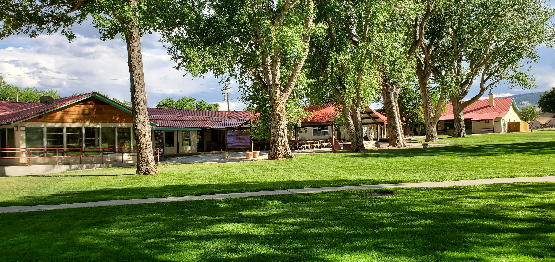
“Delivering Wilderness And Learning Adventures That Last A Lifetime”
Ambassador Webinar
April 26, 2023

Slide 2
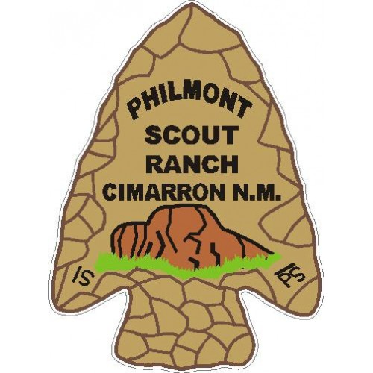
Jim Ellis
Ambassador Task Force Chair
“Delivering Wilderness And Learning Adventures That Last A Lifetime”

Slide 3
Shelley O’Neill
Director
Business Operations
“Delivering Wilderness And Learning Adventures That Last A Lifetime”

Slide 4
“Delivering Wilderness And Learning Adventures That Last A Lifetime”

Slide 5
Camping Report
=======
Shelley O’Neill
“Delivering Wilderness And Learning Adventures That Last A Lifetime”

Slide 6
Danny Tucker
Director
Philmont Training Center
“Delivering Wilderness And Learning Adventures That Last A Lifetime”

Slide 7
A Touch of Class
Menu Upgraded – Kid Friendly Options
Friday Picnic – Outdoor Grills
Housing Upgrades
Classroom Upgrades
“Delivering Wilderness And Learning Adventures That Last A Lifetime”

Slide 8
PTC Experiences
Safe Environment – Signs, Sidewalks, and Safety Moments
Opening Show
Evening Programs
SignUpGenius
Santa Fe Trail Café
“Delivering Wilderness And Learning Adventures That Last A Lifetime”

Slide 9
Focus on the Guest
Staff Leadership Webinars
Welcome Email
Be Prepared Email
Silverado Email
Weekly Faculty Communication
Welcome Guide at Check-In
Hospitality Team / Quartermaster
Bulletin Boards
Guest Evaluations
“Delivering Wilderness And Learning Adventures That Last A Lifetime”

Slide 10
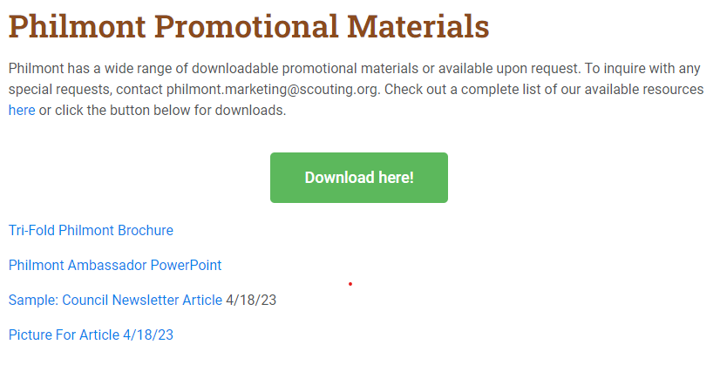
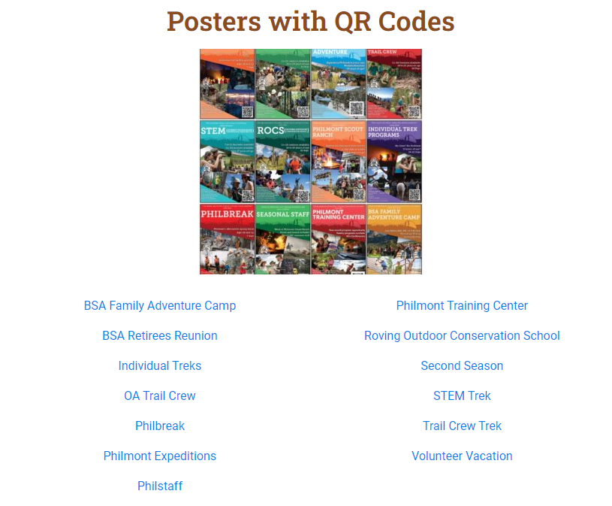
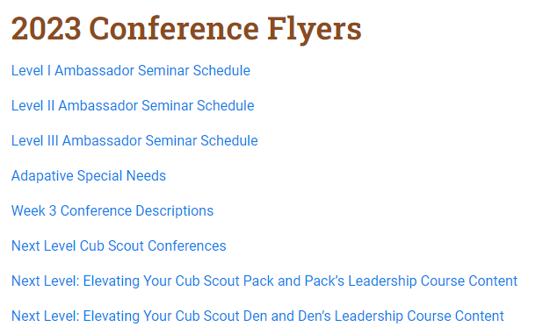
“Delivering Wilderness And Learning Adventures That Last A Lifetime”

Slide 11
2024
will be
75th
Summer
“Delivering Wilderness And Learning Adventures That Last A Lifetime”

Slide 12
Maddy Houk
Assistant PTC Director,
Program
“Delivering Wilderness And Learning Adventures That Last A Lifetime”

Slide 13
Kids and Kin Program
Silverados

Slide 14
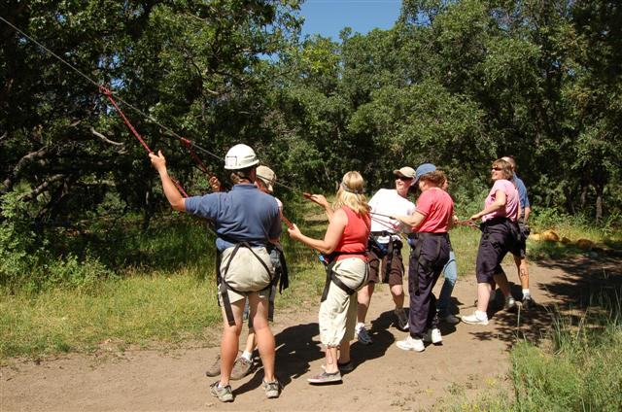
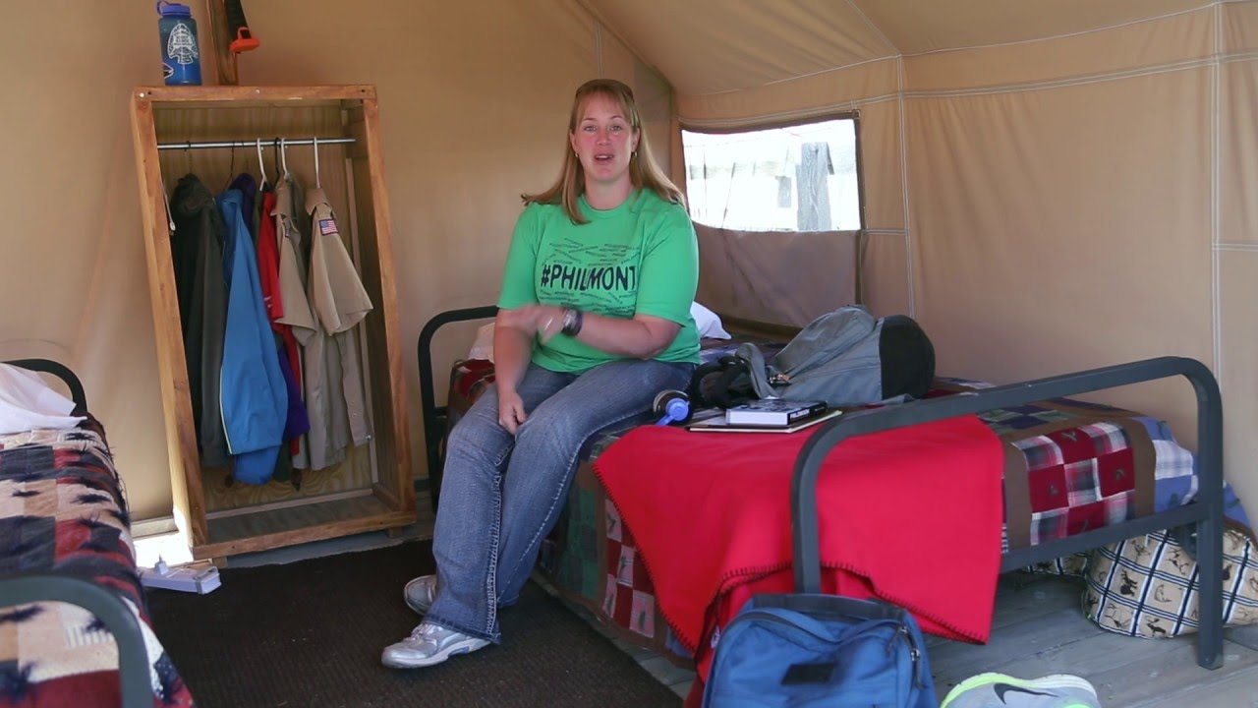
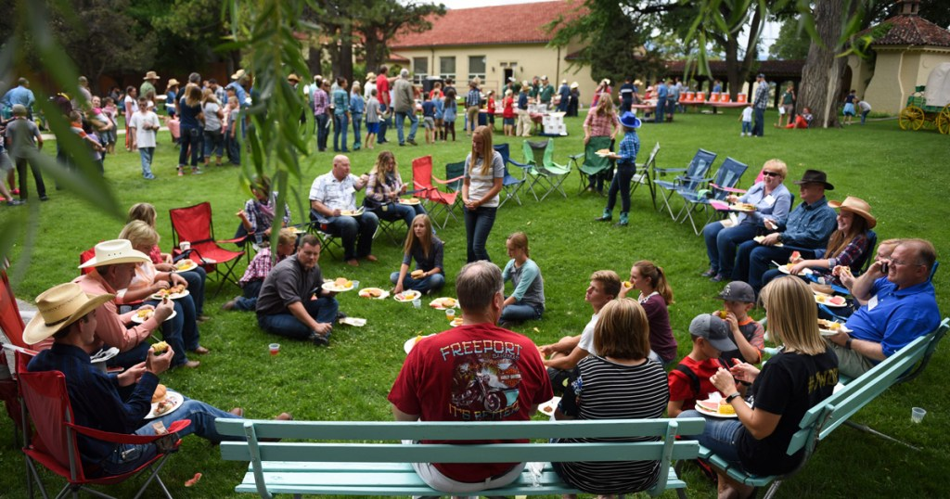
Silverados
Notes:
I’ll be covering a number of topics about Philmont. Philmont is famous for Treks, but there are also Individual Opportunities that let you experience the backcountry especially if you don’t have a Troop or Crew to go with. The Philmont Training Center provides Scout Leaders an opportunity to learn more about the Scouting program so they can better serve youth in their area. A newer program called Family Adventure Camp gives families an opportunity to vacation at Philmont. All these programs require the help of a lot of staff, and Philmont is always looking for good people to provide program to visitors.

Slide 15
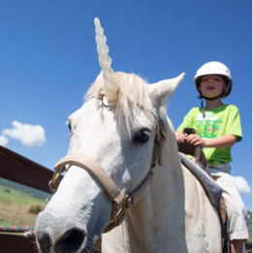
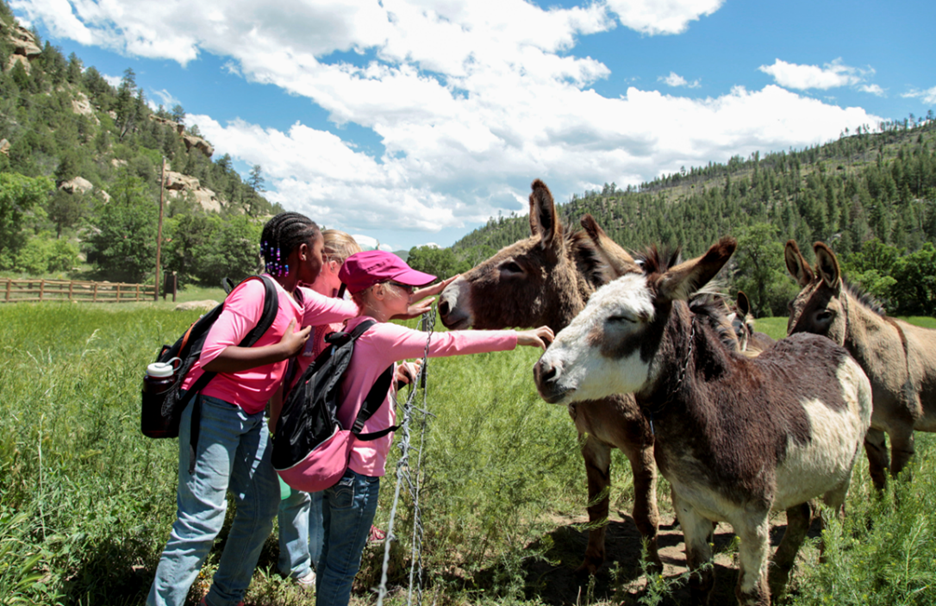
Kids and Kin
Trappers
Ages 6-10
Miners
Ages 11-13
Loggers
Ages 14-17
Notes:
I’ll be covering a number of topics about Philmont. Philmont is famous for Treks, but there are also Individual Opportunities that let you experience the backcountry especially if you don’t have a Troop or Crew to go with. The Philmont Training Center provides Scout Leaders an opportunity to learn more about the Scouting program so they can better serve youth in their area. A newer program called Family Adventure Camp gives families an opportunity to vacation at Philmont. All these programs require the help of a lot of staff, and Philmont is always looking for good people to provide program to visitors.

Slide 16
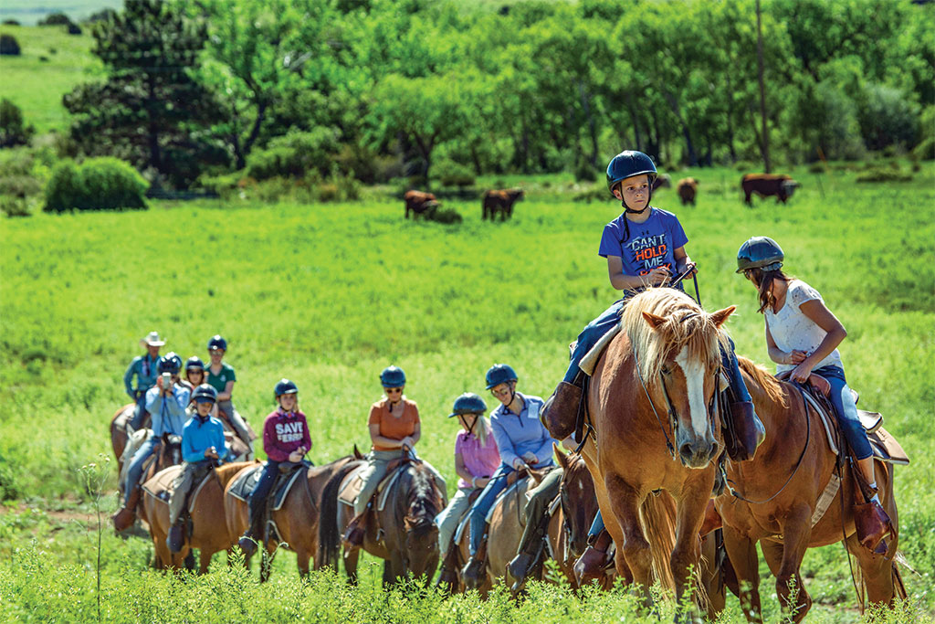
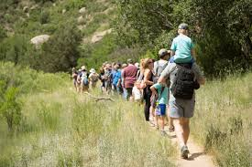
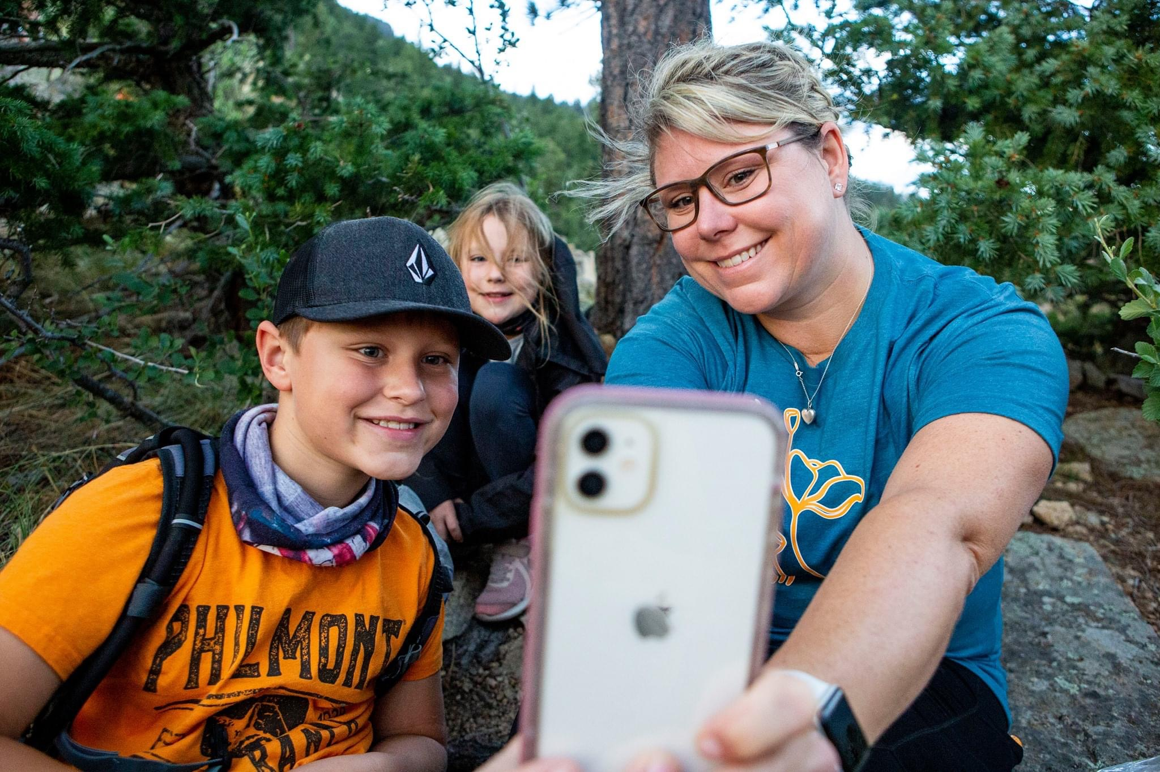
FAMILY ADVENTURE CAMP
Scouting’s Best Family Vacation!
“Delivering Wilderness And Learning Adventures That Last A Lifetime”

Slide 17
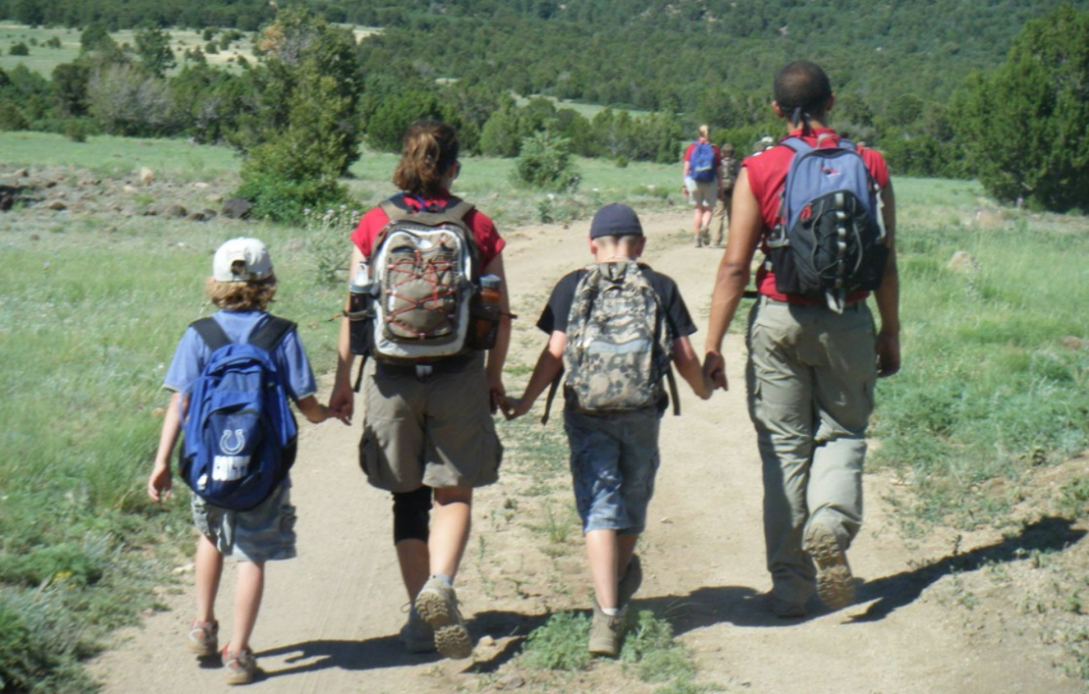
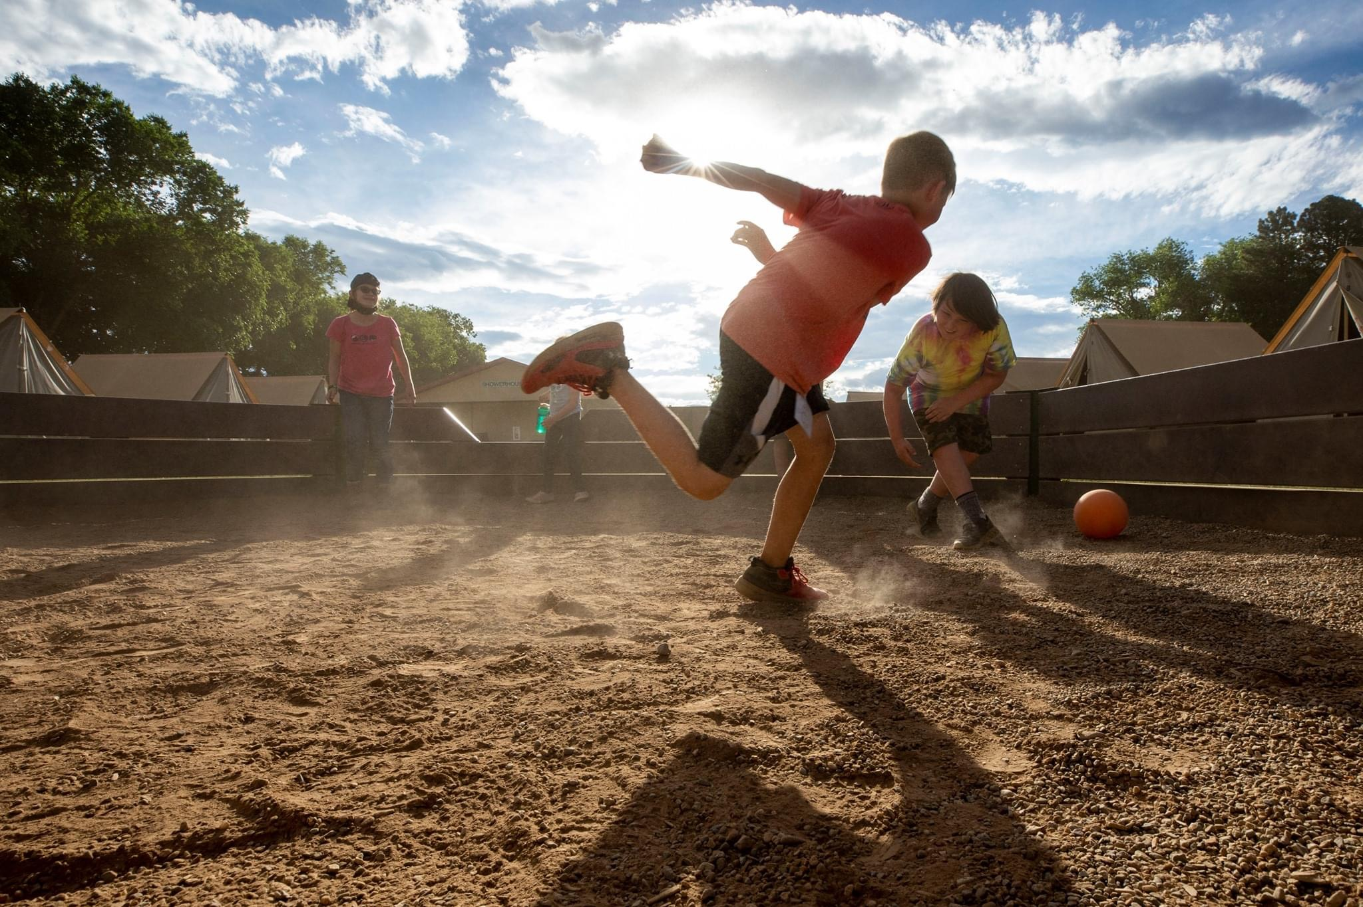
Family Adventure Camp
Welcome To Philmont Adventure FW
Philstorical Adventure HW/FW
Mini Bear Adventure HW/FW (ages 5-10)
Adventure Seekers HW/FW (ages 11-17)
Happy Hiker Adventure FW
Notes:
Family Adventure Camp lets you and your family enjoy many of the activities at Philmont for a week or half-week. It is an unsurpassed opportunity to share time together. If you bring your family while you attend PTC, they will be participating in Adventure Camp activities. Unaccompanied youth of PTC participants will be guided by Philmont counselors during their stay.

Slide 18
“Delivering Wilderness And Learning Adventures That Last A Lifetime”

Slide 19
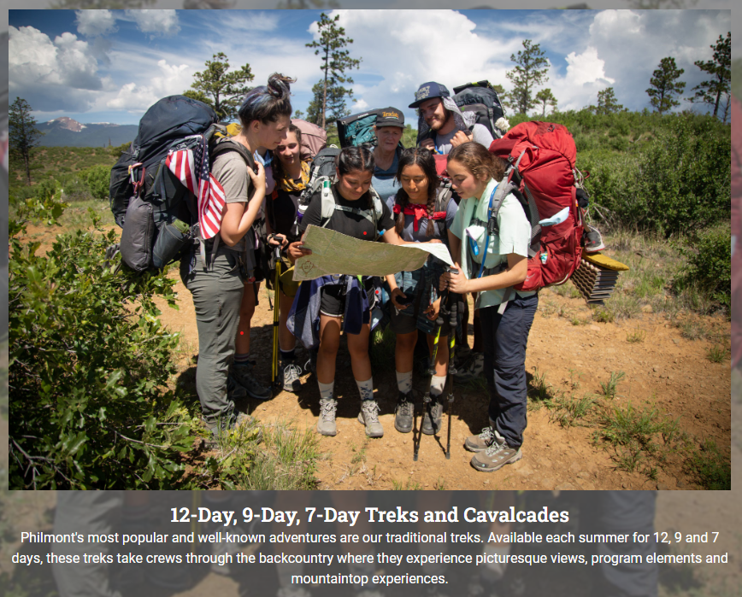
Ambassador Call to Action
2024
“Delivering Wilderness And Learning Adventures That Last A Lifetime”

Slide 20
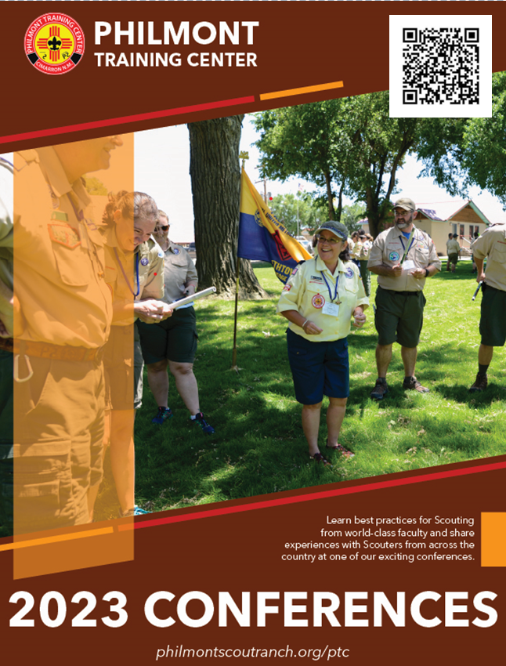
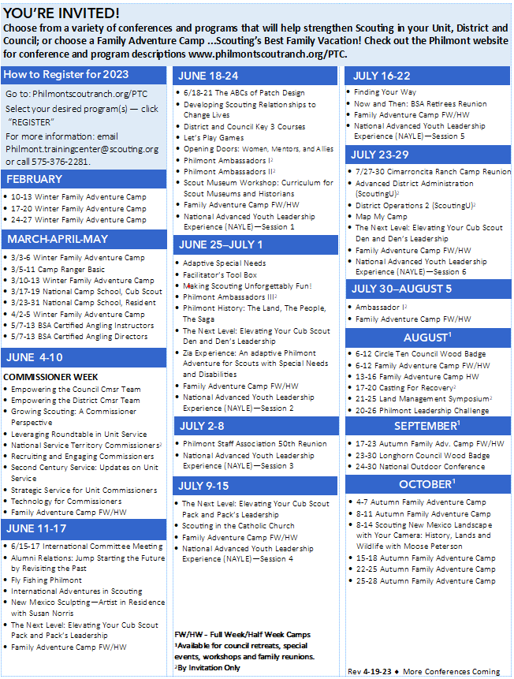
Ambassador Call to Action
2023
“Delivering Wilderness And Learning Adventures That Last A Lifetime”

Slide 21
Cub Scout Conferences
Nancy Farrell
“Delivering Wilderness And Learning Adventures That Last A Lifetime”

Slide 22
“Delivering Wilderness And Learning Adventures That Last A Lifetime”

Slide 23
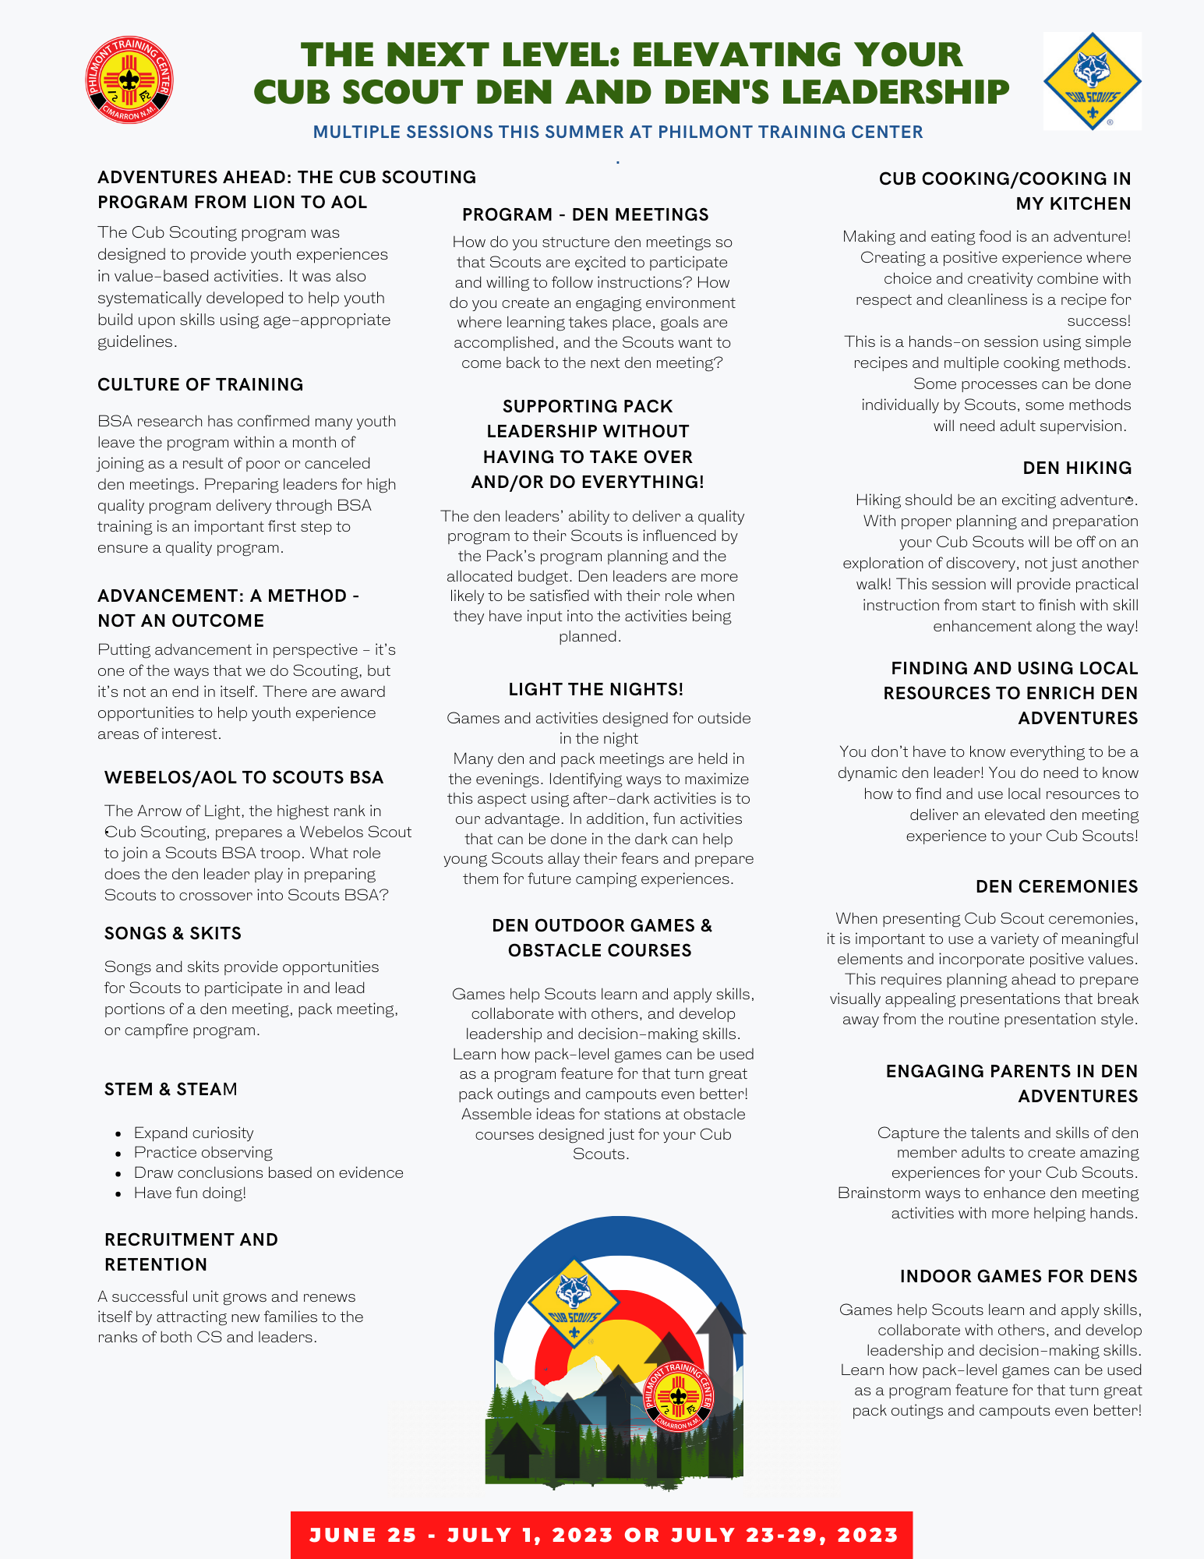
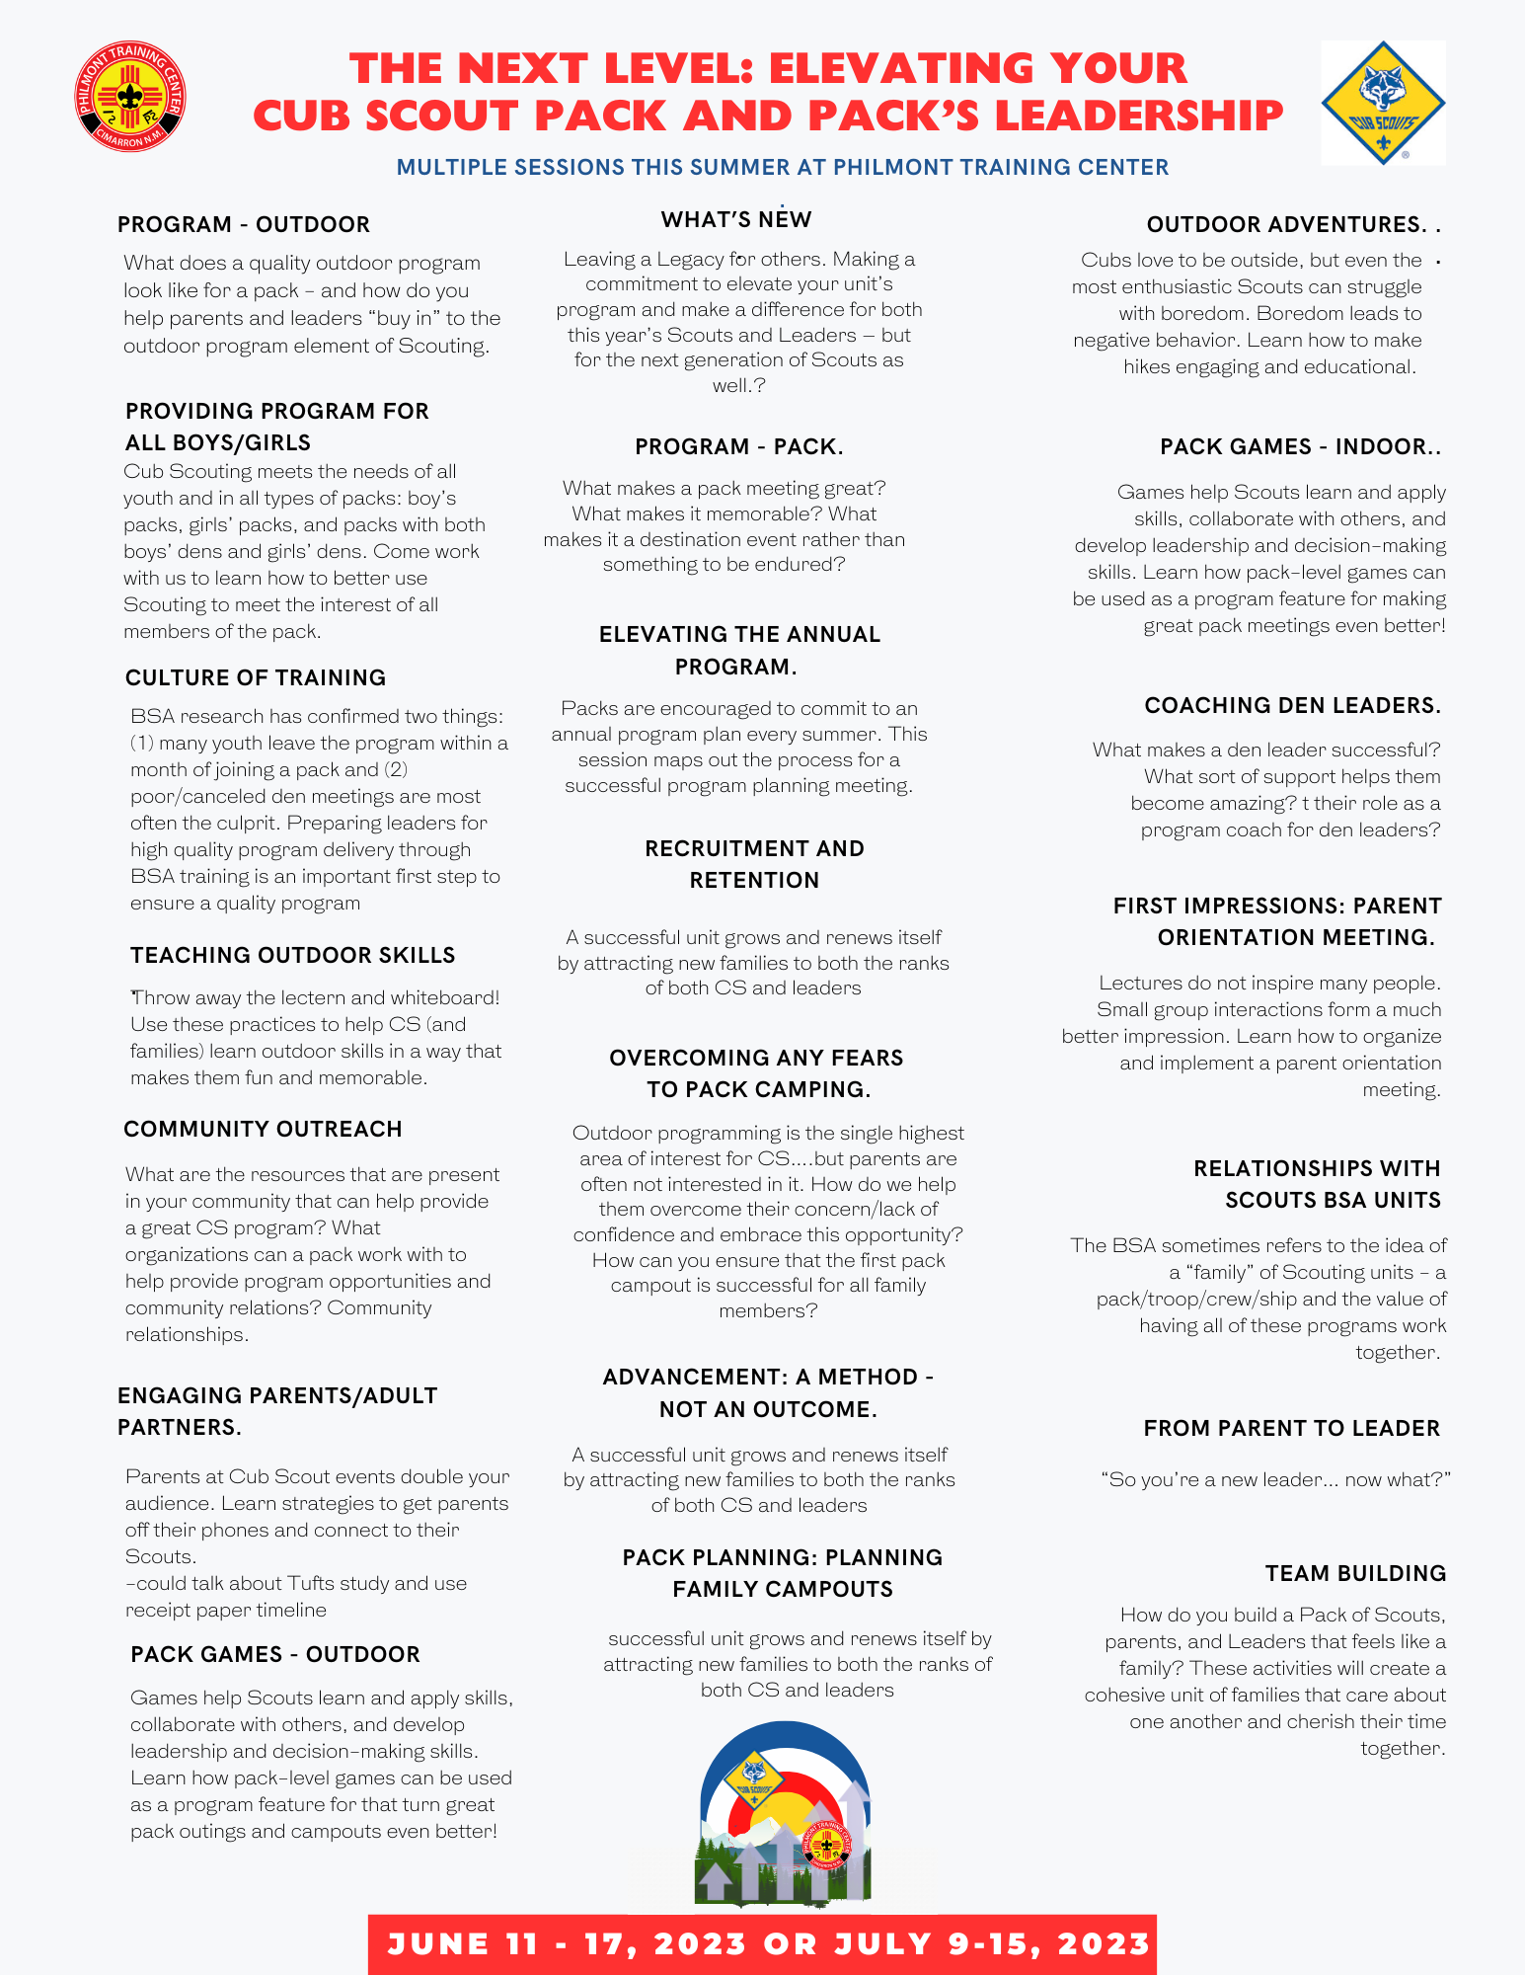
“Delivering Wilderness And Learning Adventures That Last A Lifetime”

Slide 24
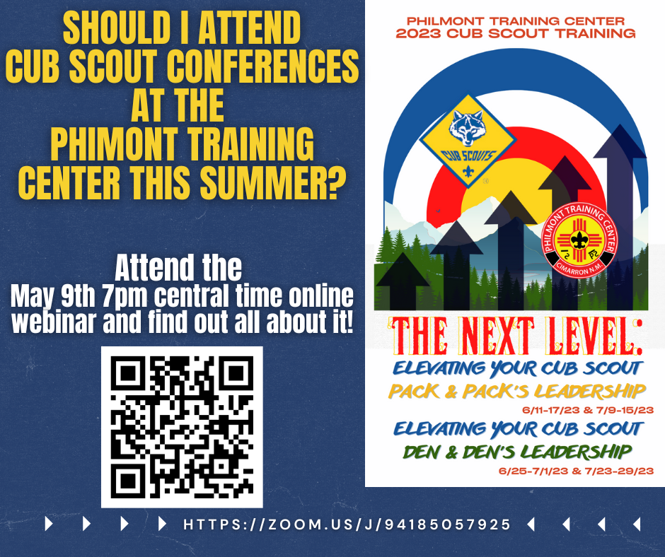
“Delivering Wilderness And Learning Adventures That Last A Lifetime”

Slide 25
Facilitator’s Tool Box
John Lesko
“Delivering Wilderness And Learning Adventures That Last A Lifetime”

Slide 26
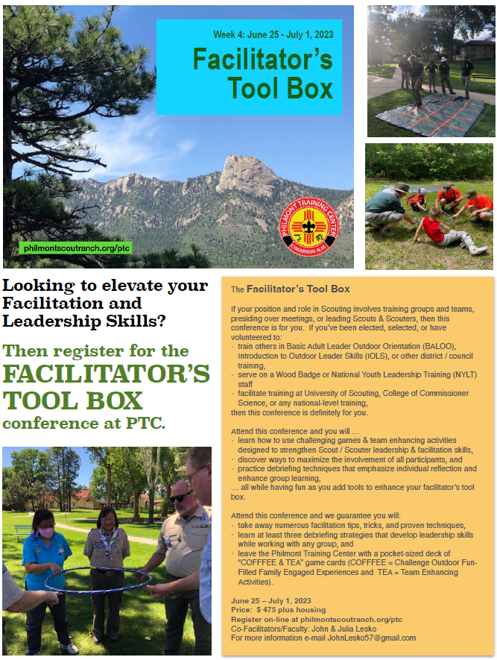
“Delivering Wilderness And Learning Adventures That Last A Lifetime”

Slide 27
Let’s Play Games
Danielle Ballantine
“Delivering Wilderness And Learning Adventures That Last A Lifetime”

Slide 28
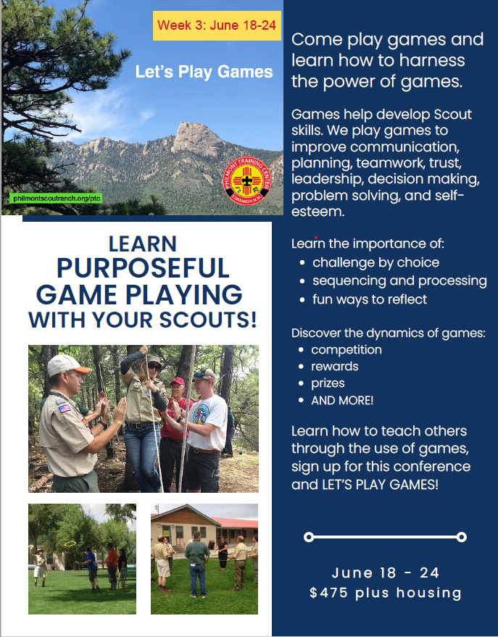
“Delivering Wilderness And Learning Adventures That Last A Lifetime”

Slide 29
Beyond Scouting –
Having Fun on the Ranch
Tom Baltutis
“Delivering Wilderness And Learning Adventures That Last A Lifetime”

Slide 30
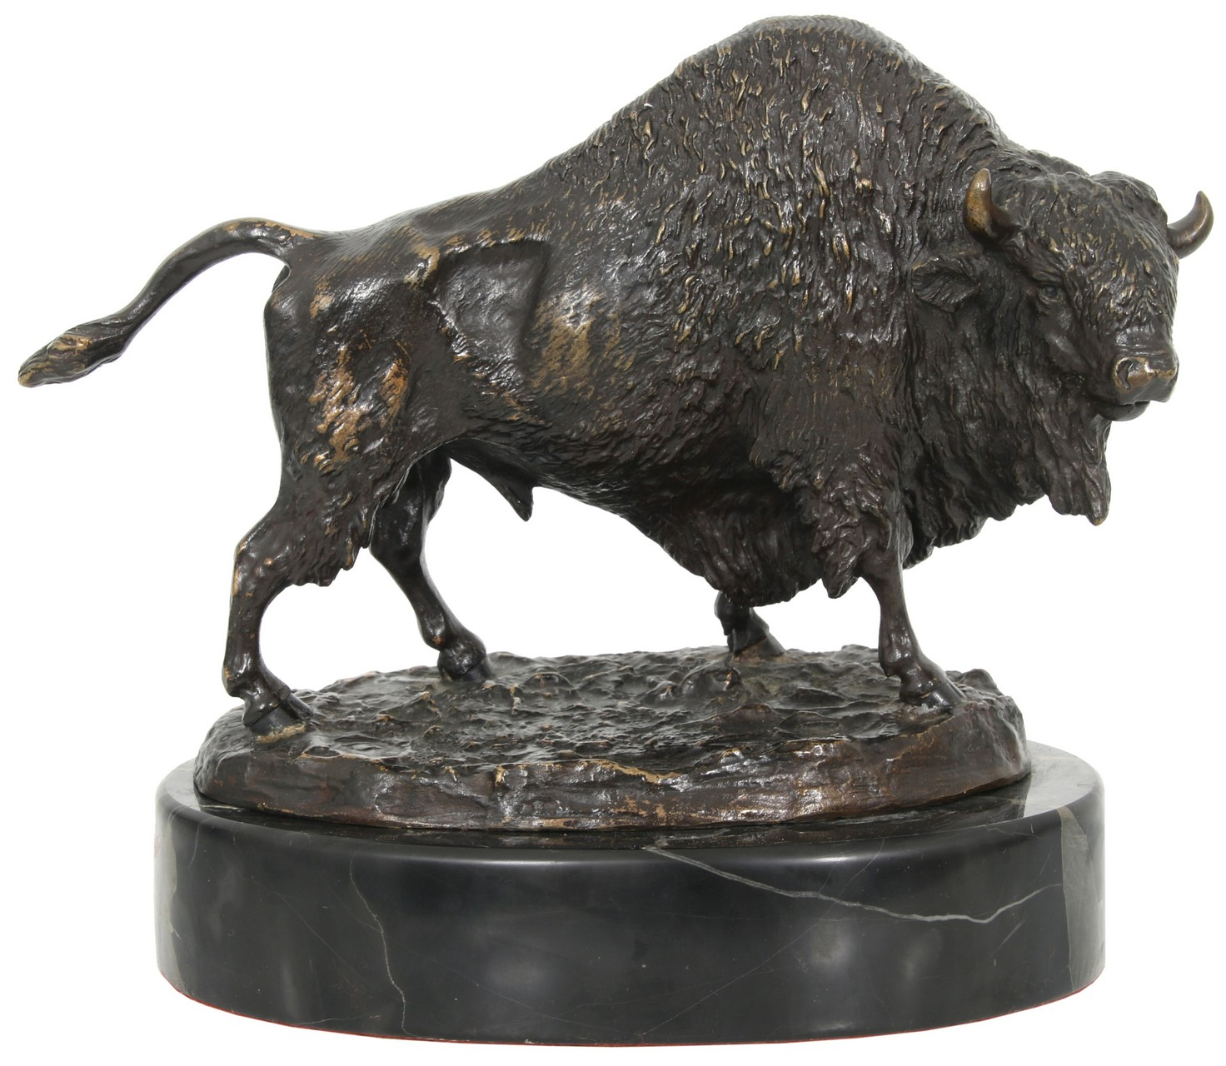
Fly Fishing Philmont (June 11-17)
New Mexico Sculpting – Artist in Residence with Susan Norris (June 11-17)
Philmont History: The Land, The People, The Saga (June 25-July 1)
Scouting New Mexico Landscape with Your Camera: History, Lands and Wildlife with Moose Peterson (Oct 8-14)
“Delivering Wilderness And Learning Adventures That Last A Lifetime”

Slide 31
Ambassador Survey Results
“Delivering Wilderness And Learning Adventures That Last A Lifetime”

Slide 32
Ambassador Survey Results
163 (59%) Completed Survey
Dropped 114 Ambassadors
Overall Ambassador Experience 4-5 Stars 91%
Attended Philmont in 2022 Yes 56% No 44%
Beneficial Communication Channels
Newsletter 93% Agree
Email Blasts 92% Agree
Website 80% Agree
Webinar 73% Agree
Facebook 68% Agree
“Delivering Wilderness And Learning Adventures That Last A Lifetime”

Slide 33
Ambassador Survey Results
Do you report Your Presentations?
All – 20%
Some – 38%
None – 42%
Number Presentations Made Since 2017:
0 (4%) 11-15 (13%)
1-5 (22%) 16-20 (8%)
6-10 (27%) 20+ (24%)
“Delivering Wilderness And Learning Adventures That Last A Lifetime”

Slide 34
Ambassador Seminars
“Delivering Wilderness And Learning Adventures That Last A Lifetime”

Slide 35
Ambassador I
Scott McAllister
“Delivering Wilderness And Learning Adventures That Last A Lifetime”

Slide 36
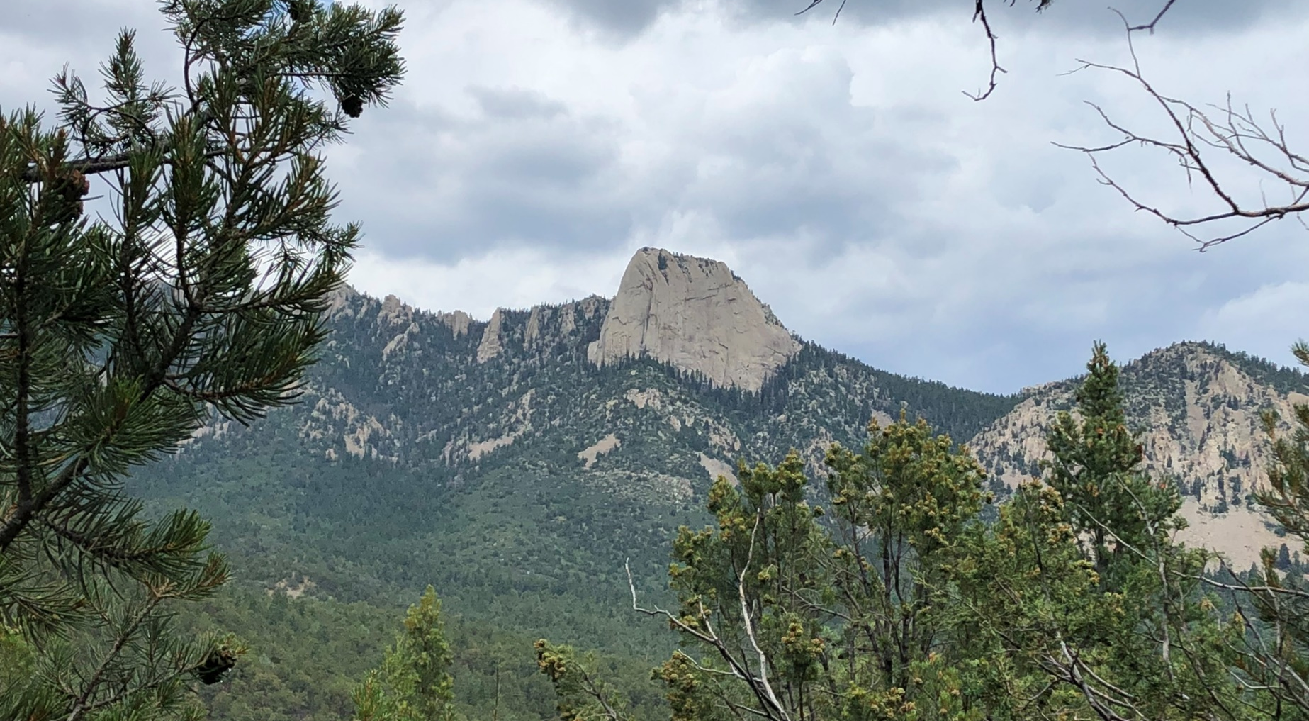
Ambassador I Conference
Top 10 reasons to attend
the Ambassador I Conference

Slide 37
No. 10
A great reason to go back to Philmont.

Slide 38
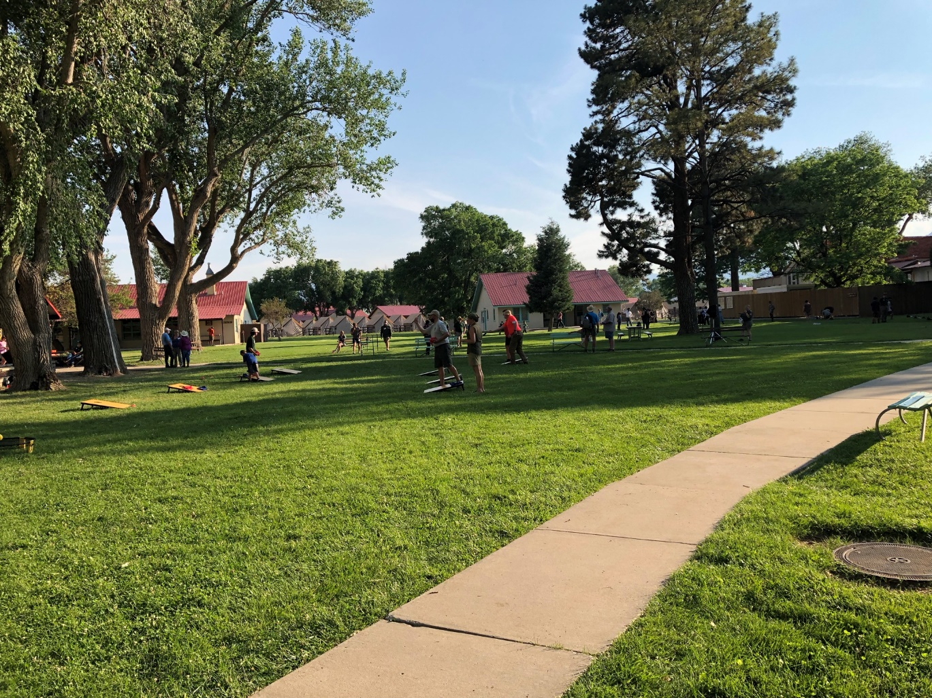
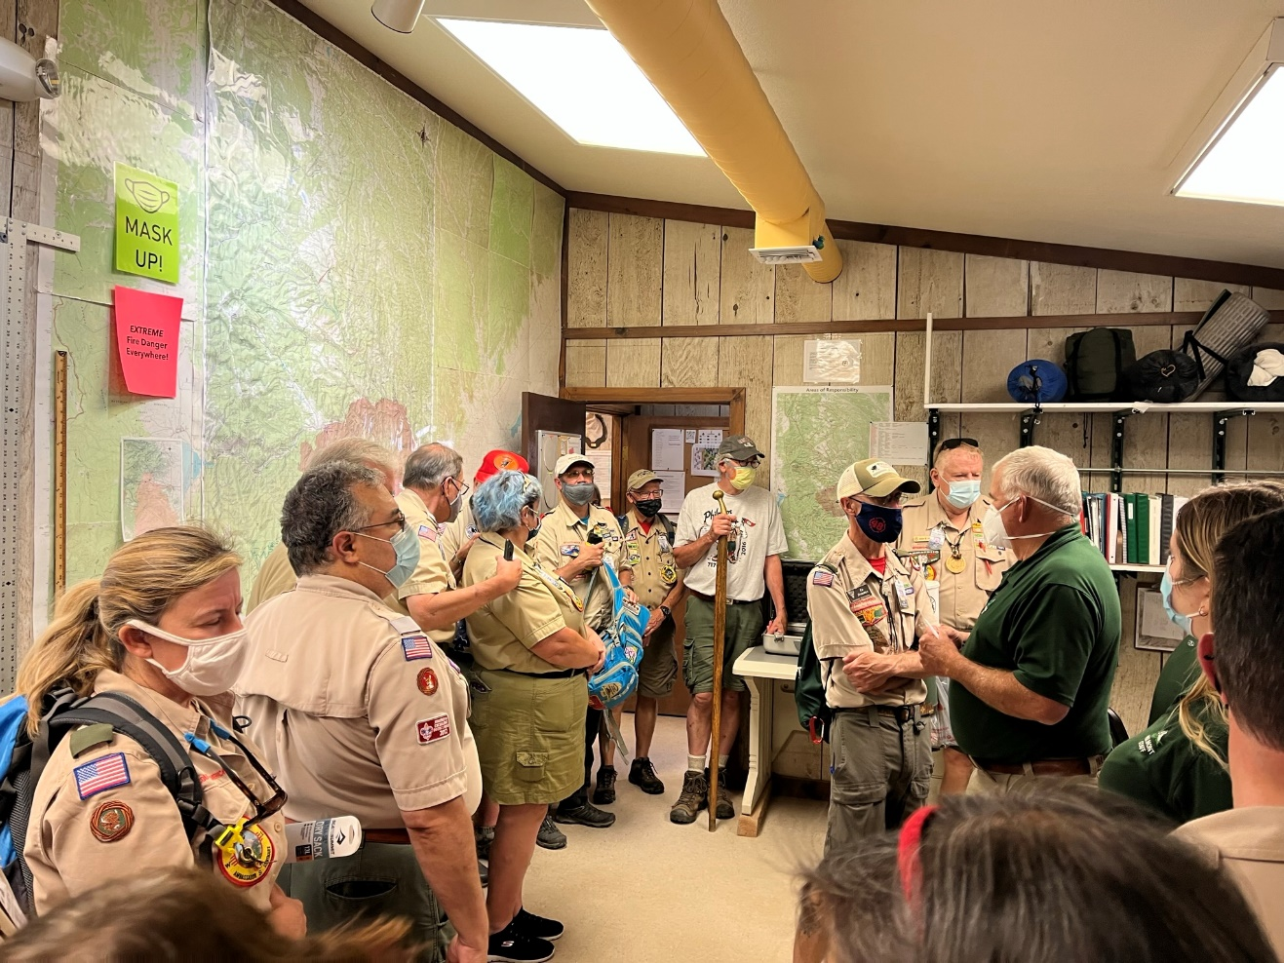
No. 9
Take a walking tour of camp headquarters and the Philmont Training Center.

Slide 39
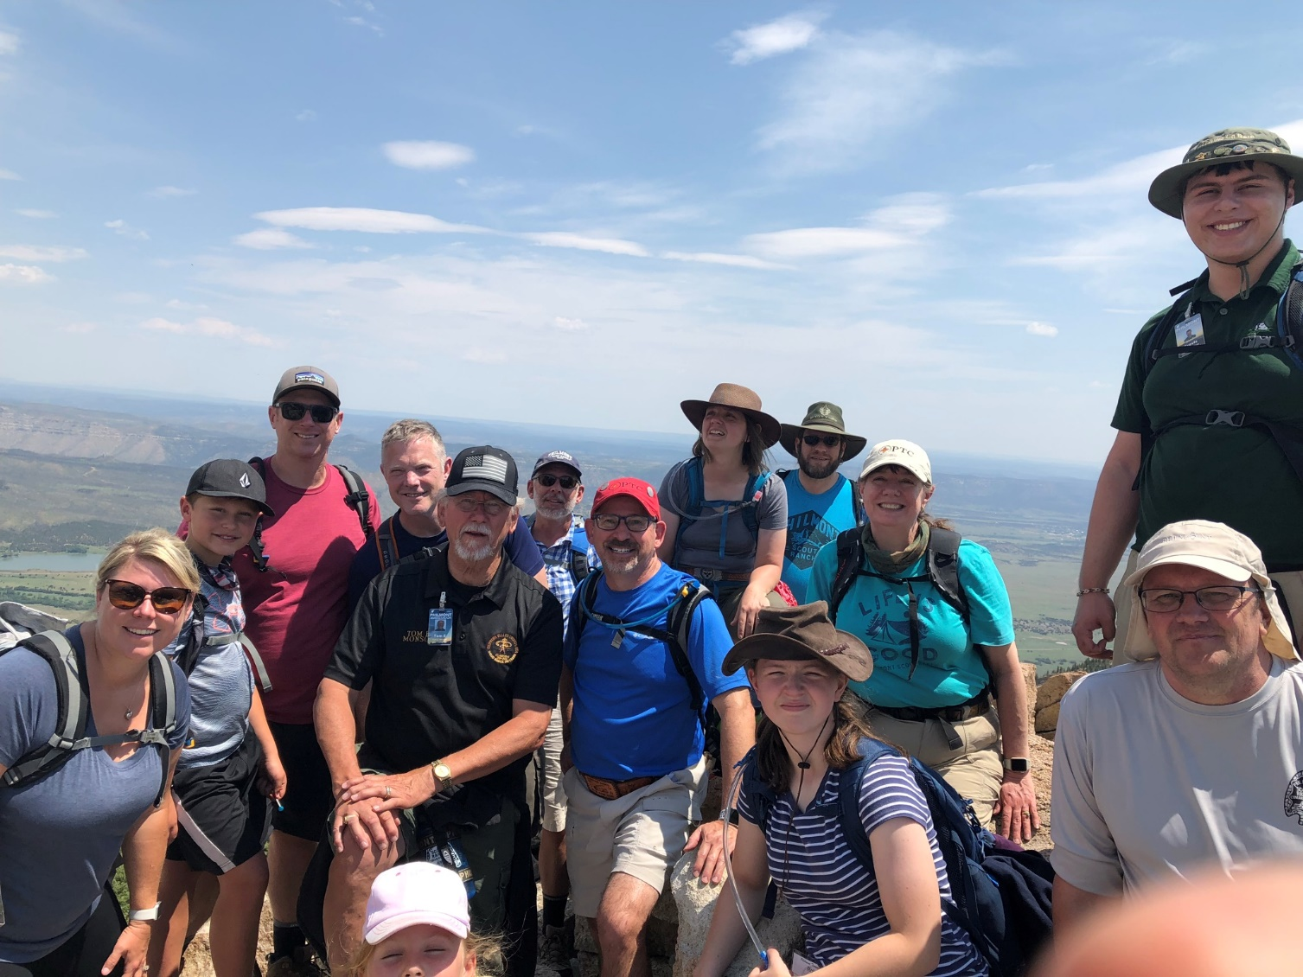
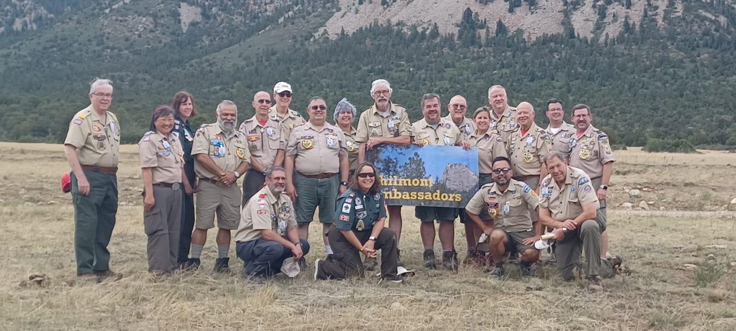
No. 8
Make lifelong friends.

Slide 40
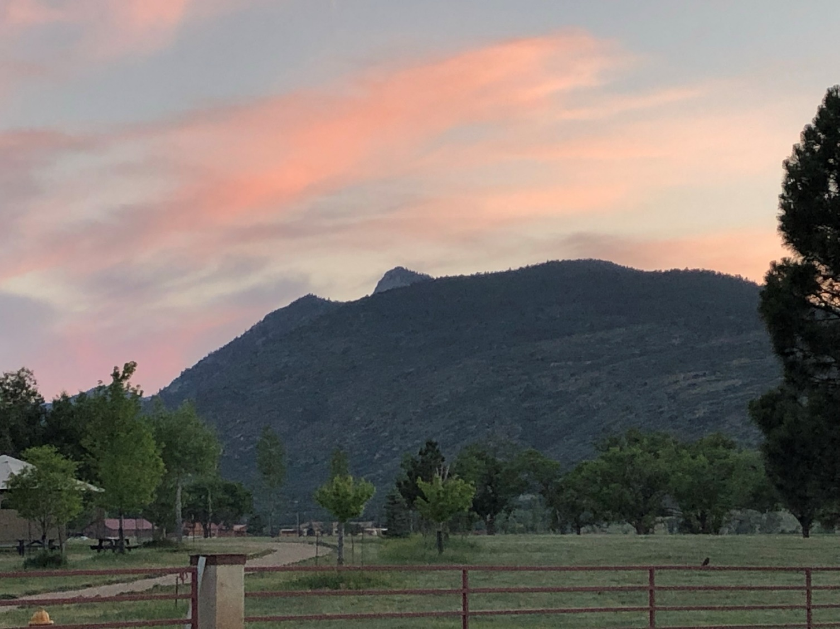
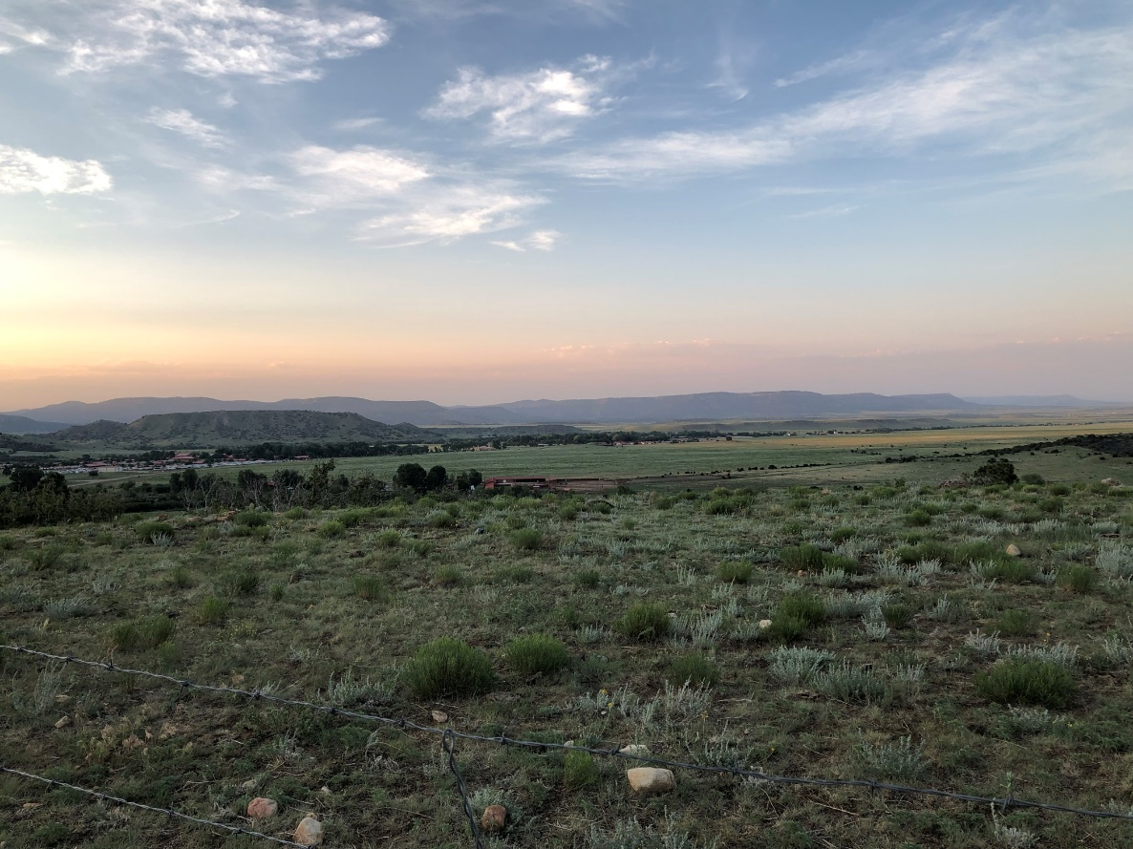
No. 7
Soaring vistas with beautiful sunsets.

Slide 41
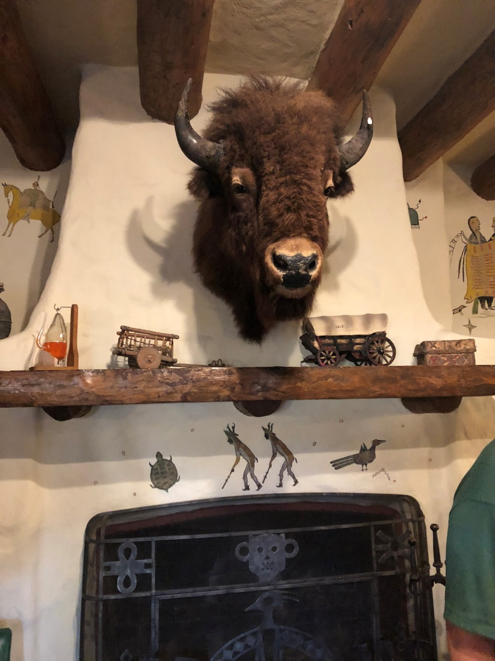
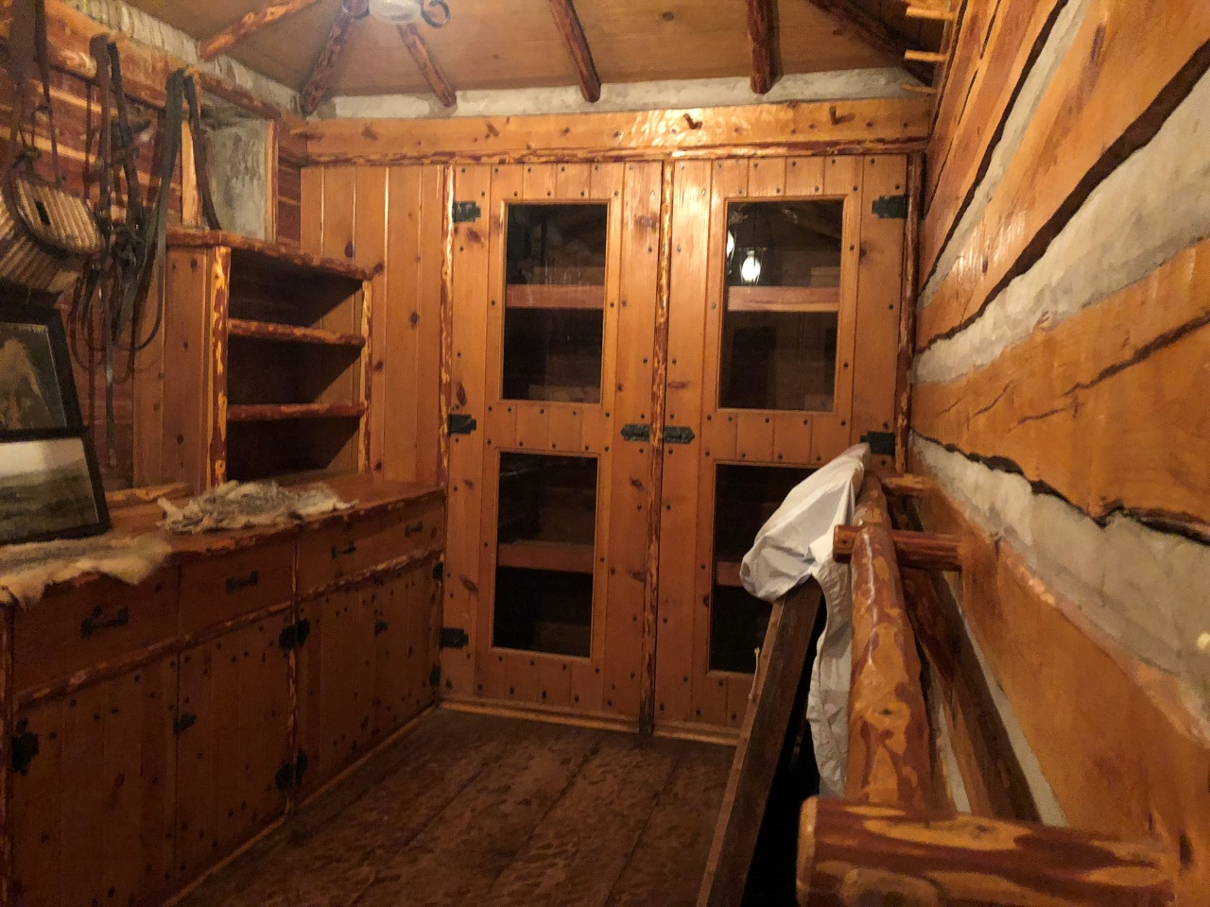
No. 6
Behind the scenes tour of Villa Philmonte.

Slide 42
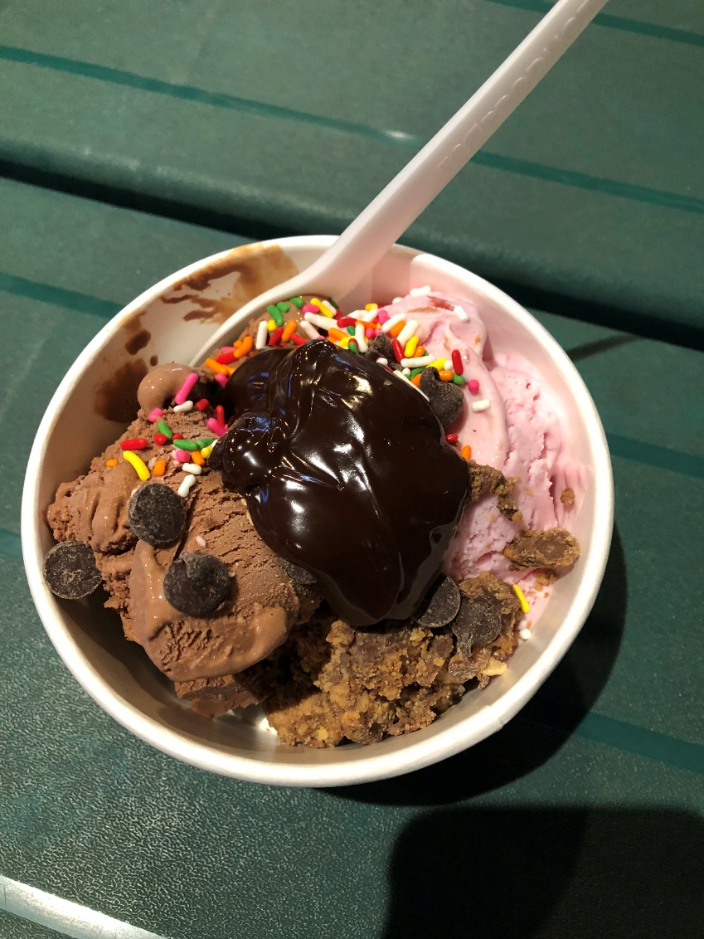
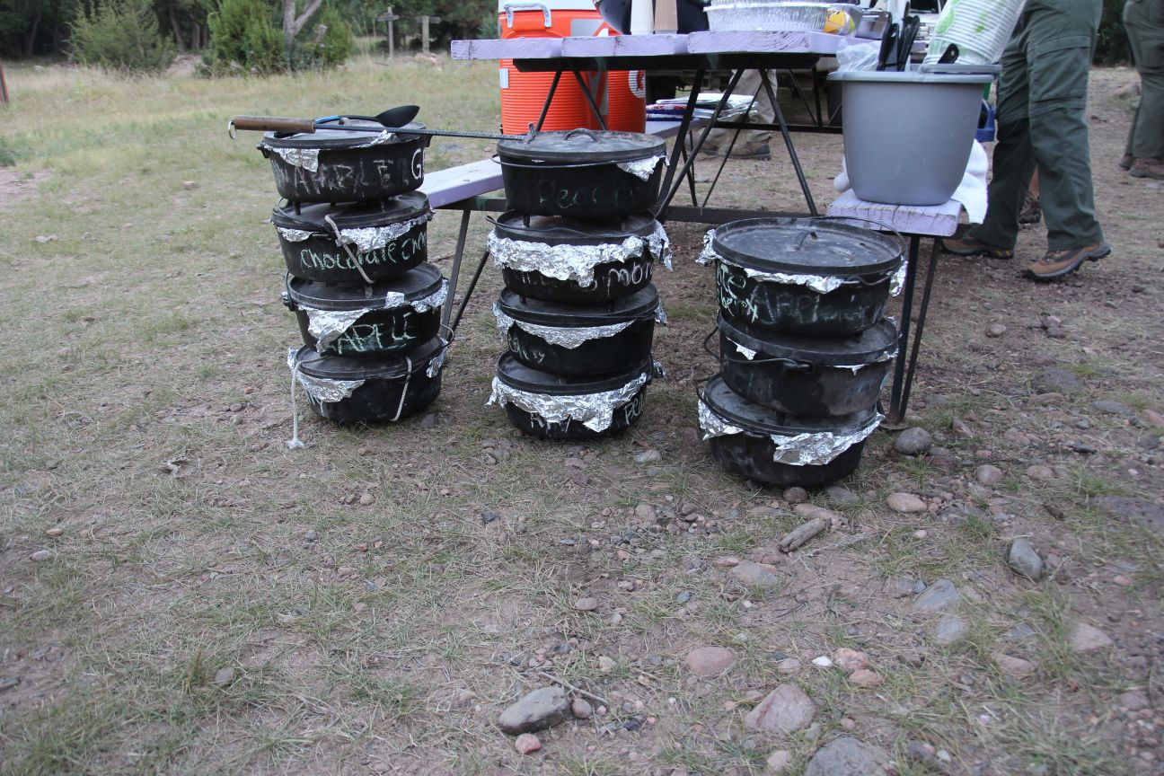
No. 5
Thursday night cobbler with a scoop of ice cream.

Slide 43
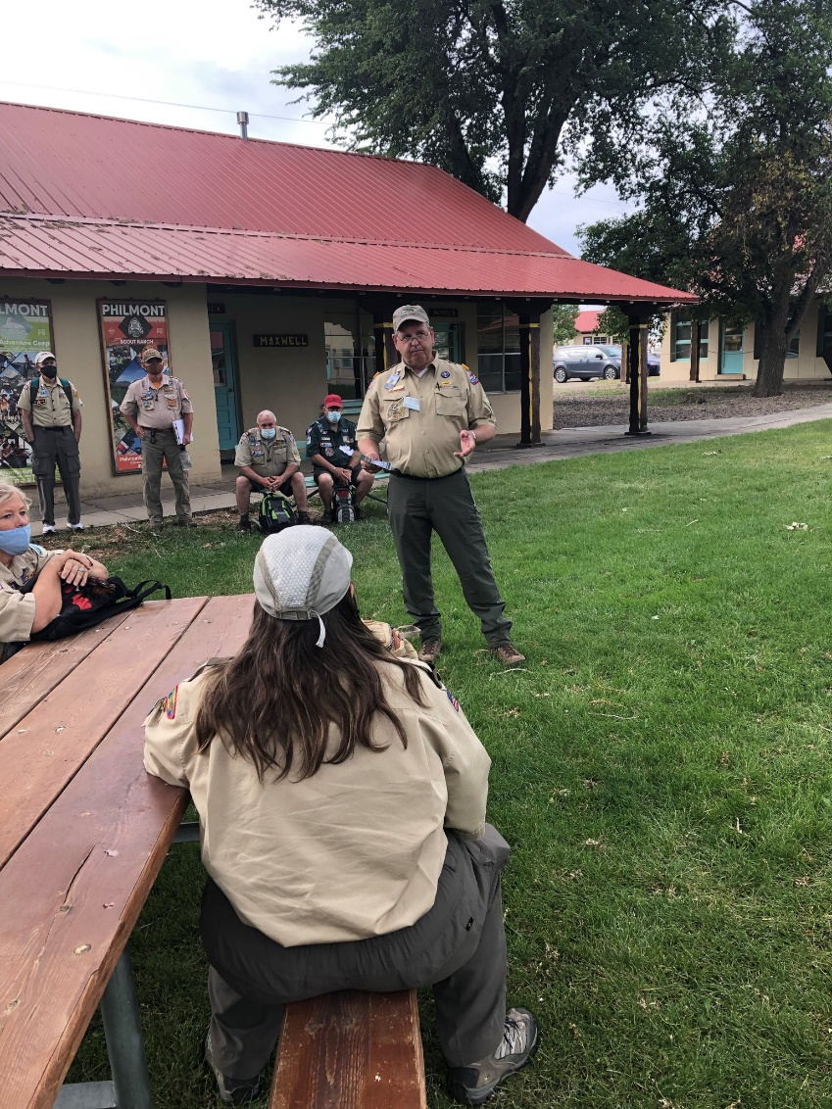
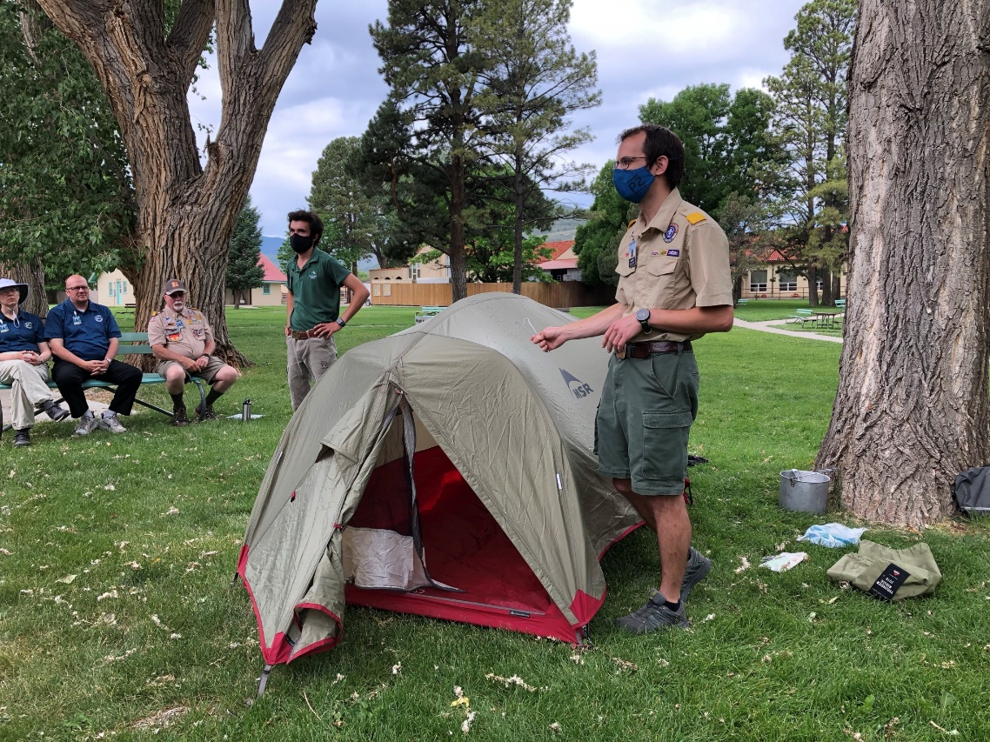
No. 4
To learn about individual programs while sitting on the lawn.

Slide 44
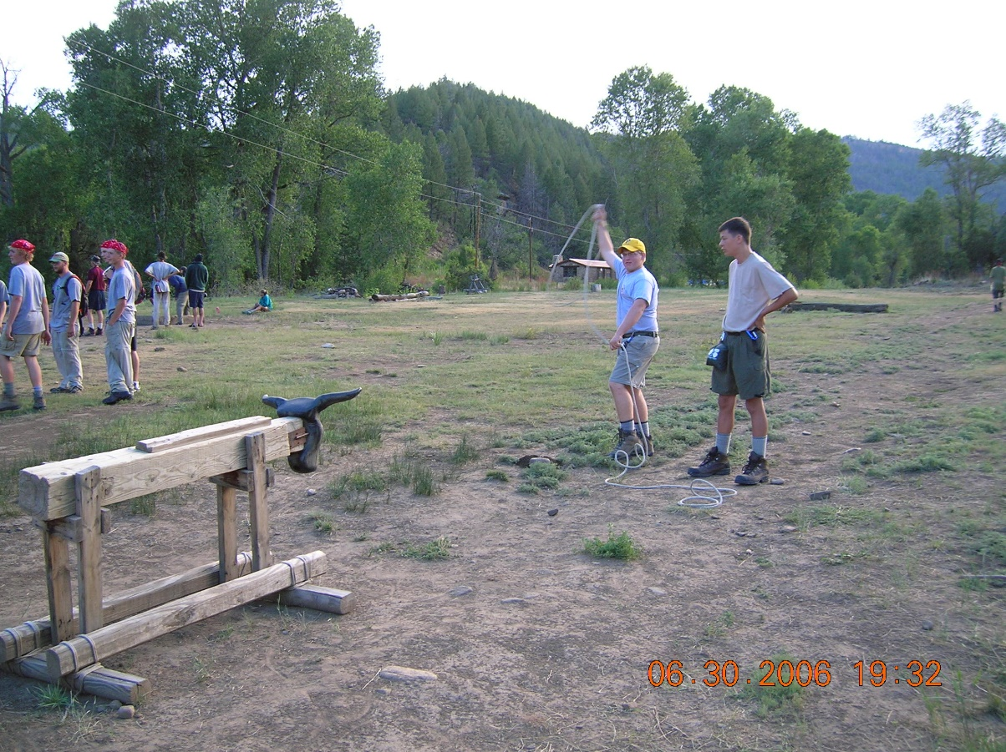
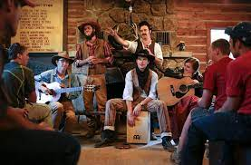
No. 3
Visit Ponil, a backcountry staff camp.

Slide 45
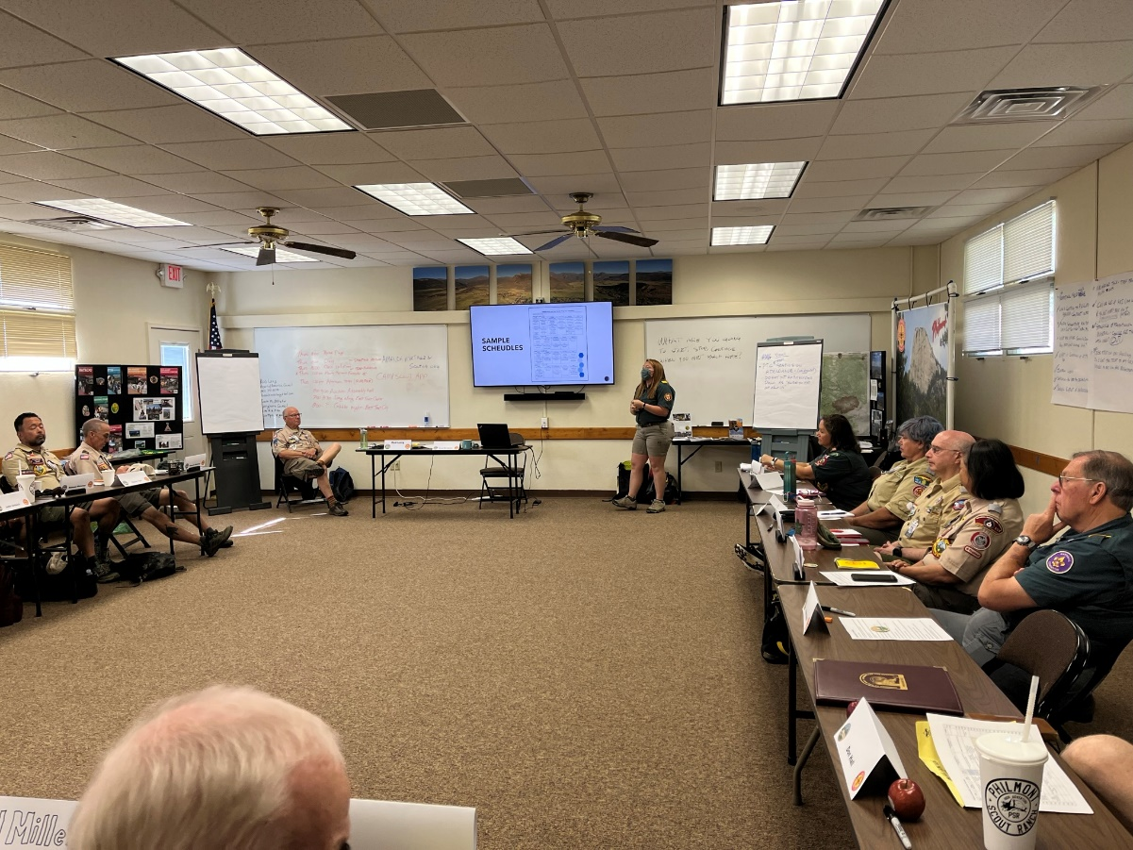
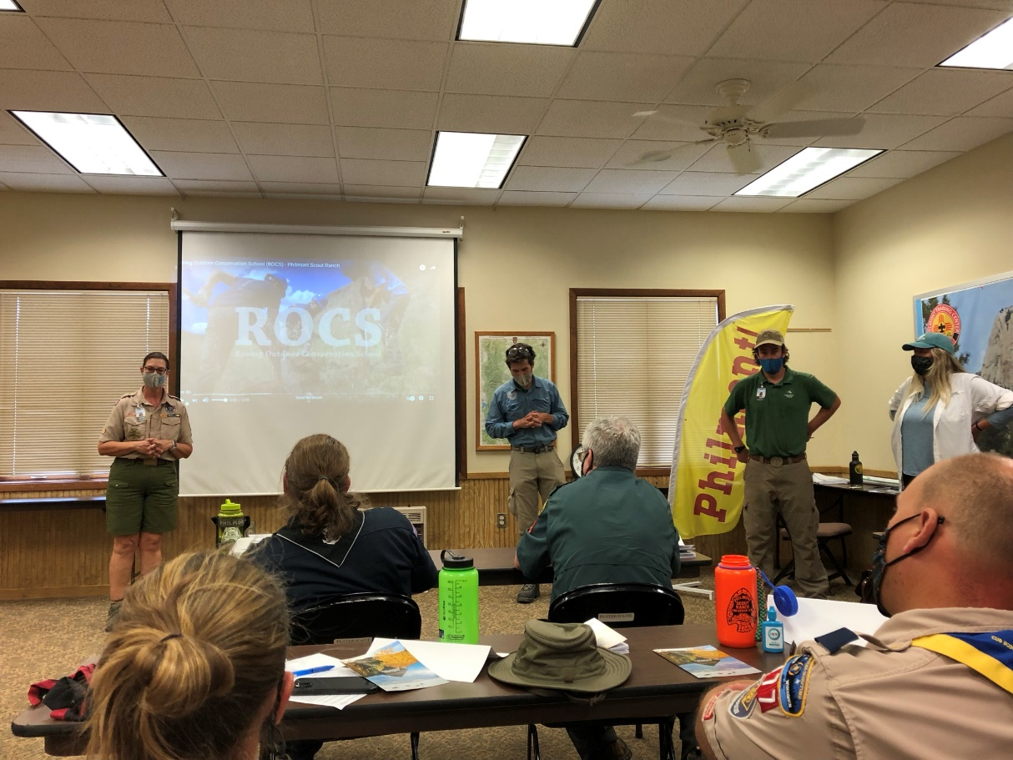
No. 2
To learn selling techniques of Philmont and what to do when you return home.

Slide 46
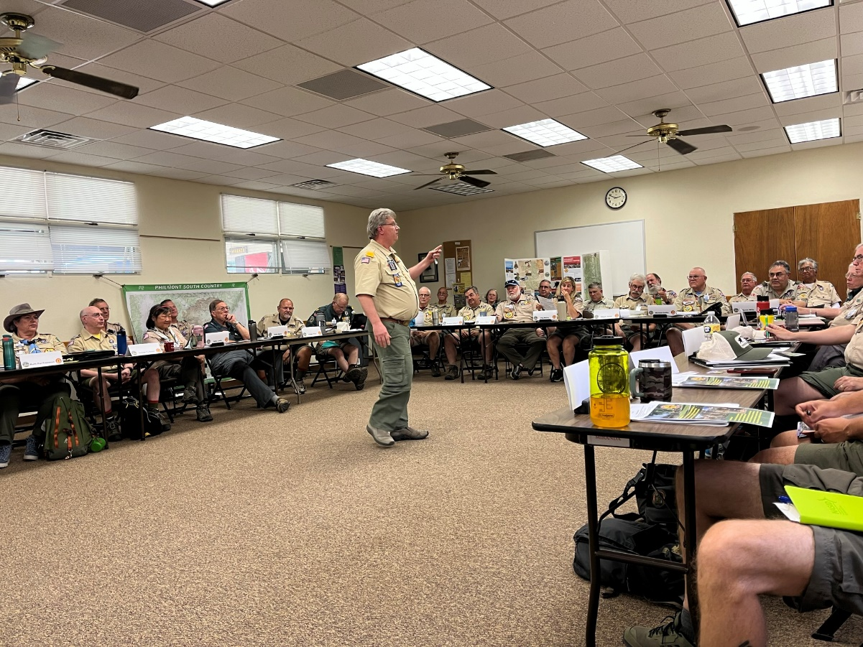
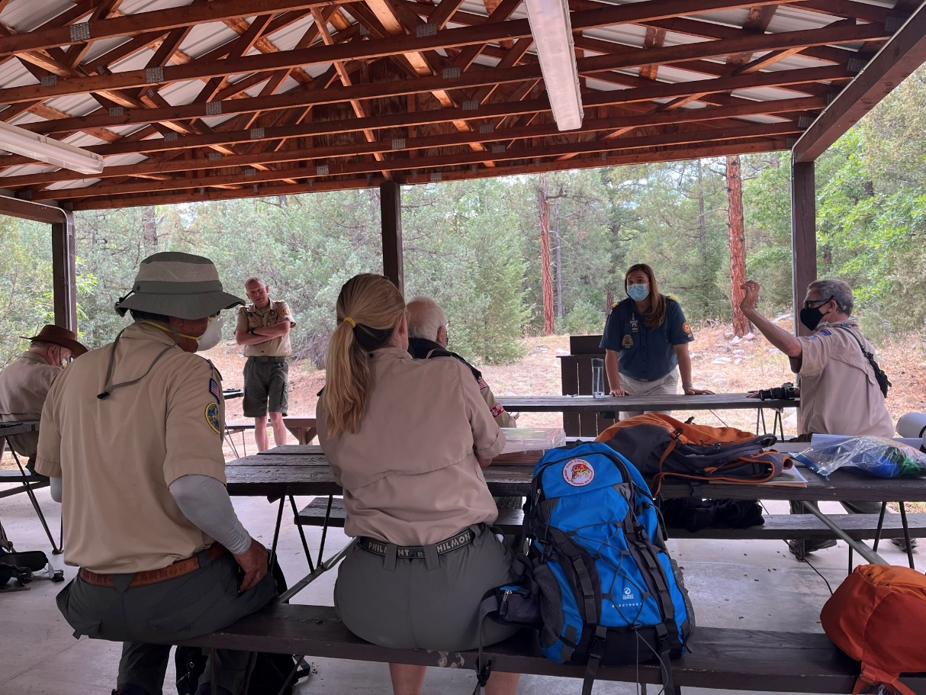
No. 1
To hear about the latest changes at Philmont from the CHQ and PTC leaders.

Slide 47
Ambassador II
Bob Weagraff
“Delivering Wilderness And Learning Adventures That Last A Lifetime”

Slide 48
Why Attend Philmont Ambassador II
Builds Upon Ambassador I
Covers Topics not Covered in Ambassador I
Tour & Deep Dive into Conservation Headquarters.
Staff Campsite Visit – Metcalf Station
Capstone for the Week – Group Project Applying What You Learned.
What an Experience!!
“Delivering Wilderness And Learning Adventures That Last A Lifetime”

Slide 49
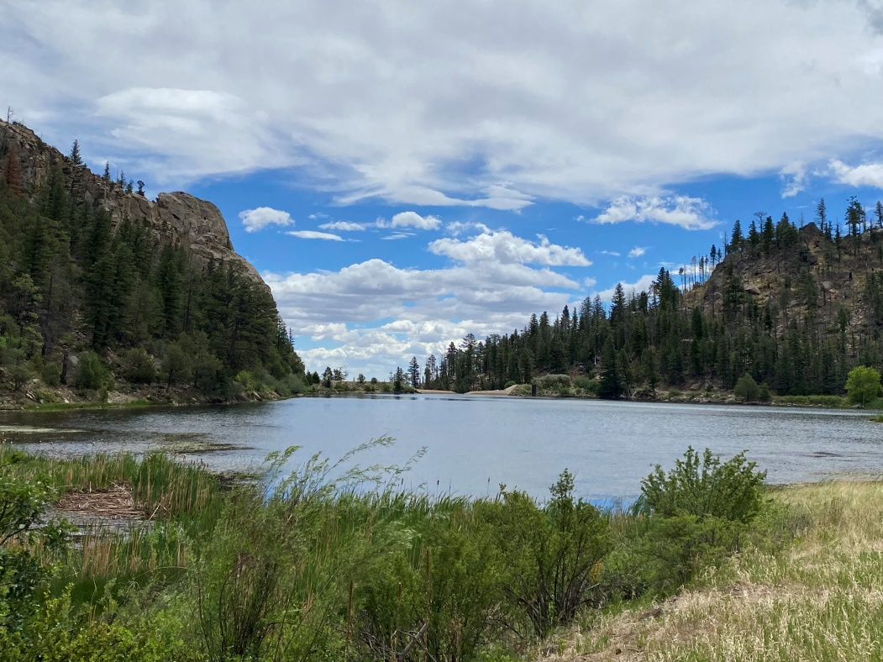
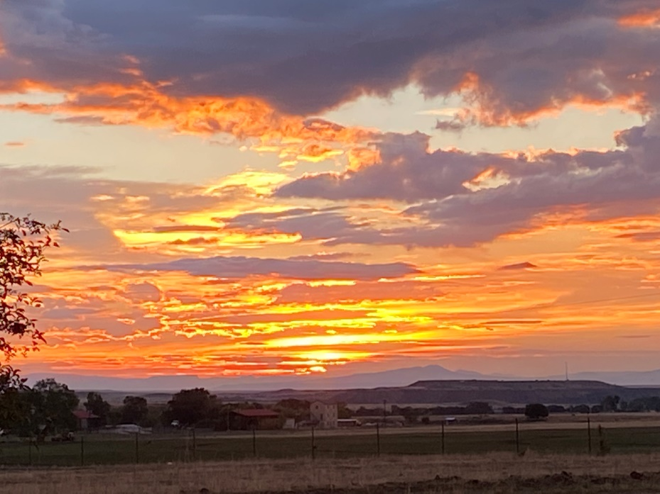
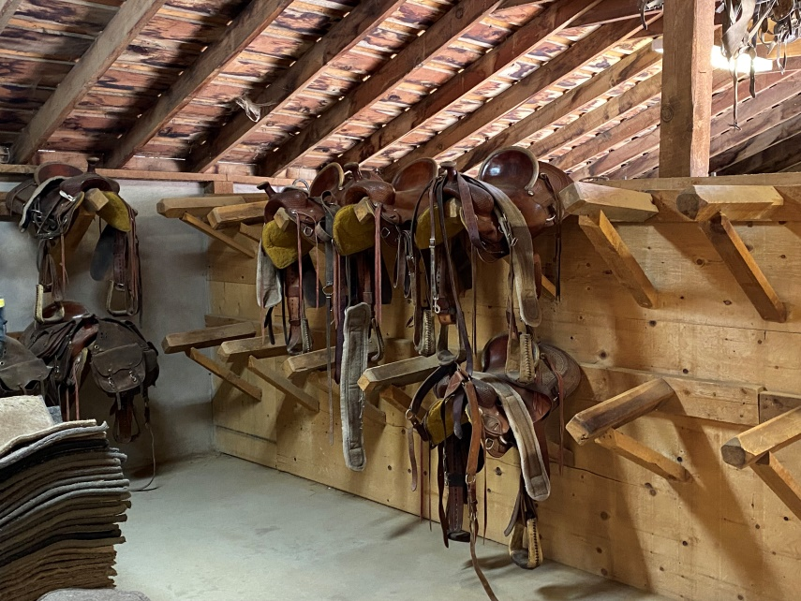
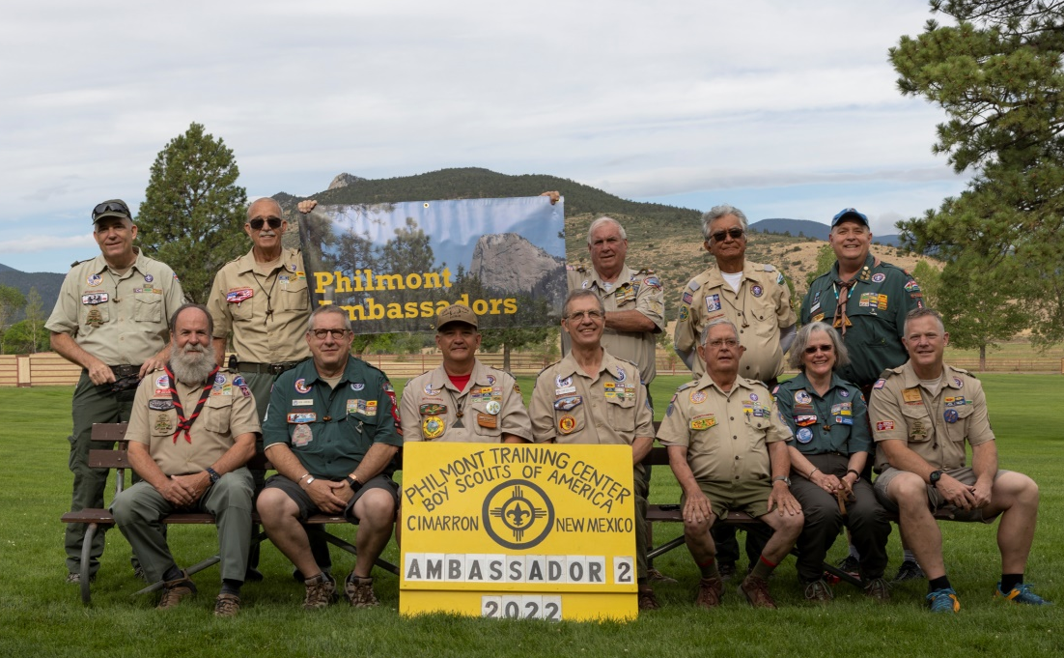
“Delivering Wilderness And Learning Adventures That Last A Lifetime”

Slide 50
Ambassador III
Rob Welander
“Delivering Wilderness And Learning Adventures That Last A Lifetime”

Slide 51
Ambassador Reception
“Delivering Wilderness And Learning Adventures That Last A Lifetime”

Slide 52
Philmont Scholarships
www.philmontscoutranch.org/rates/
“Delivering Wilderness And Learning Adventures That Last A Lifetime”

Slide 53
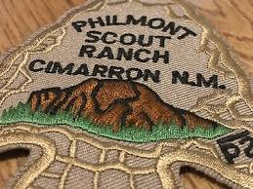
Ambassador Autumn Adventure
September 17-24, 2023
Bob Weagraff
“Delivering Wilderness And Learning Adventures That Last A Lifetime”

Slide 54
Philmont Autumn Adventure
When: September 17th to the 24th.
Where: Philmont Scout Ranch – Central Section? Camp Ideas - Tooth Ridge Camp, Hunting Lodge, Sawmill. Crew will decide with our trek guide.
Why: A Different Experience. Nature & You As One.
History: Only Open to Philmont Ambassadors. First Autumn Adventure was in 2021. Currently four participating in 2023.
“Delivering Wilderness And Learning Adventures That Last A Lifetime”

Slide 55
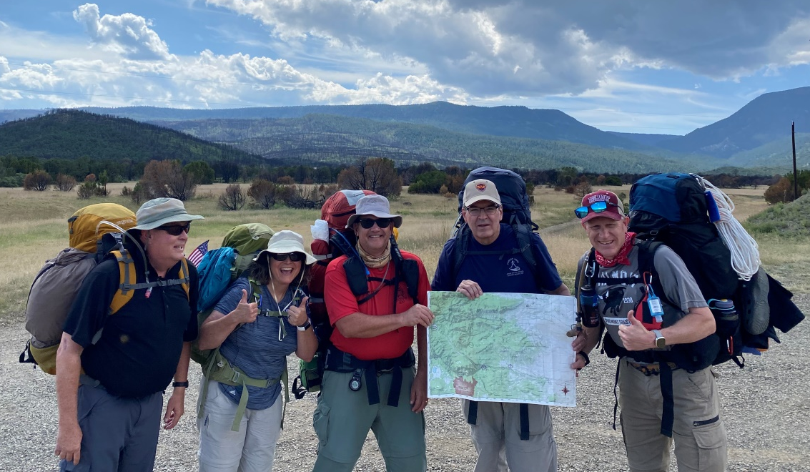
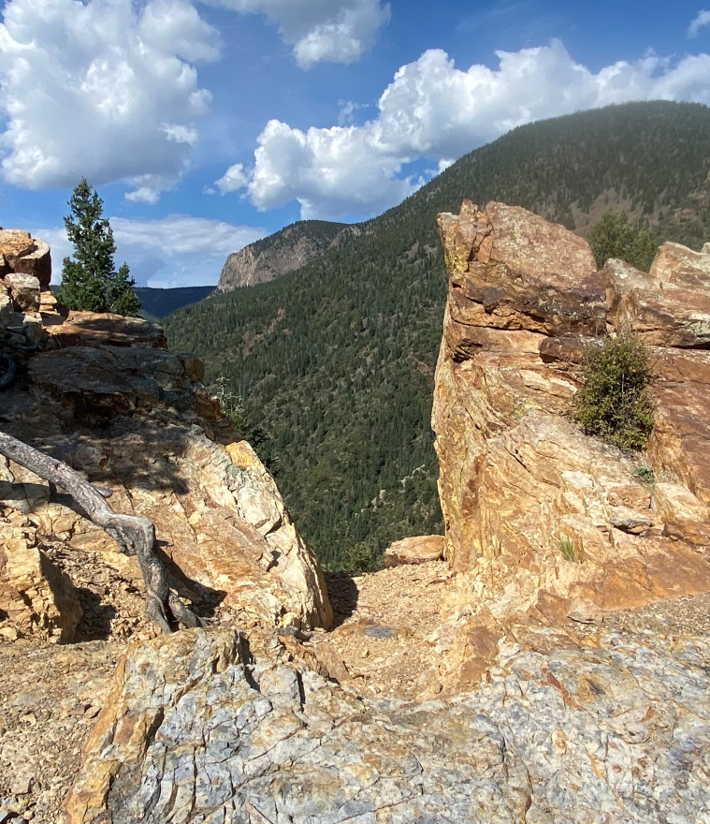
“Delivering Wilderness And Learning Adventures That Last A Lifetime”

Slide 56
Closing Thoughts
“Delivering Wilderness And Learning Adventures That Last A Lifetime”

Slide 57
“AND”
“Delivering Wilderness And Learning Adventures That Last A Lifetime”

Slide 58
Ambassador Challenge
Jim Ellis
Ambassador Task Force
Chair
“Delivering Wilderness And Learning Adventures That Last A Lifetime”

Slide 59
“Delivering Wilderness And Learning Adventures That Last A Lifetime”

Slide 60
“Delivering Wilderness And Learning Adventures That Last A Lifetime”

