Slide 1
Philmont Scout Ranch
Experiences that last a lifetime
Notes:
Note: Introduce yourself and describe what you will be covering in this presentation.

Slide 2
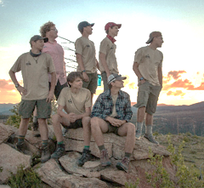
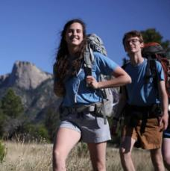
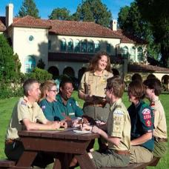
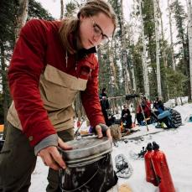
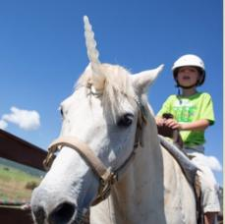
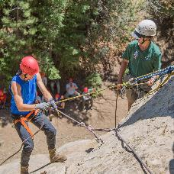
Philmont Experiences
Crew Treks
Individuals
Training Center
Off-Season
Family and
Unit Camps
Jobs
Notes:
Philmont delivers wilderness and learning experiences that last a lifetime.
Philmont is famous for Treks, but there are also Individual Opportunities that let you experience the backcountry especially if you don’t have a Troop or Crew to go with. The Philmont Training Center provides Scout Leaders an opportunity to learn more about the Scouting program so they can better serve youth in their area. Philmont is also open year-round for off-season adventures in the fall and winter. Family Adventure Camp gives parents and children or grandparents and grandchildren an opportunity to vacation at Philmont. A new program called Unit Adventure Camp lets youth ages 11 to 13 plus in your Troop get a taste of a high adventure camp while using the Training Center as a base camp. The All these programs require the help of a lot of staff, and Philmont is always looking for good people to provide program to visitors, so I’ll touch on that as well.

Slide 3
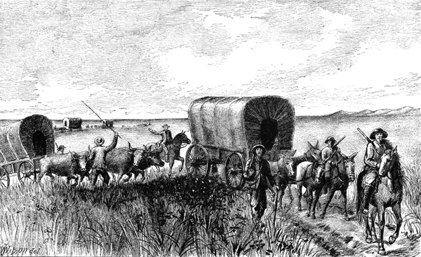
But first, some history
Notes:
Philmont is steeped in history. The area of northeastern New Mexico around the Ranch abounds in historic characters, legends and myths. These all add to the magic of Philmont.

Slide 4
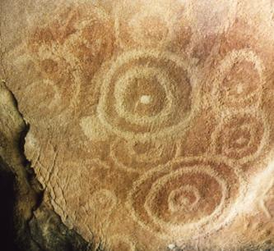
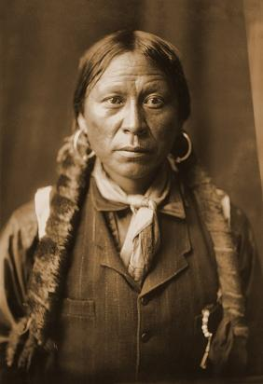
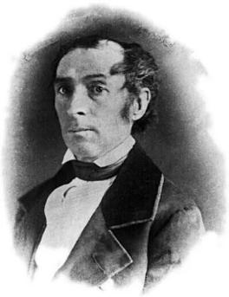
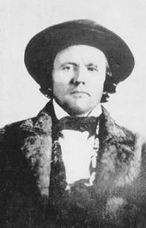
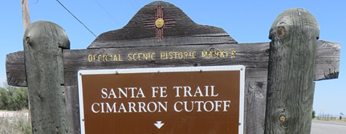
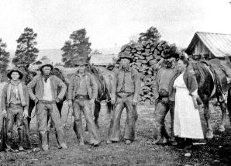
Notes:
Ancient peoples left their mark on the rocks which can be seen at Indian Writings camp. Native Jicarilla (Hee-kah-ree-yah) Apache and early Mexican settlers made this their home as well. Carlos Beaubien, originally a fur trader from Quebec, moved to Taos to set up business. He obtained a very large land grant from the Mexican Government in 1841 that included the site of Philmont. The Santa Fe trail passed right through Philmont, and you can still see the wagon ruts etched into the landscape. The famous frontiersman Kit Carson once made his home here along the trail and later in nearby Taos. Eventually, gold miners, loggers, ranchers and homesteaders came this area of New Mexico seeking a better life.
The nearby town of Cimarron was a real part of the Wild West. The St. James Hotel (formally Lambert’s Inn), was host to such notables as Wyatt Earp, Bat Masterson, Jesse James, Black Jack Tom Ketchum, Annie Oakley, Buffalo Bill, Fredrick Remington, Governor Lew Wallace, and Zane Grey. Bullet holes from gunfights can still be seen in its walls.

Slide 5
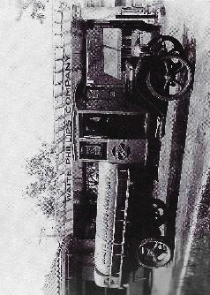
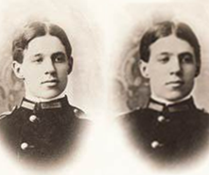
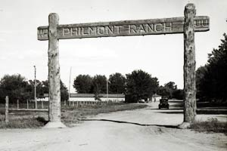
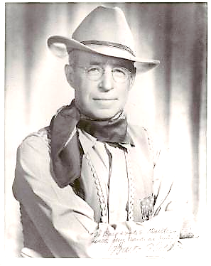
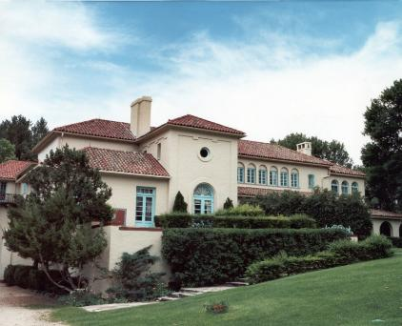
Waite Phillips
Notes:
One of the latecomers to the area was a man named Waite Phillips. His life is central to the story of Philmont Scout Ranch. Waite Phillips was an Iowa farm boy who roved the West with his twin brother Wiatt at the turn of the 19th century. After Wiatt’s death from appendicitis in 1902, Waite moved back to Iowa and later to Oklahoma to join his other brothers in business. They became successful in the early oil industry. Waite’s elder brother Frank founded the Phillips Petroleum Company known for its trademark Phillips 66 gasoline.
Waite founded his own successful oil company which he eventually sold in 1925 for $25 million. He built a mansion in Tulsa, OK and acquired a 300,000 acre ranch in New Mexico where he built his summer home. There, he could enjoy riding the range, hunting and fishing in the mountains, and entertaining his friends.

Slide 6
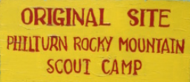
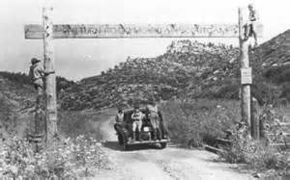
A Generous Donation
“These properties are donated and dedicated to the Boy Scouts of America for the purpose of perpetuating faith, self-reliance, integrity and freedom….
Waite Phillips, December 31,1941
Notes:
Scout Troops from the newly formed Boy Scouts of America approached Mr. Phillips asking to camp on his land. Waite learned more about Scouting and admired its principals embodied in the Scout Oath and Law. His first donation of nearly 36,000 acres in 1938 was put to such good use that he donated an additional 91,000 acres in 1941. The first camp was named Philturn for Phillips and the Scouts’ “Good Turn”. Over his lifetime, Waite Phillips gave half his fortune to charity.
Today, Philmont Scout Ranch is now one of the four national high adventure bases of Scouting America. It is famous for backpacking trips in the Sangre de Cristo (Blood of Christ) Mountains for scout crews. However, Philmont offers many more Scouting adventures than Treks which I’ll be talking about later in this presentation.

Slide 7
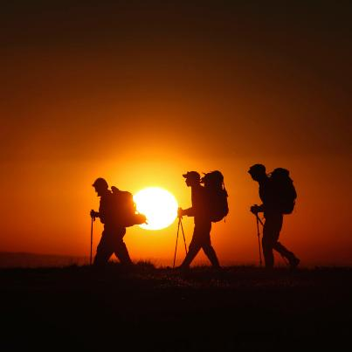
Philmont Adventures
Notes:
Philmont is synonymous with adventure, and we’ll first talk a bit about them.

Slide 8
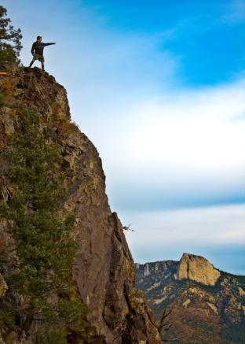
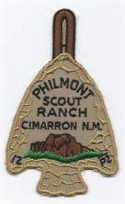


7, 9 or 12 day Expeditions
Mountain backpacking
25 to >70 miles
Fantastic scenery
Many activities
Notes:
Philmont has developed several programs for Scout groups. Principal among them are high adventure expeditions, commonly known as Treks, and Cavalcades which are essentially treks on horseback. Individual Units can form their own crews of older scouts. Scout Councils can put together contingent crews made up of scouts from several units, individual scouts, and even include Venture, Sea Scout and Explorer groups.
A Philmont Trek is often the highlight of a Scout’s experience. Scouts backpack with their crew through mountainous terrain on itineraries from about 50 to 78 plus miles over 12 days. There also treks of 7 and 9 days available.
Staffed camps have activities, potable water and even showers. Most trail camps have a bear cable, wilderness toilet, and waste sump. You’ll definitely be roughing it most of the time. Some backcountry camps are in wilderness areas with no water available so scouts learn conservation principals.
Along the way, trekkers will have great scenery and be able to participate in many activities.

Slide 9
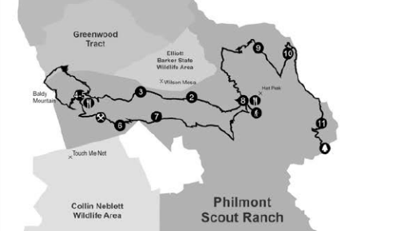
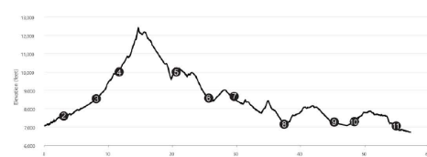
Example 12 Day Trek – Challenging, 58 Miles
Camping & Hiking Highlights
Baldy Mountain – 12,441 ft.
N & S Ponil Canyons
Dean Skyline
Program Highlights
Horse rides
Baldy Gold Mine District
Continental Tie and Lumber
Rocky Mt. Fur Company
Cimarron & NW Railway
Homesteading
Campfire show
COPE
Baldy
Notes:
Here is an example of just one 12-day trek. The Itinerary Guide you’ll get shows each Trek’s route, trail profile and highlights. Philmont pretty much guarantees that you can get you first or second pick of Itineraries.
This one covers 58 miles in the scenic central part of the Ranch. My next slide shows the highlights of this Trek.

Slide 10
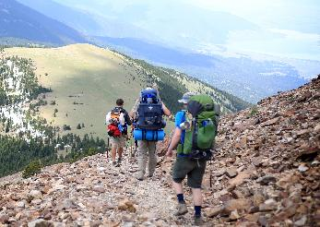
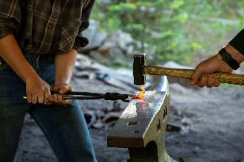
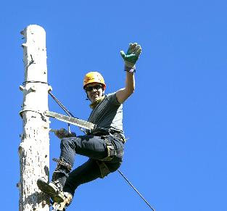
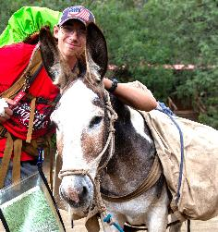
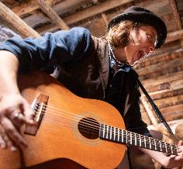
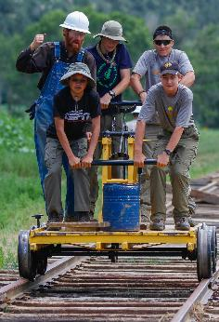
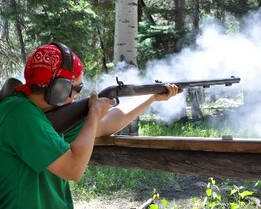
Notes:
Here’s just a few of the activities on this 58 mile Trek. You get to ascend Baldy Mountain, Philmont’s highest peak. You also climb spar poles at the historic Continental Tie and Lumber Company camp, do blacksmithing at Baldy Town. You shoot muzzle loading rifles and participate in a campfire show at Miranda. At the railroad station at Metcalf, you’ll pump a handcar. Tired of backpacking, you’ll use burros part of the way to carry your packs, just like in the old West. All along the way, you’ll marvel at the fantastic scenery high in the Sangre de Cristo range in the Rocky Mountains.

Slide 11
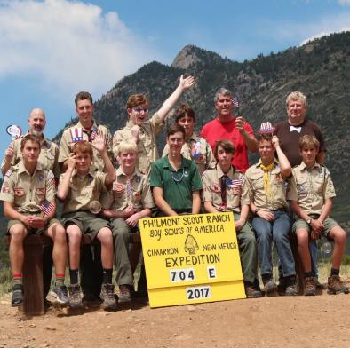
Crew Composition
8 to 12
Youth led
Minimum 3, Max 4 Adult Advisors over 21
Co-ed advisors if crew is co-ed
All must meet height/weight limits
3 WFA Trained*
3 CPR Trained*
* Wilderness First Aid
* Cardiopulmonary Resuscitation
Notes:
Every Philmont crew is effectively run by a youth called the Crew Leader, elected by its members. The Adult Advisors are there primarily to ensure safety. Crews range from 8 to 12, including the 3 or 4 Adults. Co-ed crews must have two-deep co-ed advisors. Three crew members, either adult or scout, must be WFA and CPR trained.
Everyone must meet Philmont’s strict health requirement regarding height and weight.

Slide 12
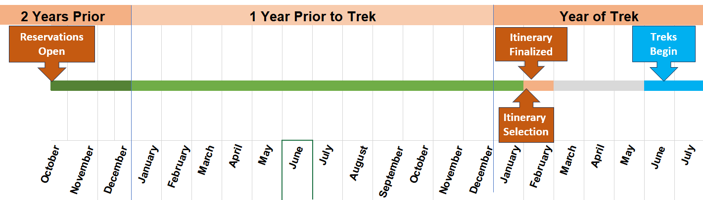
Unit Registration Process
Recruit Prepare Fundraise Train
Guaranteed
Trek Ends
Notes:
Individual units can get a slot for a Trek by applying to Philmont each in the fall about 18 months before you want to go. There is no longer a lottery. Units that apply by the guranteeed trek deadline will get a Trek. Those that apply afterwards may not get the exact dates they want, but Philmont will do its best to accommodate them.
It’s important to include younger scouts in your long-range planning process because they may be the ones leading their Trek in a few years.
The long lead time before you trek helps you get ready through recruiting, team-building, practice backpacking trips and fundraising. Be sure to reach out to other units in your area to fill out the numbers in your crew.
Sometimes a crew may need to cancel a reservation and their slot opens up. Check on the Philmont web page for openings that come up like this. Well-prepared crews may be able to get a Trek for the coming summer, but it is usually better to give yourselves time to prepare for the adventure ahead.

Slide 13



Trek Match System
Wanted
Scout
looking for
A crew
Wanted
crew
looking for
A scout
www.registerphilmont.org/entry/trek-match/interest
Notes:
The match system on the Trek registration page helps match a lone scout looking to join a crew or a crew looking to find a scout or leader to fill their ranks. This is a great way to give more youth the opportunity to have a Philmont experience.

Slide 14
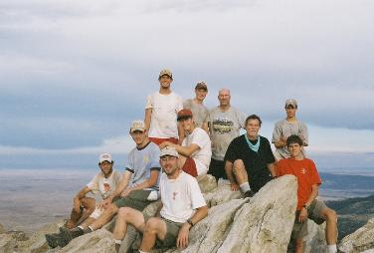
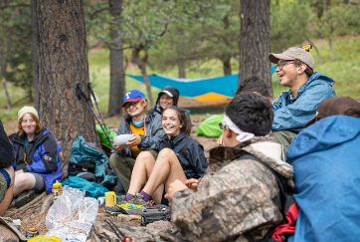
Council Contingents
    From one or several units
    Co-ed or single-sex
    Can Combine Scouts BSA, Venturing, Sea Scouts and Explorers
Notes:
Council contingents can be made up of one or several units and can also include individual scouts as well as Venture, Sea Scouts and Explorers. Each council has its own procedures for setting up a Council Contingent, so check with yours for details. These are great opportunities for scouts whose Troop may not be able to go on a Trek.

Slide 15
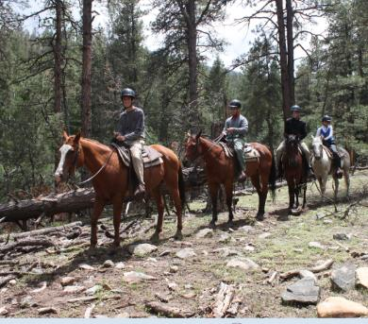
Cavalcades
8 days
10 to 15 people
Drawing held in January for following summer
Weight limit for all riders
Notes:
Cavalcades are essentially treks on horseback. There is a minimum of 10 participants per cavalcade. It’s good to reach out to other units to fill any Trek to the maximum allowable number of 15 because the cost for a cavalcade is the same whether there are 10 or 15 people. A drawing is held each January to fill slots for the following summer because demand for these is high.
Cavalcades visit camps and have activities along the trail much like Treks. At the end of their trip, riders participate in a Gymkhana which is a friendly horse-riding skills competition.
There is a weight limit on participants that applies to everyone on the trek, including adults, for the safety of the horse and rider.

Slide 16

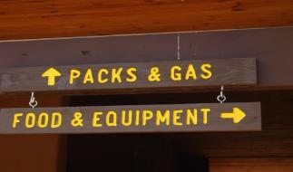
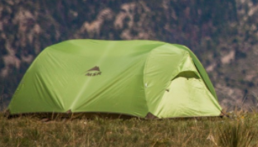
Backpacking Equipment
  Most crew gear free from Philmont.
  Packs can be rented.
  Can bring you own
  Any combination OK
Notes:
Many troops may not have backpacking equipment because it is a big investment for a scout. Philmont can provide you with almost all the crew essentials. Philmont gear is durable and been proven to stand up to the rigors of the backcountry. You can bring all your own gear or mix what you have with Philmont gear. Philmont also can provide MSR stoves, so you do not have to cope with shipping fuel.
If you choose to use Philmont tents, be sure to bring your own stakes! Your Philmont Ranger, who accompanies you for your first days on the trail, will teach you backcountry essentials along with bear safety procedures. You must carry and use Philmont bear bags and rope.
Remember, backpacking gear makes great birthday and holiday presents.

Slide 17
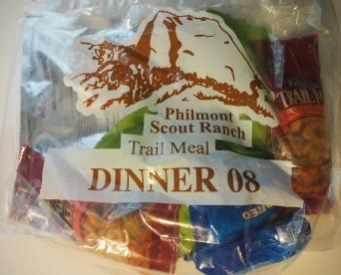
Trail Food
Provide all your needed
energy
Pick-ups every 2 – 3 days
Swap boxes at staffed
camps
Can accommodate special needs
  Kosher/Halal/Hindu dinners
  You can bring your special diet needs and have them delivered on trail (gluten fee, etc.)
Notes:
Philmont provides meals that give you all the energy you’ll need each day of your Trek. Each food packet feeds two people.
Cooked one-pot dinners are designed to be eaten with a bowl and spoon, so you don’t need to haul lots of eating utensils. Commissaries along your route re-supply you with provisions. Some commissaries have trading posts where you can purchase supplies like extra fuel or batteries.
Be sure to have packs large enough to accommodate all the food you’ll be carrying. For a crew of 12, a three-day supply of food will be 54 packages. Each package is about the size of a liter water bottle.
Staffed camps have food drops where you can swap out meal components or pick up extras.
If you have special needs, Philmont will work with you to accommodate your diet.

Slide 18





Expect Weather
Days
  75 – 95 F
  Cool mornings
  Afternoon showers
  Rain jacket and pants!
Nights
  40 - 55 F
  Temperature
  drops at night!
  Occasional
  night showers
Notes:
You will be in the high country where the weather can change frequently. Be Prepared. Don’t bring just a poncho for rain! You’ll need a rain jacket and pants. Plan to dress in layers so you can adjust as the temperature fluctuates through the day.
Summer weight sleeping bags may not keep you warm at night because the temperature drops fast in the mountains once the sun goes down. Philmont recommends a bag rated to 20 degrees weighing less than 5 pounds.

Slide 19
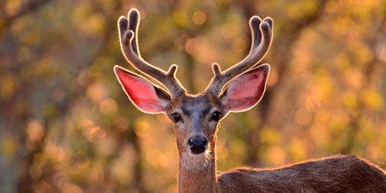
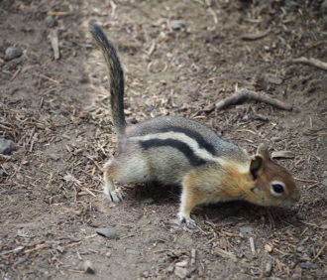
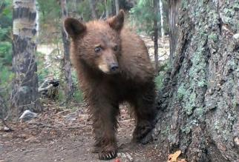
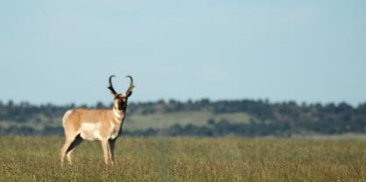
Encounter Wildlife
Notes:
Wildlife is abundant on the ranch. Mule deer are plentiful, and so are mini-bears (chipmunks) which can be as destructive to packs and food as real bears. Philmont has pronghorn, elk, black bears, bison, and mountain lions along with smaller animals like racoons, beaver and jackrabbits. Golden eagles, red-tail hawks, magpies, jays, and hummingbirds can be seen on the fly. Be aware that you also share the backcountry with snakes and spiders.
Although it may be exciting to see a bear, it is best to follow Philmont’s bear safety practices to keep both you and the bear safe.

Slide 20
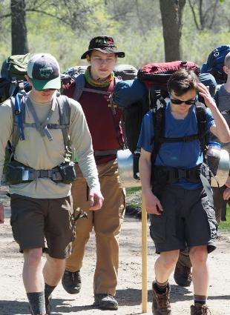
Words of Wisdom
Get in shape!
Read everything Philmont sends you
Read it again!
Have extra adult on-deck
Make it affordable
Notes:
There is no substitute for getting in shape by doing backpacking trips or long hikes with your full pack on. You don’t need mountains - just hike! Be creative in your local area. You can do multi-day backpacking trips at a state park and make multiple loops. Building your basic cardio fitness is the most important thing you can do to be in shape for Philmont.
Have an extra adult willing to go on short notice so that if one drops out, you still have three-deep leadership. Philmont is strict about this policy.
“A Scout is Thrifty” Driving may be the least expensive way to travel if you have time. Economize by camping along the way or staying at churches. Adult leaders in the military reserve may arrange to stay on military bases.
For long distance travel, you may need to fly into Denver, Colorado Springs or Albuquerque. There are travel companies that can help with transport to Philmont or you may rent vehicles.
Amtrak loves scout groups! Philmont will pick up crews at the Amtrak station in Raton, NM. The train makes long-distance travel easy and saves overnight accommodation costs along the way,

Slide 21
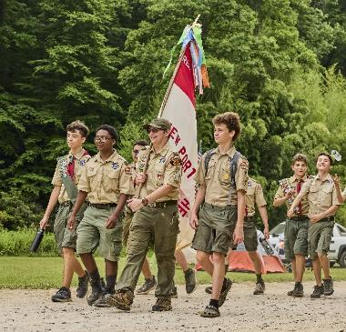
Unit Adventure Camp
Notes:
Beginning in 2025, Troops with younger scouts ages 11 to 13 can spend a week at Philmont to get a taste of what High Adventure is like. They’ll use Philmont Training Center’s facilities as a base camp. If the Troop’s older Scouts are on 7 day trek, this is an ideal opportunity for everyone to be at Philmont at the same time.

Slide 22
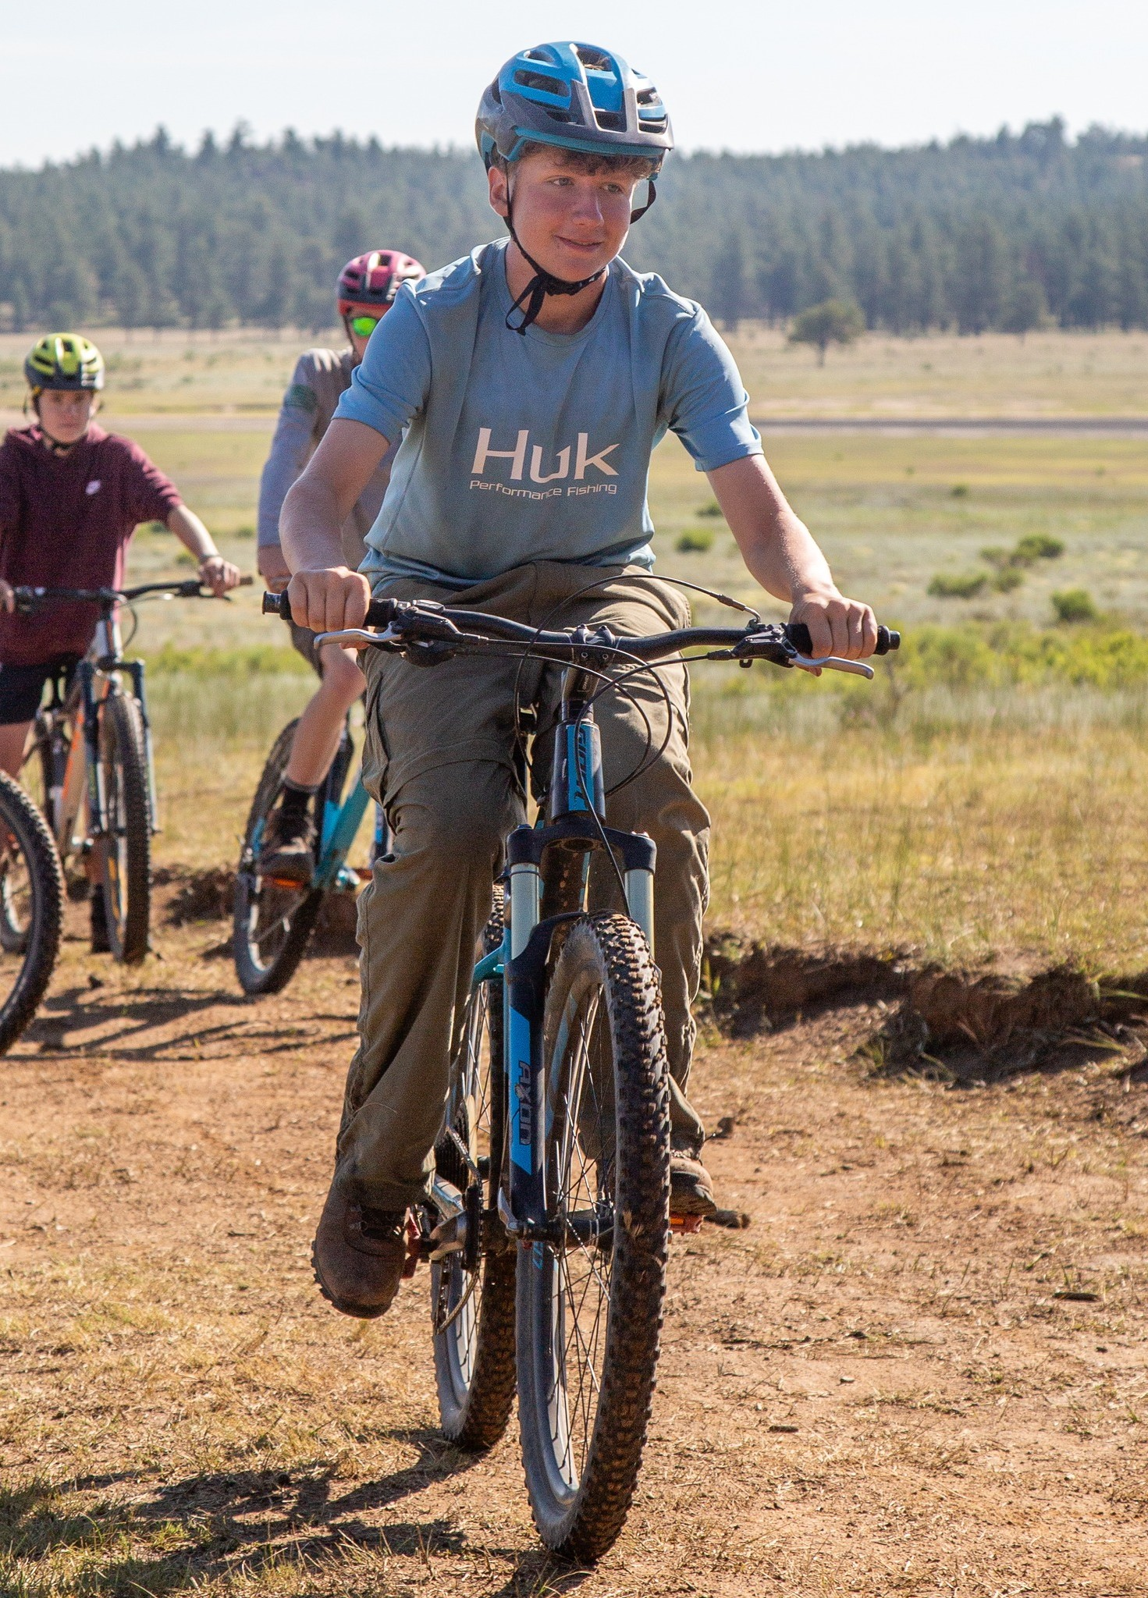
Program features
For scouts 11-13
Full week at Philmont!
Base Camp at PTC
High Adventure-type
activities
Lots more Scouts experience Philmont
Notes:
Troops with younger scouts ages 11 to 13 can spend a week at Philmont to get a taste of what High Adventure is like. They’ll use Philmont Training Center’s facilities as a base camp. You are not restricted on the number of adults you bring, unlike on a Trek, so more of the troop can experience Philmont. If the Troop’s older Scouts are on 7 day trek, this is an ideal opportunity for everyone to be at Philmont at the same time.

Slide 23
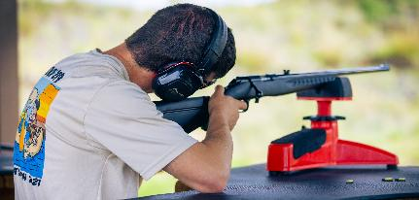
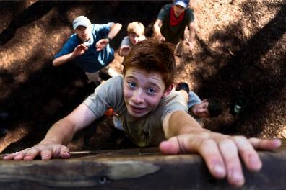
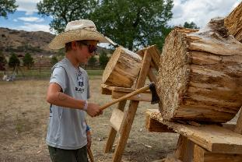


Adventure Camp
Activities
Notes:
During their week, Scouts will go on day hikes, use shooting ranges and climbing areas and other exciting areas around the Ranch.

Slide 24

Stay and Play Option
Notes:
Ther New Stay and Play option allows crews to arrive one or two days early so that they can acclimate to the altitude. While staying at PTC’s facilities, they’ll have more time to explore the area. They’ll even be able to get a head start on their Trek by doing their conservation project early.
Crews staying after their trek can unwind and relax. Both early and late crews can tap into the Adventure Pass option to do extra climbing, shooting and hiking.

Slide 25

Come Early or Stay After
Arrive early to acclimate
Enjoy Philmont after Trek
Use PTC facilities
Add Adventure Pass
Notes:
Ther New Stay and Play option allows crews to arrive one or two days early so that they can acclimate to the altitude. While staying at PTC’s facilities, they’ll have more time to explore the area. They’ll even be able to get a head start on their Trek by doing their conservation project early.
Crews staying after their trek can unwind and relax. Both early and late crews can tap into the Adventure Pass option to do extra climbing, shooting and hiking.

Slide 26

Individual Opportunities
Notes:
Philmont offers great programs called Individual Opportunities for scouts to experience Philmont if they do not have a chance to go on a Trek with a unit. Several Individual Opportunities combine a week of work with a week of trekking. This results in a substantially reduced cost. Although you have to arrange transportation for a scout to and from Philmont, the ranch can assist with travel from airports in Denver, Colorado Springs, and Albuquerque or the Raton, NM Amtrak Station.
NEW – Parents or guardians may stay at Family Adventure Camp while their scout is on an Individual Trek. You might even be able to volunteer to help out at Philmont during your stay.

Slide 27

Rayado
Ages 15 to 20
Ultimate 21-day backcountry Trek
Explore remote areas
Notes:
Rayado crews roam the entire backcountry and visit places that normal treks do not get to visit. A Rayado Trek really builds self-sufficiency and teaches skills so that attendees can lead other high adventure outings.

Slide 28

Trail Crew
Ages 16 – 20
7 day work/
7 day Trek
Learn
conservation techniques
Reduced cost
Notes:
Trail Crews help maintain the Philmont Backcountry. After your work week is done, you get to plan your own 7-day trek. Because you work for part of your experience, the cost is reduced compared to an equivalent trek.

Slide 29

Order of the Arrow
Trail Crew
Ages 16 – 20
7 days work/
7 day trek
Embody
“cheerful service”
Reduced cost
Notes:
Like Trail Crew, the OA Trail Crews maintain backcountry paths. They also incorporate OA leadership and cheerful service principles into the program. Cost is reduced because of the work you do for Philmont in building and maintaining trails.
Later in your scouting career, you may get the satisfaction of hiking a trail that you built.

Slide 30

Roving Outdoor
Conservation
School
16 to 20 years
21 day Trek
Learn advanced land
resource management
Reduced cost
Notes:
Anyone interested in natural resource management should take advantage of the Roving Outdoor Conservation School, or ROCS, to learn vital skills in the backcountry. Philmont teaches forestry, geology, fish and wildlife management, watershed management, and many more disciplines while on this extended trek. Participants will work on conservation projects in the backcountry and so the cost of the experience is less than an equivalent trek.

Slide 31

Ranch Hands
Ages 16 to 20
Ranch work 8 days/
8 day cavalcade
Experienced or novice
Reduced cost
Notes:
Those with equestrian care experience can put it to good use as a ranch hand. Or you can take this opportunity to learn what ranching is all about. Ranch Hands help with Philmont horses, cattle and livestock for a week.
Afterwards, they go off on their own cavalcade which is a trek on horseback. The cost is reduced because of your work on the ranch.

Slide 32

Financial Assistance
This Photo by Unknown Author is licensed under CC BY-NC
Notes:
There are costs associated with a Philmont trek, but don’t let lack of funds stand in the way of a youth attending Philmont. You’ll have over a year to do fundraising to support your trip.

Slide 33

Scholarships
Search “Trek Scholarship” on website
$400/crew from
Waite Phillips
Your council may have camperships
Seek Local donors
    VFW, Legion, etc.
Notes:
Philmont has money available to assist Scouts to go on a trek. For example, each crew is eligible for one Waite Phillips Scholarship for one Scout. If a Scout truly has financial difficulty affording a Trek, reach out to Philmont to see if it can help.
Scholarships may be available through your council or by appealing to local donors.
Patriotic community groups like veterans’ organizations are especially helpful when it comes to helping Scouts attend a camp like Philmont.

Slide 34

Philmont Staff Association
Scholarships awarded:
  Trail Crew
  OA Trail Crew
  Ranch Hands
  Rayado
  ROCS
Apply on www.philstaff.org
Notes:
Philmont Staff Association is made up of past employees and training center faculty. It is especially supportive of Individual Opportunities with scholarships. Reach out to the PSA if you are going on one of these adventures.

Slide 35

Philmont programs
Check with Camping Department on incentives/discounts*
  Early registration
  Late season registrations
  Returning crews
  First-time crews
  * Subject to change
Notes:
Philmont from time to time offers incentives such as discounts for early registration or registering for a Trek later in the summer when attendance can drop off. Contact the Philmont Camping Department for more information.

Slide 36





Why Philmont?
Program
Places
People…
…You can’t get anywhere else!
Notes:
Scouting America has a lot of opportunities for High Adventure. Philmont offers a unique combination of programs, places and people that make it a wonderful place for Scouts to experience what it is like to have a wilderness experience while participating in activities in a very special mountain setting. What’s more, Philmont has been doing this since 1938, so it has the resources and guides to make your Trek successful, whether it is you first or you have been there many times.

Slide 37

P hilmont T raining C enter
Notes:
Philmont Training Center, better known as PTC, is open to all Scouters in all Programs. It is even open to non-scouters wanting to learn more about leadership or just wanting a family vacation.
Conferences are held on the grounds of the beautiful Villa Philmonte which Waite Phillips donated to be a center of Scouter training programs.

Slide 38

PTC – Learning and Fun!
Enroll on-line
Gain program insights
Learn new skills
Meet Scouters from
all over
Bring your family for the
best vacation EVER!
Notes:
It’s easy to find available conferences and sign up online. PTC conferences run the gamut -from Scout skills to running a District or Council. Many involve people skills like building relationships and working with scouts of different abilities. They are all designed to improve your scouting experience and programs for the youth we serve.
At PTC, you’ll meet and learn from Scouters from across the country. Bring your family along so everyone can enjoy the southwestern hospitality.

Slide 39

Unit Leaders
Den Leaders
District personnel
Commissioners
Key 3
Chartered Org Reps
Religious leaders
Any Scouter
Non-scouters too!
Notes:
Any registered Scouter and even non-scouters can attend PTC. If you are involved with youth programs of any kind, PTC is there to help you help our youth.

Slide 40

Conferences
Commissioners
Outdoor skills
Relation building
Unit essentials
Leadership
Faith and Scouting
Special Needs and dozens more!
Notes:
Conferences cover a wide range of topics so that every Scouter can find one that fits their interest. Commissioners have a week all to themselves in June. What better place to learn outdoor skills than in “God’s Country” at Philmont Scout Ranch? Leadership and teamwork are at the core of Scouting, and you can pick up tips and techniques from national experts on these topics.
Scouting is also increasingly serving youth with special needs, and PTC can equip you to meet them. You can learn about adaptive equipment and techniques that let all youth participate in outdoor adventures.

Slide 41
Weekly Schedule
Sun | Mon | Tues | Wed | Thurs | Fri | Sat
 |  |  |  |  |  | Depart
 | Lunch
Arrive |  |  | Free time
 | Dinner
Breakfast
Conferences
Conferences
Conferences
Dinner
Evening Activities
Notes:
Your weekly schedule at PTC includes plenty of time to be with your family at meals and during evening activities. Conferences have breaks during Wednesday when you can explore the surrounding areas.

Slide 42

Bring your whole family!
Kids and Kin Program
  Infants to 5 – Small Fry
  6 to 10 – Trappers
  11 to 13 – Loggers
  14 to 17 – Miners
  Non-conference
  Spouses - Silverados
Notes:
PTC’s family program, now called “Kids and Kin”, is for the spouses and children (even grandchildren) of conference attendees. Philmont’s awesome counselors will keep them engaged through the day with age-appropriate activities such as games and crafts for youngsters, hikes and pony rides for older kids, and shooting, climbing and high ropes courses for teens. While the kids are being looked after, spouses can enjoy museum tours, learning to paint or craft, or just relax on the Villa Philmonte grounds. You’ll all have time together at meals and in the evening for loads of fun at campfires, range sports, crafts and other Philmont family activities.
Loggers and Miners get to spend a night camping out with a parent to get a feel for Philmont’s beautiful backcountry.
Other family programs like Philmont’s “Duty to God” and Junior Ranger and Wrangler activities provide opportunities to earn recognition for completing their associated activities.

Slide 43

Family Adventure Camp
Notes:
Many Scouters who attend PTC wish they could spend more time with their families than sitting in a classroom all week. Well, they can! Family Adventure Camp lets them and their family enjoy many of the activities at Philmont for a week or half-week. It is an unsurpassed opportunity to share quality time together.

Slide 44

Options
Full week and
Half Week
Overnight visit
Day visit
Notes:
You can schedule a week or half week at Family Adventure Camp. There is now even an option where you can spend just a half day or a full day doing the fun activates at PTC if you just happen to be in the area or passing through.

Slide 45






Family Camp Activities
Welcome Home
Happy Hiker
Adventure Seeker
Angler
Adventure
Mini Bear
Adventure
Philstorical
Notes:
There are many activities that you can do at Adventure camp. The best part is that you get to choose what you want to do.
We call Philmont HOmE – Heaven on Earth- and the Welcome HOmE adventure gives you a taste of all Philmont offers.
Want to explore the beautiful backcountry? Then head off on the Happy Hiker adventures to some of the peaks and passes in the Sangre de Cristo mountains.
Parents with older children can climb, shoot, fish and camp with the Adventure Seekers.
Philmont’s streams and lakes have an abundance of wary trout. Spend time trying to outsmart them while fly fishing on the Angler Adventure. Philmont supplies the guides and equipment, but you have to bring your luck.
Mini-bears – those seemingly ever-present chipmunks – act like kids, and the Mini-bear Adventure is full of great activities for 5- to 10-year-olds.
You get to know the history of the Southwest and Philmont on the Philstorical Adventure.

Slide 46

Accommodations
Source: Google Earth
Notes:
Philmont has several types of accommodations for your visit there/

Slide 47



Housing
Terrace Tents
Deluxe Tents
Modern private
restrooms
Roofed housing*
* Limited availability
Notes:
Staying at Philmont is pretty much like glamping. Comfortable Terrace Tents have real beds, electricity, and a storage cabinet. Deluxe family tents sleet up to 6 with a queen bed for parents and bunks for children. Modern private restrooms make your stay clean and comfortable. Depending what else is going on at PTC, there may even be motel-like roofed housing available.

Slide 48


Meals Included!
Gluten-free and
vegie alternatives
Always PB&J and cereal & milk for
picky eaters
Salad/fruit bar
Notes:
All your meals are included during your stay. The food service can accommodate special needs such as gluten-free or vegetarian. Salad and fruit bars help you eat healthy. Picky eaters always have PB&Jand cereal and milk available along with other kid-friendly choices.

Slide 49




PTC
Amenities
Notes:
PTC has amenities and activities all week. You’re welcomed by the opening campfire show when you arrive, Later in the week there’s Western Night when you can try out your line dancing. The fully equipped craft center has all kinds of materials for you and your kids to perfect your skills, learn a new one, or learn how to paint, sculpt, or work leather. PTC has a coin laundry, useful for keeping active kids clothes clean, and you can always pick up essentials at the Tooth of Time Traders.

Slide 50




Notes:
PTC has many activities that make it great vacation destination for Scouters and their families. PTC has playgrounds for children and nurseries for infants. No one gets bored with special events like its famous cobbler night and ice cream social. There are plenty of games for everyone to enjoy.

Slide 51

Advanced PTC Courses
Notes:
PTC offers advanced training experiences both for Youth Leaders and Adult Leaders. These are the ultimate in taking the skills and knowledge learned at home and applying them in the magnificent Philmont scenery. The goal of these courses is not to re-teach you what you already learned, but to let you use your training in unique and challenging ways.

Slide 52





NAYLE
Notes:
National Advanced Youth Leadership Experience (NAYLE) is the ultimate experience where young men and women can enhance their leadership skills through team building, ethical decision-making, problem solving and service to others. The NAYLE program takes place at the Rayado Ridge Leadership Camp, approximately 8 miles from base camp and situated in the beautiful foothills viewing Urraca Mesa and Crater Peak. The youth participants will camp in a team setting that enables them to use their leadership skills to resolve challenging situations. The week concludes with a closing challenge for each Scout to use what they’ve learned in service to others.

Slide 53


NAYLE
National Advanced Youth Leadership Experience
Completed NYLT (or equivalent)
Physically Fit
14 (or 13+)
to 18/20 years
Proven Unit
Leader
Notes:
To be able to participate in NAYLE, participants must meet the following requirements:
Successful completion of Introduction to Leadership Skills for Troops, Crews or Ships (ILST or ILSC) and National Youth Leadership Training (NYLT).
Be in top physical condition; a Scouting America Annual Health and Medical Record Parts A-B-C is required. Participants must meet BMI requirements as listed on Part C, and be able to hike 3 miles with a 35 pound pack.
Be 14 years of age (or 13 years of age and completed the 8th grade) and not yet 18 (for Scouting America) or 20 (for Sea Scouts, Explorers and Venturing.)
Hold a unit leadership position.

Slide 54

Philmont Leadership Challenge
Great Wood Badge
ticket item*
Put WB skills into
practice
* Do not have to have complete ticket
Notes:
Adults learn to internalize and practice their leadership skills in this action-packed backcountry conference. The conference hones the skills taught in Wood Badge in an outdoor environment. PLC underscores the values of Scouting and teamwork and promotes the concepts of servant leadership. Open to all Scouting Leaders. Note that participants will not have an opportunity to be with family during the week.
PLC is open to participants who must:
Have successfully completed Wood Badge (you may still be working on your tickets).
Complete a BSA Annual Health and Medical Record – parts A, B, and C and meet height, weight, and blood pressure requirements upon arrival and be approved for participation by the on-site Philmont medical staff.
Must be able to hike 3 miles carrying a 35 pound backpack at 7,000 foot elevation.

Slide 55

PTC Two Step Registration
1
Register for your activity
Campspot for your PTC accommodations
2
Notes:
Like many other places with activities that you go to, registering for PTC is a two-step process. First you register for the dates and activity you want to do – whether it be a conference or Family Adventure Camp, then you select the type of accommodation you’d like – terrace tent, deluxe, etc.

Slide 56

More Experiences
Notes:
Philmont is not just for Scout Treks and Training. There are other activities that enable visitors to enjoy all the mountains have to offer.

Slide 57

Autumn Adventure
Fall scenery
Choose your route
Scouters or family groups
Per person daily fee
Notes:
Autumn adventure is a great opportunity to get out in the backcountry with fellow Scouters. Your route is tailored by your group. Philmont will provide you with a Ranger guide during your time. It can provide camping equipment and meals just as for a regular trek. You can even plan for special backcountry activities like fly fishing and rock climbing. All of this is for a reasonable per person per day fee.

Slide 58

Sportsman Adventures
Elk
Mule deer
Pronghorn
Bison
Turkey
Apply through your council
Notes:
Since the 1940s, Philmont has been offering guided, invitational big game hunts to those actively involved in Scouting. Participants are considered upon recommendation from a local council Scout Executive. If approved, they will be able to submit an application for a lottery to hunt. New Mexico game regulations apply.

Slide 59

Fly fishing invitational
In September
Invite through Council
Executive
Incentive for donors
Notes:
Philmont’s benefactor Waite Phillips was an enthusiastic and accomplished fly fisherman. He spent many days beside some of America’s most prominent citizens, fly rod in hand, fishing the small streams and lakes of “God’s Country.” You can enjoy the same quality experience at the Philmont Scout Ranch Annual Fly Fishing Invitational, held each year in September. This weekend of fellowship is open to adult Scouters who are recommended or accompanied by their local Scout Executive. The experience is a great way for local councils to build relationships with donors.
Guides are provided by Philmont.

Slide 60

Winter Adventure
Learn cold weather camping
Skiing and S.A.R. activities
Philmont provides gear
Notes:
Cold-weather camping is the ultimate test of your ability to camp and travel in the backcountry and learn to live in harmony with the environment. Training in winter camping will prepare you to safely enjoy many winter adventures and to teach others to enjoy these unique experiences.
Participants in Winter Adventure learn to camp comfortably in cold weather and enjoy Philmont’s beauty in a way few others have. Crews snowshoe to their camp, sleep in tents or snow shelters. Activities include cross country skiing, snow shelter building, and earning either Search and Rescue or Snow Sports merit badge.
Winter Adventure expeditions take place from late December through March.

Slide 61

Seasonal Jobs
Notes:
Philmont has over 1000 job openings each summer for seasonal staff. You do not have to be a Scout or have Scouting experience. Three are a wide variety of positions available. You’ll be working with extraordinary people like yourself from across the country with a wide range of backgrounds and interests.

Slide 62

Positions available
Rangers
Program camps
Living history
Customer service
Retail operations
Maintenance
Many more!
Notes:
Opportunities abound for both male and female young adults. Expect to spend your first season around base camp learning the ropes, then get other opportunities in the backcountry as you return year after year. You can also check out the Philmont Jobs page for information about full-time positions available.

Slide 63

Job basics
18 and up
Co-ed
No scouting experience required
Housing and food provided
May earn academic credit
Notes:
Job candidates must be over 18. Positions are available to both male and female candidates, and no prior scouting experience is necessary. On top of competitive wages, both food and housing are provided for the summer. College students can look into whether their school will give them academic credit, and many positions qualify as internships.

Slide 64


Job perks!
25% free time
  Backcountry
  opportunities
Staff wellness program
Life-time friendships
Notes:
It’s the adventure of a lifetime to work at the world’s largest youth camp. All positions have scheduled time off so you can get to the Philmont backcountry. You’ll make plenty of friends who you can spend time with during your employment.

Slide 65

I want to go back to Philmont!
Experiences that last a lifetime www.philmontscoutranch.org
Notes:
With so many adventures awaiting for you at Philmont, one visit may not be enough. That’s why everyone who visits this special place says “I want to go back to Philmont!”

Slide 66
Questions?
PowerPoint by Tom Baltutis
Philmont Ambassador
Communications Coordinator
Rev. 3.2 August 2025 tfbaltutis@gmail.com

